Slide 1
PDE Update
April 2024

Slide 2
O David Deitz
Fine Arts Education Consultant
PA Dept of Education
c-odeitz@pa.gov

Slide 3
Update Topics from Past Years
Arts PLC
Modern Band
State and National Standards
ESSA (Every Student Succeeds Act)
Title IV and ESSER (Elementary and Secondary School Emergency Relief) funding
Career Readiness
Teacher Evaluation in the Arts
Music Teacher Shortage (?)
Arts Education Access Data

Slide 4
Khalid Mumin, Secretary of Education
Secondary English Teacher, Scotland PA
Superintendent, Reading and Lower Merion SDs
Author: Problem Child: Leading Students Living in Poverty Towards Infinite Possibilities of Success.
Biography

Slide 5
Joining the Arts & Humanities PLC
pdesas.org

Slide 6
Update: Multi-Factor Authentication
Update your profile

Slide 8
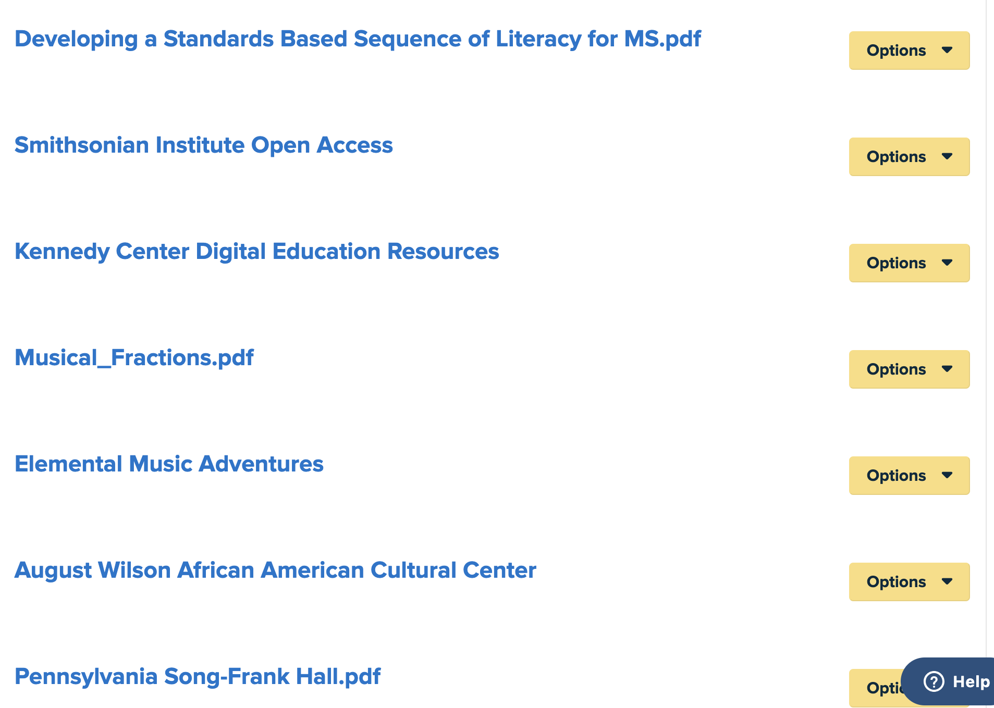
There are 3 of them!

Slide 9
Arts and Humanities PLC
eBlast

Slide 12
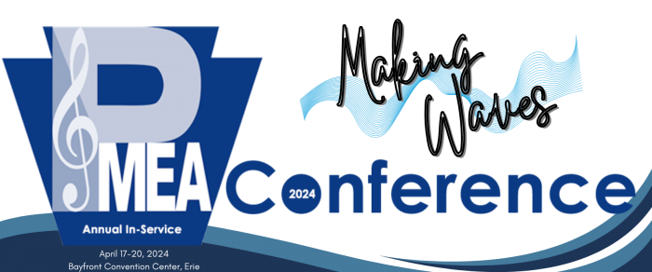
Modern Band at this Conference
PMEA Modern Band Showcase (Friday)
8:30 am State College Area HS Rock Ensemble
10:30 am New Oxford HS Brickyard Six
12:00 pm Spring Grove Area HS Select Modern Band
2:30 pm Ridley HS – Refrigerator
9:30 pm PMEA Modern Band Jam Session
GUITAR/MODERN BAND Sessions (Thursday)
• Back to Bassics
• Exploring the Modern Band Method
• Let’s Write a Song Together!
• Modern Band Playbook: Where do I Start?

Slide 13
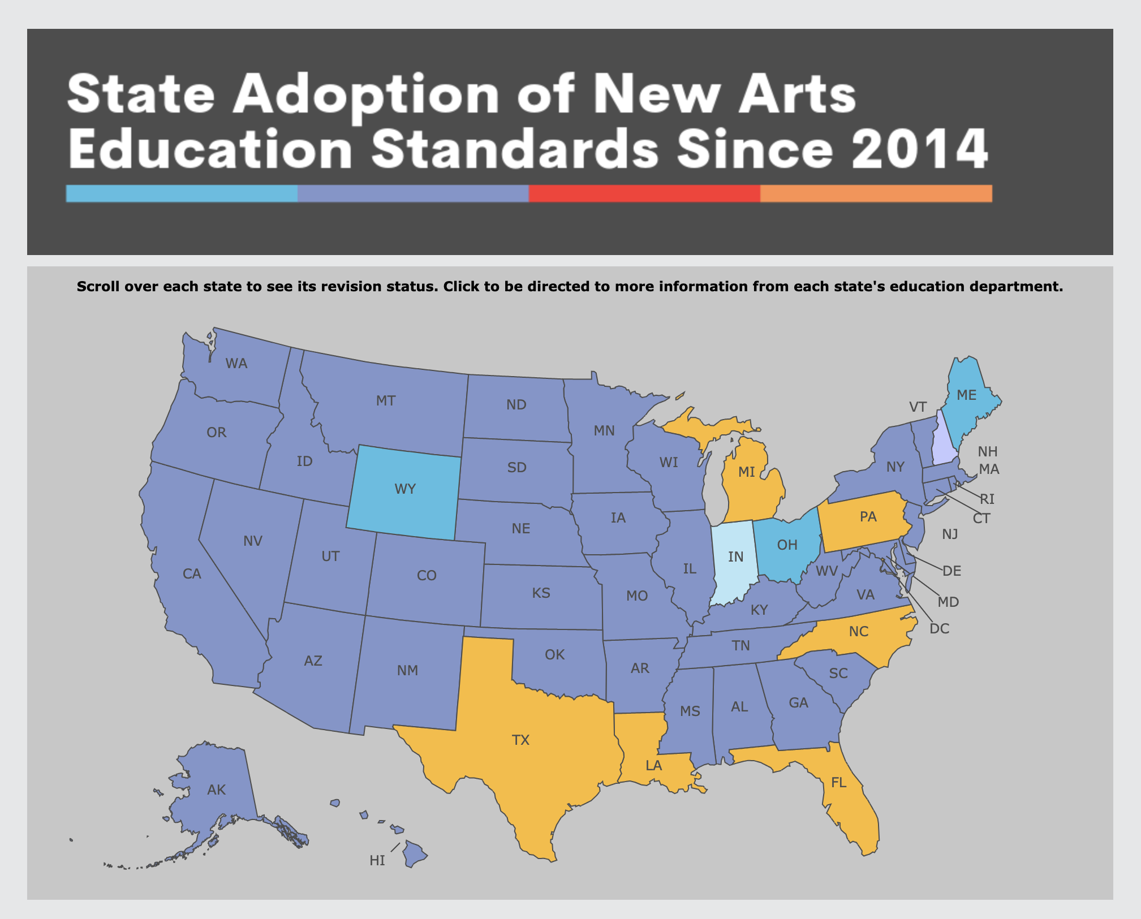
There is currently no public plan for the Pennsylvania Department of Education to adopt new arts education standards.

Slide 14
Arts Education Organizations in PA

Slide 15
Current Programs Certified for Licensure
Drexel University: Undergraduate
Seton Hill University: Undergraduate
Point Park University: Undergraduate & Graduate
Dance Certification January 2023

Slide 16
Folk and Traditional Arts Arts in Education Residencies

Slide 17
Career Readiness

Slide 18
Teacher Evaluation for Arts Educators
Act 13 for Arts Teachers
Danielson Framework Examples of Practice for Music.pdf
SPM-Music Teacher (2).pdf
Using Classroom Portfolios to Evaluate Arts Educators
NAfME Teacher Evaluation Position Statement
Practical Ideas for Evaluating Teachers of the Arts (Dance, Theatre, Music, Visual Art) Colorado Dept. of Education
Archiving Teacher Effectiveness (Music)
Teacher Evaluation: Look Fors in Music
SAS PLC

Slide 19
Why Arts Teacher Access Data?
To look at relationships that change over time
School enrollment changes
Arts teacher employment changes
To find gaps in access to arts educators
To tell a story; frame a narrative that:
Predicts future need or surplus
Supports advocacy efforts
Informs ways in which the field of arts education is changing

Slide 20
Public School Enrollment Data
General decline in public school enrollment across the country
Axios 1.8.23, Politics and Policy
Notes:
Public school enrollment fell by 3% during the first year of the pandemic, according to federal data. The largest decline since 1943, it wiped out a decade of enrollment growth.
The decrease left public schools with 49.4 million students in fall 2020 — about 1.4 million fewer than the previous fall.
Up until 2020, there had been a slight increase in public school enrollment
National Center for Education Statistics (NCES) 2019-2020
National 3% (back to 2009 levels)
State 5%

Slide 21
Music Teacher Shortage Data
https://files.eric.ed.gov/fulltext/EJ1315165.pdf

Slide 22
Last year’s message
The need for music teachers in public schools has not decreased at the rate of student population decrease.
The percent increase of music teachers in charter schools has surpassed the percent increase of students in charter schools.
There are more music teachers employed than in 2012 or 2017, but .6% fewer are employed in public schools.

Slide 23
Pennsylvania Music Teacher Data
PMEA | 2018 | 2109 | 2020 | 2021 | 2022 | 2023
Collegiate | 677 | 752 | 541 | 542 | 610 | 715
Retired | 392 | 366 | 281 | 239 | 289 | 352
Active | 2997 | 3033 | 2839 | 2087 | 2394 | 2664
PDE
Public Charter CTE/IU | 2311 | 2497 | 3566 | 3858 | 3968 | 4034
?

Slide 24
How can today’s data help us--PMEA--to prepare for the future of music education?
Music teacher prep program graduation rates in relation to need.
Retirement
Resignations
Music teacher need based on student participation rates, esp. ensemble participation.
Are ensembles smaller post-Covid?
Will there be some low participation numbers for certain grade levels?
Do any unique populations lack access to music education?

Slide 25
Suggestion: get your personal devices out now so you can take a picture of the upcoming QR code.

Slide 26
The Pennsylvania Dashboard for the…
Download the Report
PA Release Date
October 2023

Slide 27
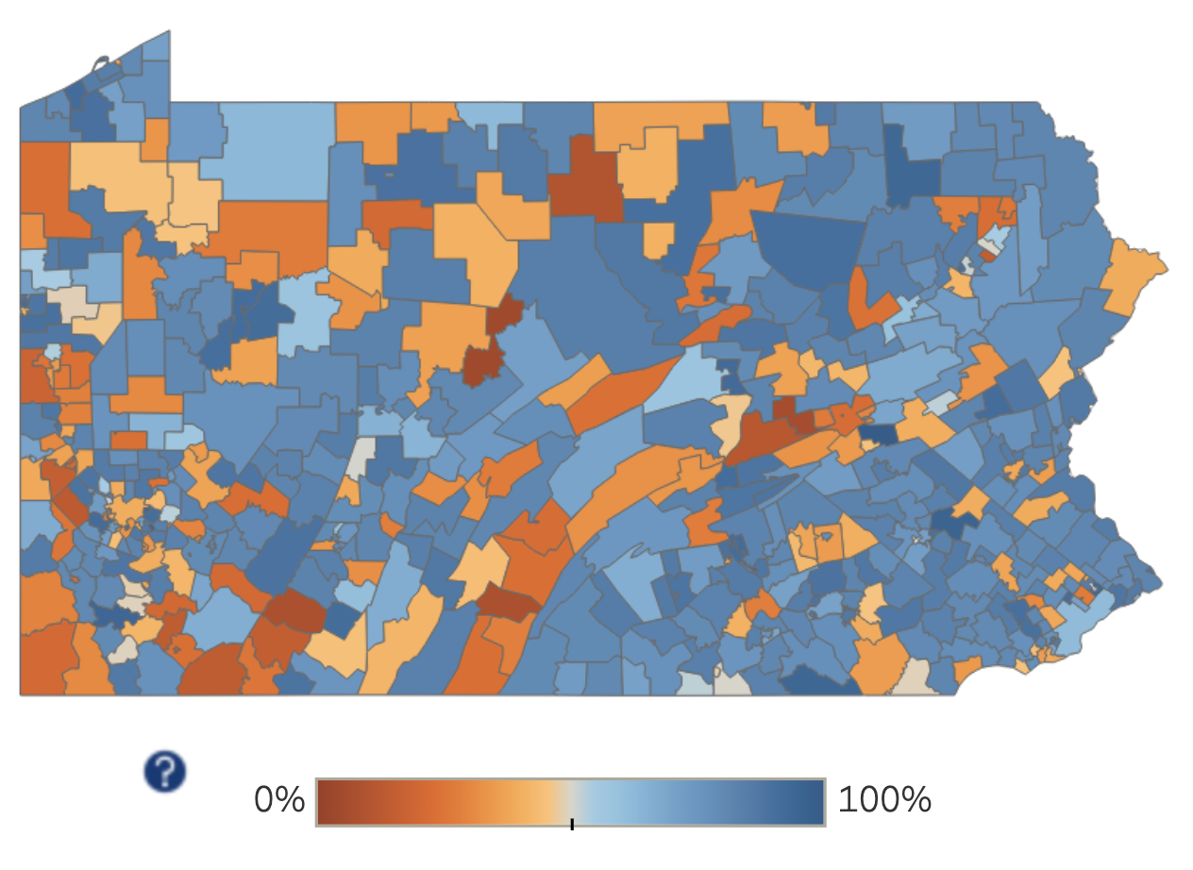
Updated Yesterday!
https://artseddata.org/pennsylvania/

Slide 28
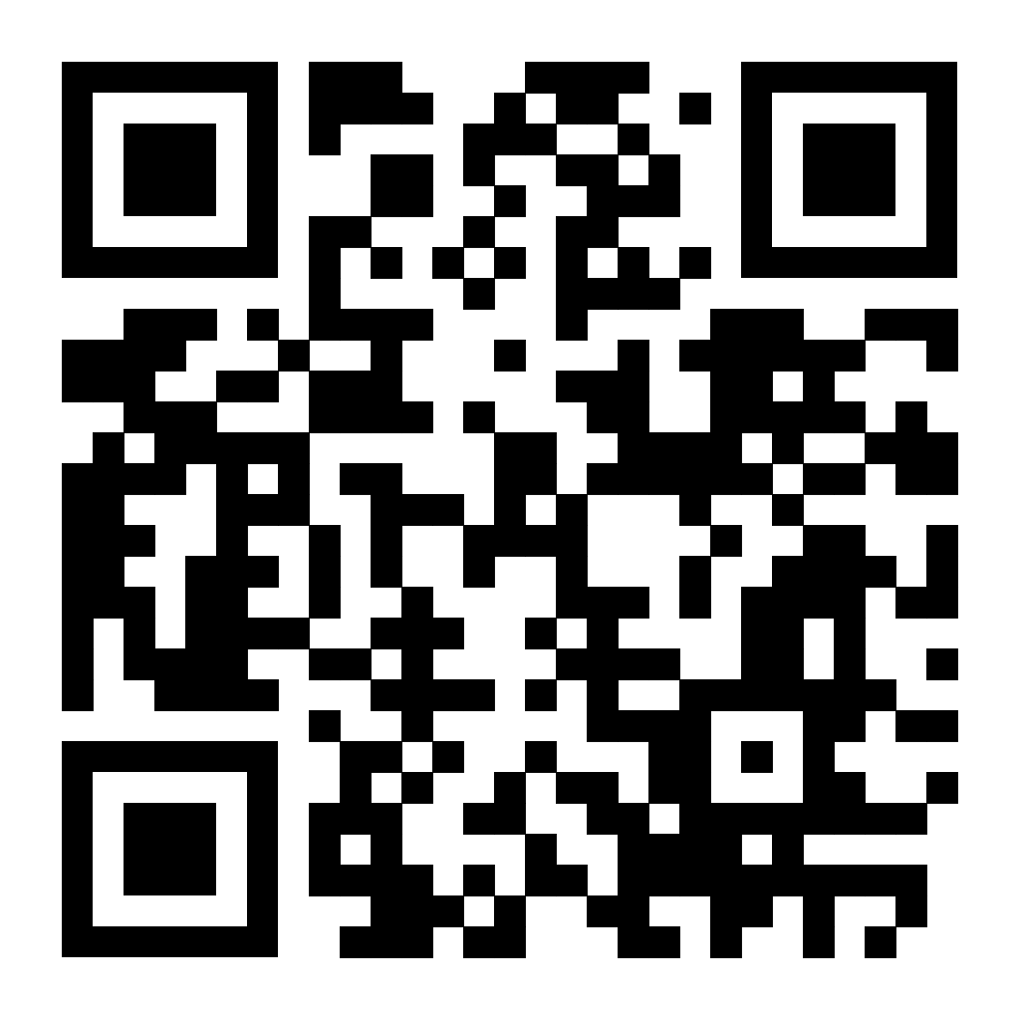
Mobile App
https://public.tableau.com/views/PAArtsEdMobile_PROD/Overview?:language=en-US&publish=yes&:sid=&:display_count=n&:origin=viz_share_link

Slide 29
Music
Course Enrollment in 2022

Slide 30
School Profile Tab

Slide 31
Course Count by Year

Slide 32
School Courses for the Exchange of Data
Subject Code (05, Visual and Performing Arts
https://nces.ed.gov/scedfinder/Home/Browse

Slide 33
SCED Code Reporting Definitions: Band
Some SCED Code definitions are similar, causing variation in reporting between school districts.
GENERAL BAND (CODE #05101)
General Band courses help students develop techniques for playing brass, woodwind, and percussion instruments and their ability to perform a variety of concert band literature styles. These courses may emphasize rehearsal and performance experiences in a range of styles (e.g., concert, marching, orchestral, and modern) and also include experiences in creating and responding to music.
CONCERT BAND (CODE #05102)
Courses in Concert Band are designed to promote students’ technique for playing brass, woodwind, and percussion instruments and cover a variety of band literature styles, primarily for concert performances and also include experiences in creating and responding to music.
Which code was used by schools who have Wind Ensemble, High School Band, Cadet Band, etc?

Slide 34
SCED Code Visualization for Music

Slide 35
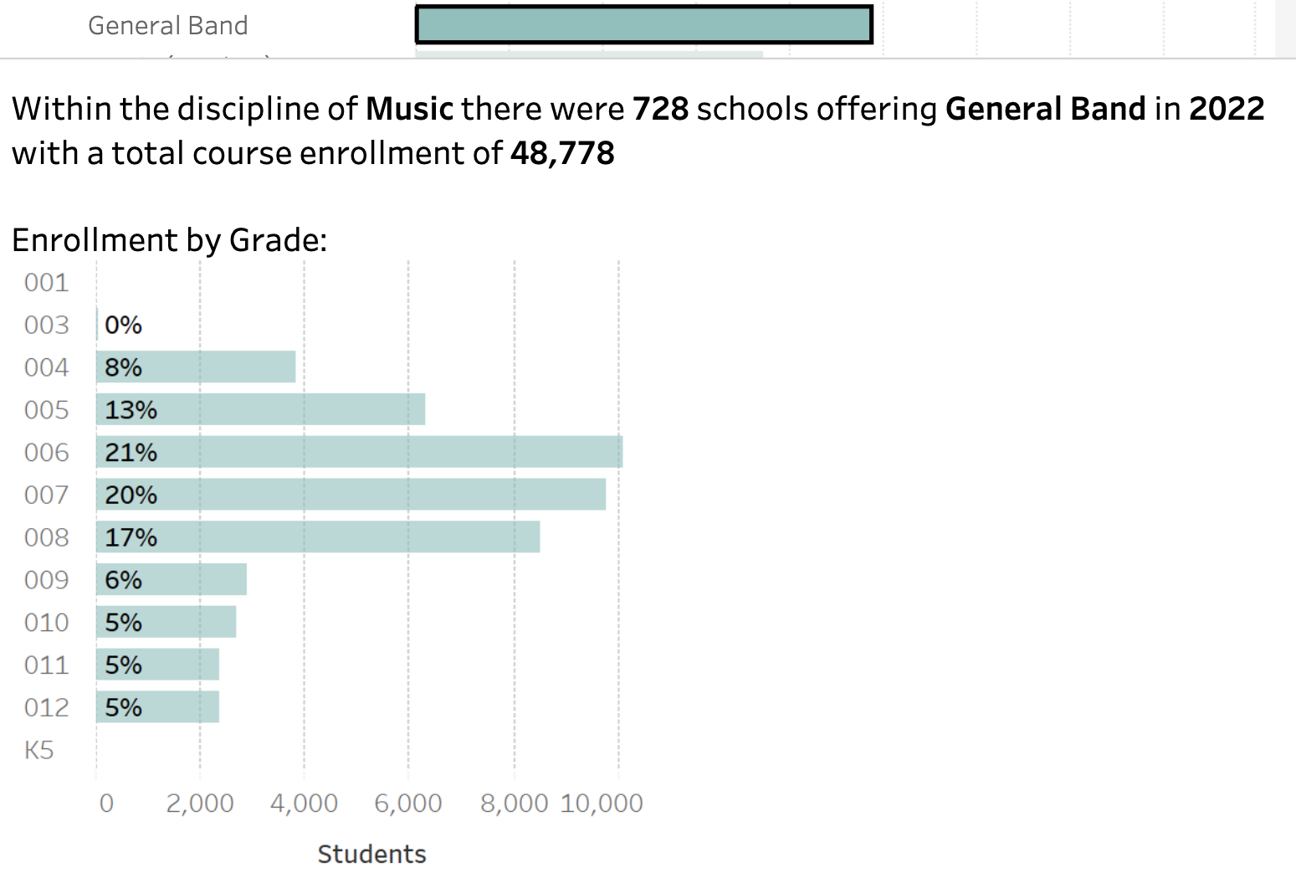
SCED Code: General Band

Slide 36
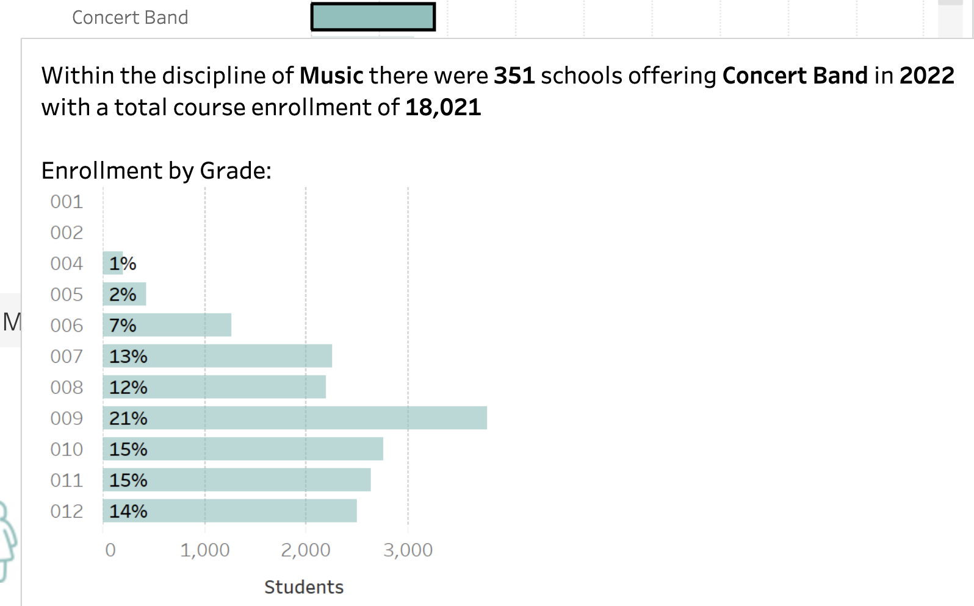
SCED Code: Concert Band

Slide 37
PA SCED Code Crosswalks for Arts
Integrated Arts
Theatre
Dance
Music
Media Arts
Visual Art

Slide 38
PA SCED Code Crosswalks
1. Dance
2. Music
3. Theatre
4. Visual Art
5. Media Arts
6. Integrated Arts

Slide 39
PA SCED Code Crosswalk Language

Slide 40
Finding accuracy and consistency
Possibly incorrect?
There’s a Jewelry SCED code.
What’s the best code?

Slide 41
Your help is needed!!
1. Learn more about the Dashboard and the Crosswalks
Today, 4:30 pm, CC130A
Exploring the PA Dashboard
2. Find your Pupil Information Management System (PIMS) Administrators and help them crosswalk your school’s courses to
the SCED codes.

Slide 42
Arts PLC
Modern Band
State and National Standards
ESSA (Every Student Succeeds Act)
Title IV and ESSER (Elementary and Secondary School Emergency Relief) funding
Career Readiness
Teacher Evaluation in the Arts
Music Teacher Shortage (?)
Arts Education Access Data

Slide 43
Thanks for all you do each and every day! O. David Deitz---Fine Arts Education Consultant---PA Department of Education

