Slide 1
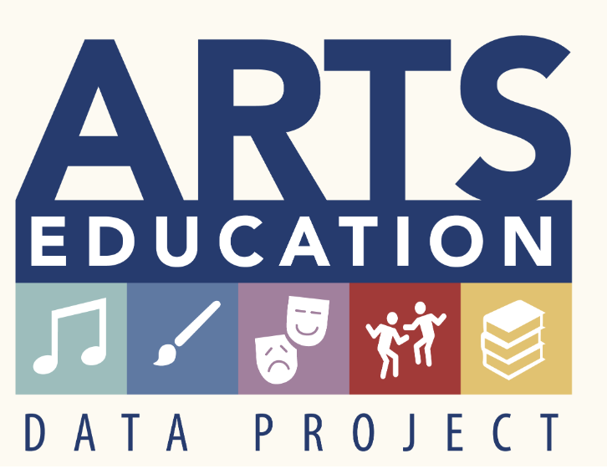
The Pennsylvania Dashboard for the…

Slide 2
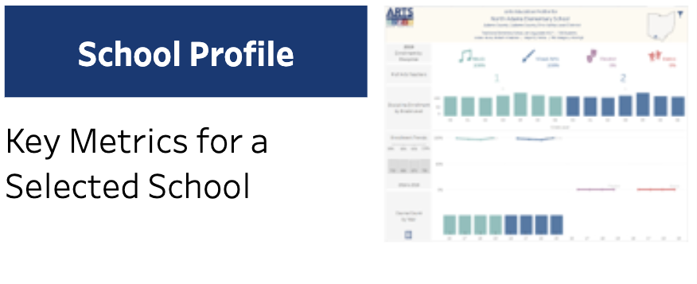
School Profile

Slide 3
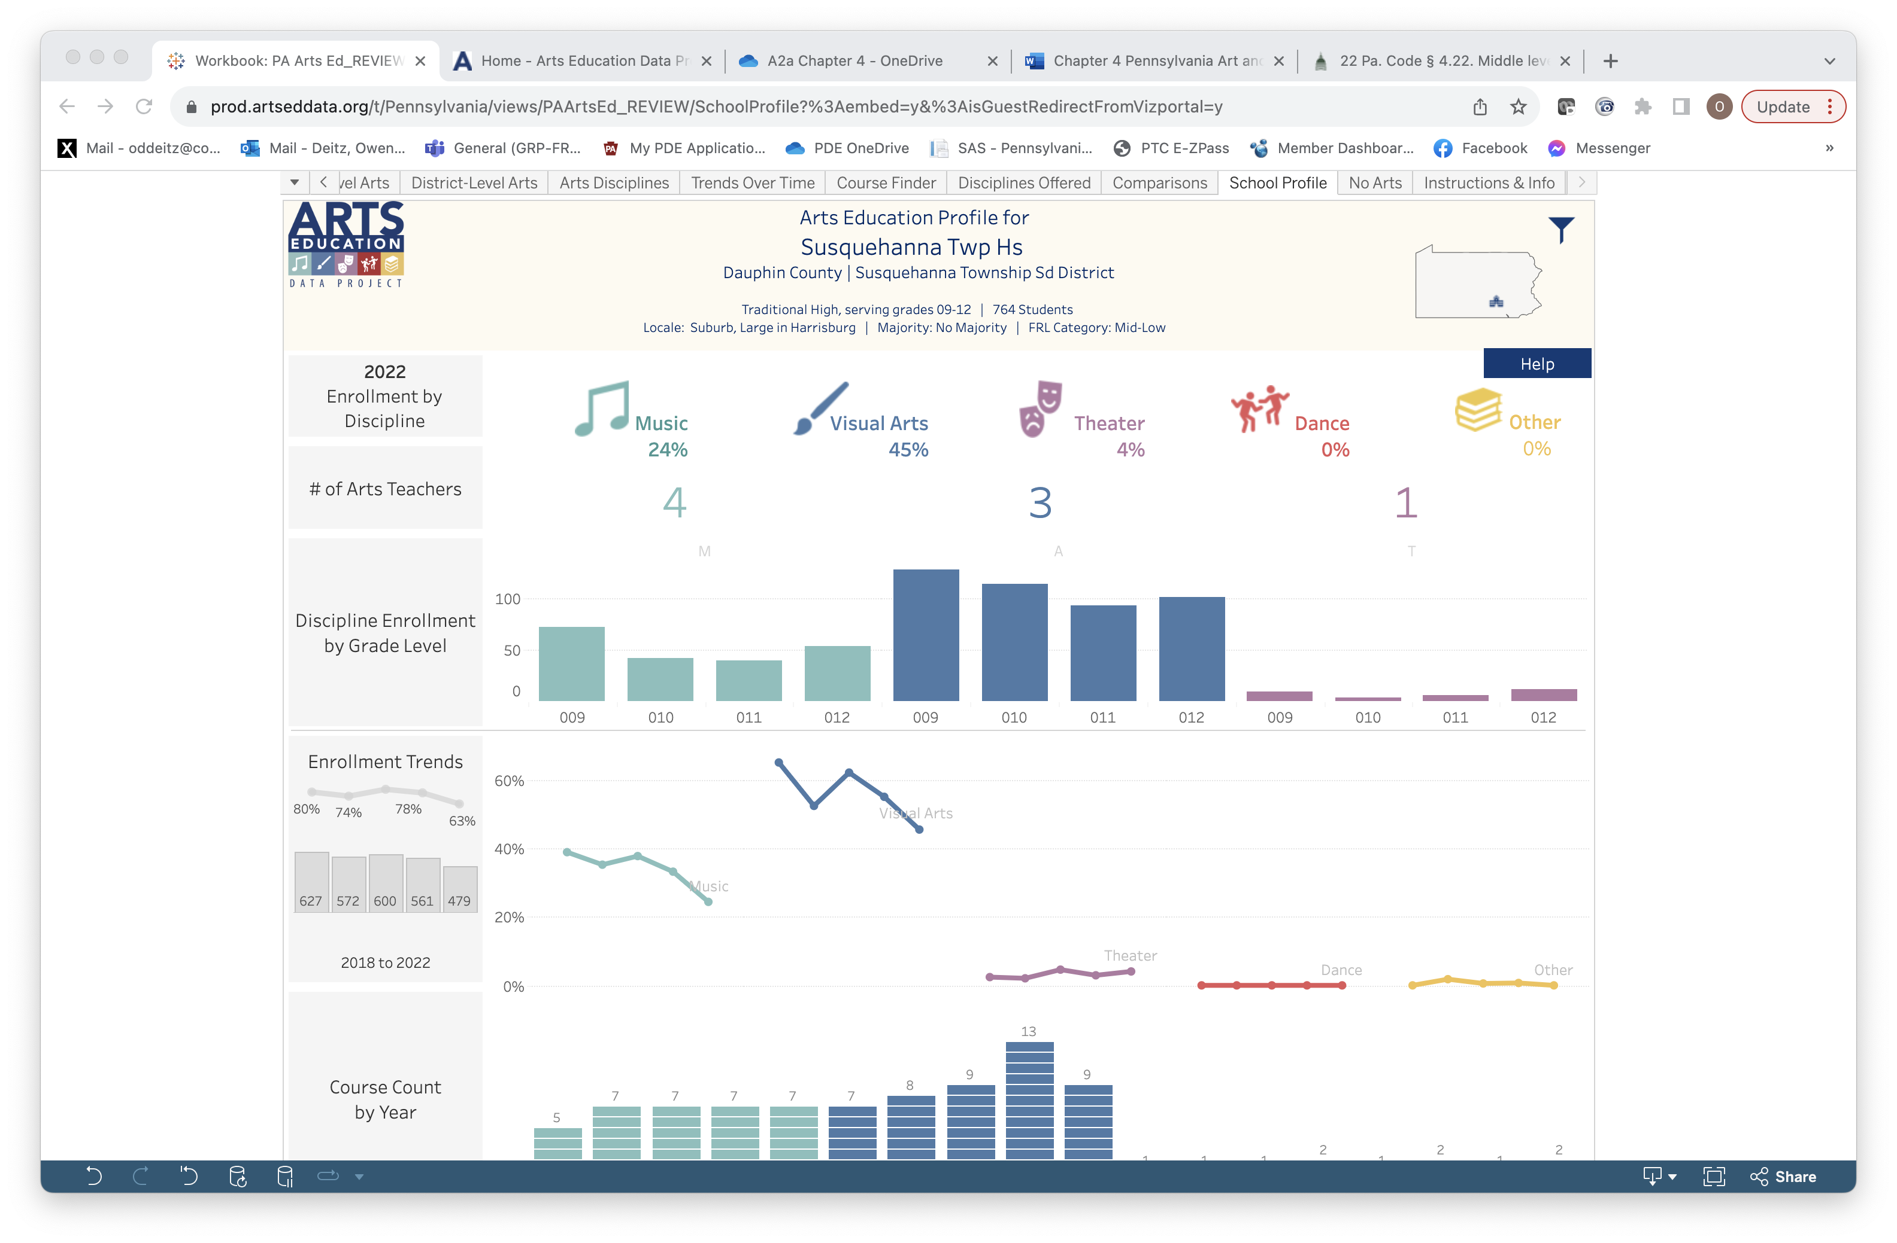
School Profile: Enrollment and Teacher Data
Select and arts icon to see enrollment data for that discipline within the selected school.
The number of teachers teaching courses in each arts discipline is provided for the selected school.
NOTE: Visualizations on this page are color-coded.
Green=Music, Blue=Visual Art, Purple=Theater, Red=Dance, Gold=Others

Slide 4
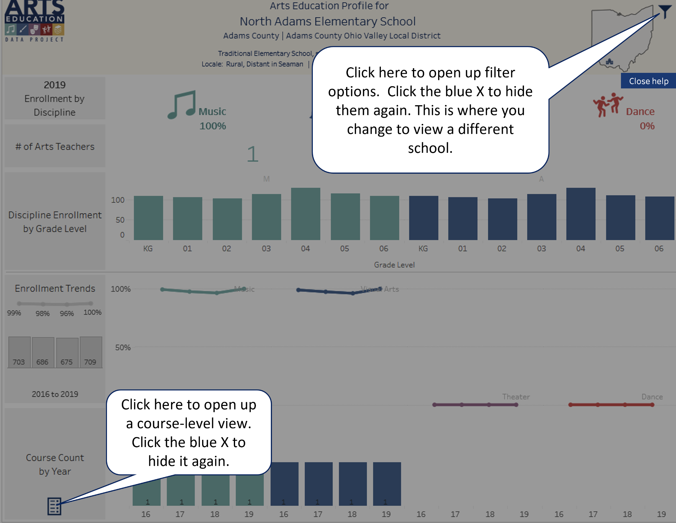
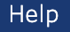
School Profile: Help
Select the Help button in the upper right-hand corner to better understand how this page presents data.

Slide 5
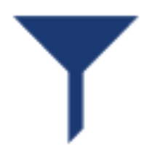
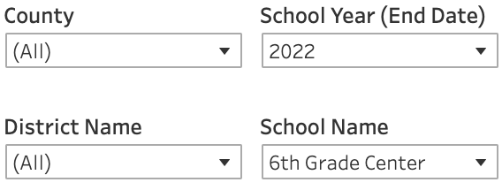
School Profile: Filter Icon
Use the filter icon and drop-down lists to filter by County, District, School Year, and School Name.
Selecting a county narrows the drop-down list of districts/schools. Be sure to select a school name, otherwise, “6th Grade Center” remains as the default and no data will appear.

Slide 6
School Profile: Grade Level Enrollment
Select one of the bars in the graph to view enrollment data by discipline and grade level for the selected school.
NOTE: Visualizations on this page are color-coded.
Green=Music, Blue=Visual Art, Purple=Theater, Red=Dance, Gold=Others

Slide 7
School Profile: Enrollment Trends
Trendlines are used to show changes in enrollment. Reminder: elementary schools did not report data prior to 2020. The school used for this example is a high school.
Select a data dot in the discipline-specific trendlines to view specific enrollment data for each year in that discipline.
Total enrollment in all arts courses is provided for each year for the selected school.

Slide 8
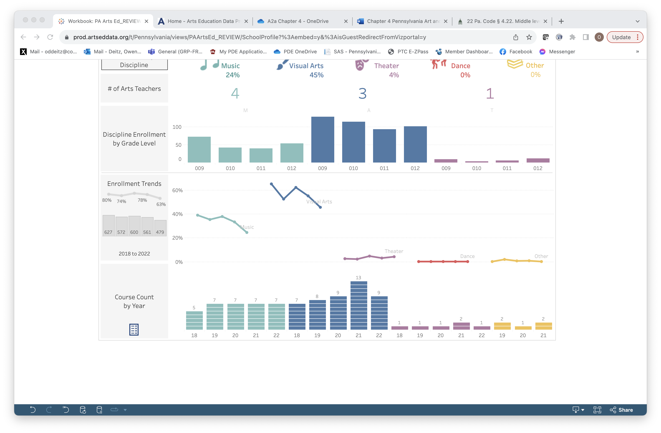
School Profile: Course Count
This visualization shows the change over time in the number of arts courses offered for the selected school.
Select this icon to see what courses are offered at the selected school. (Go to the next slide)

Slide 9
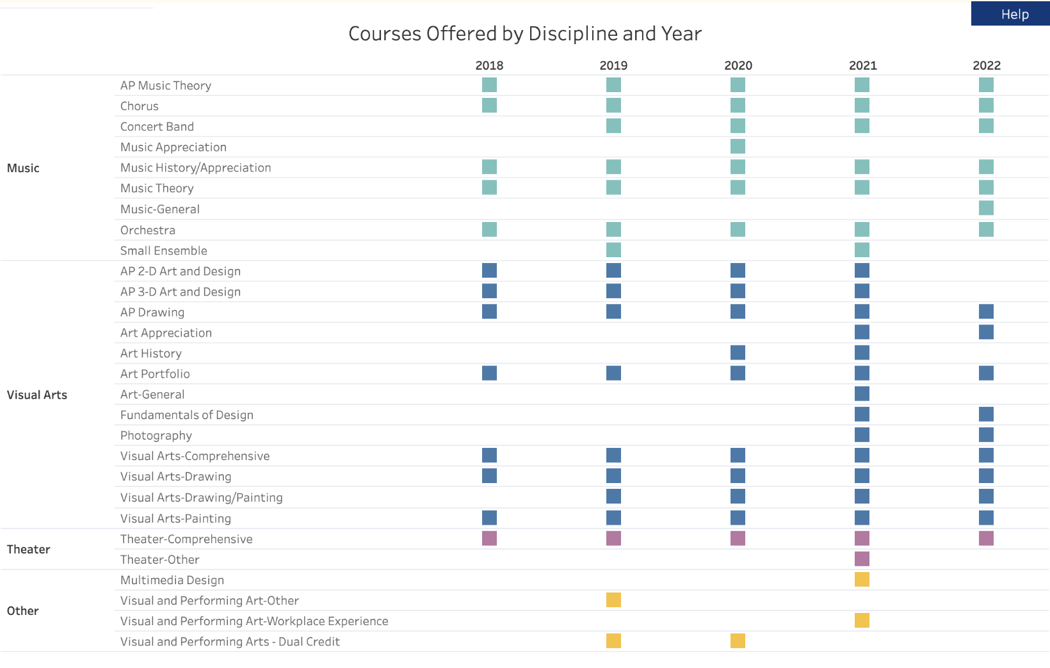
School Profile: Course Count Expanded
Clicking on the Course Count icon provides specifics about the courses offered in the selected school.

