Slide 1
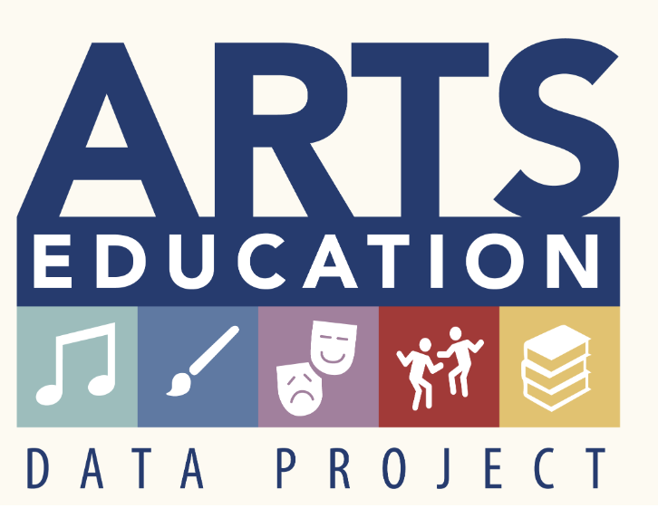
The Pennsylvania Dashboard for the…

Slide 2
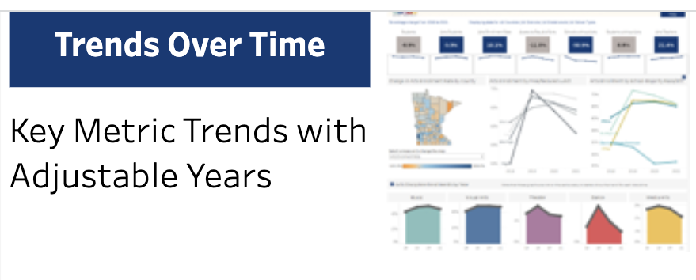
Trends Over Time

Slide 3
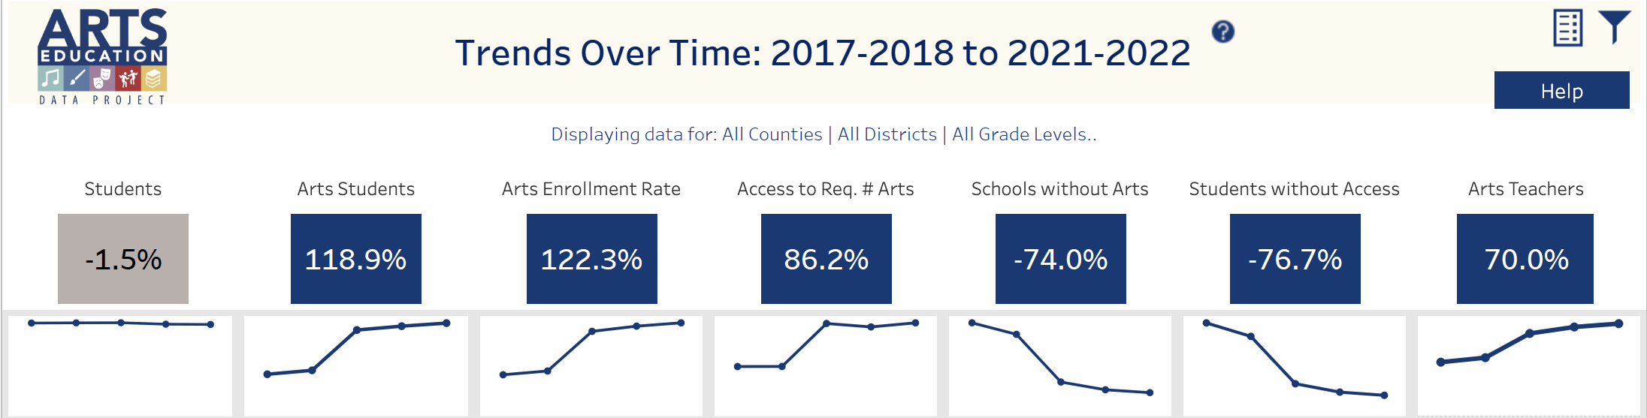
Trends Over Time: Understanding Trendlines
This dashboard shows the change over time for several key arts metrics in Pennsylvania. By default, the earliest year of data is compared to the most recent year available.
This page offers two filter icons. Each will be described in upcoming slides.
Note: between years 2019 and 2020, a large increase in arts participation and numbers of teachers can be observed. Prior to 2020, schools were not required to report arts data at the elementary level, so trend lines will show dramatic changes between 2019 and 2020.
Pennsylvania Code (Title 22, Chapter 4) requires that students are offered courses from the arts disciplines of Music, Visual Arts, Theater and Dance.

Slide 4
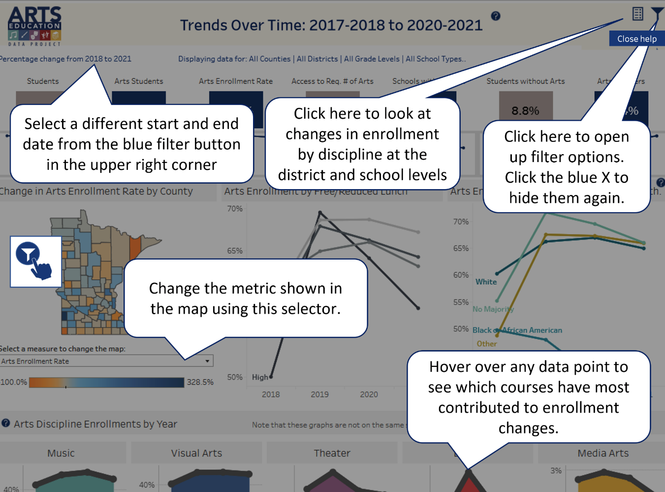
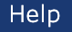
Trends Over Time: Help
Select the Help button in the upper right-hand corner to better understand how this page presents data.

Slide 5
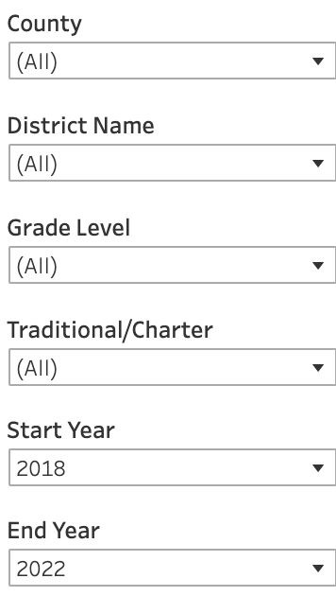
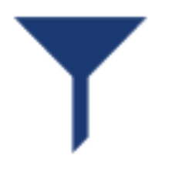
Trends Over Time: Filter
Remember to select the filter icon to sort Trends Over Time by County, District, Grade Level, Traditional/Charter, and Start/End Year. The data visualization will change!

Slide 6
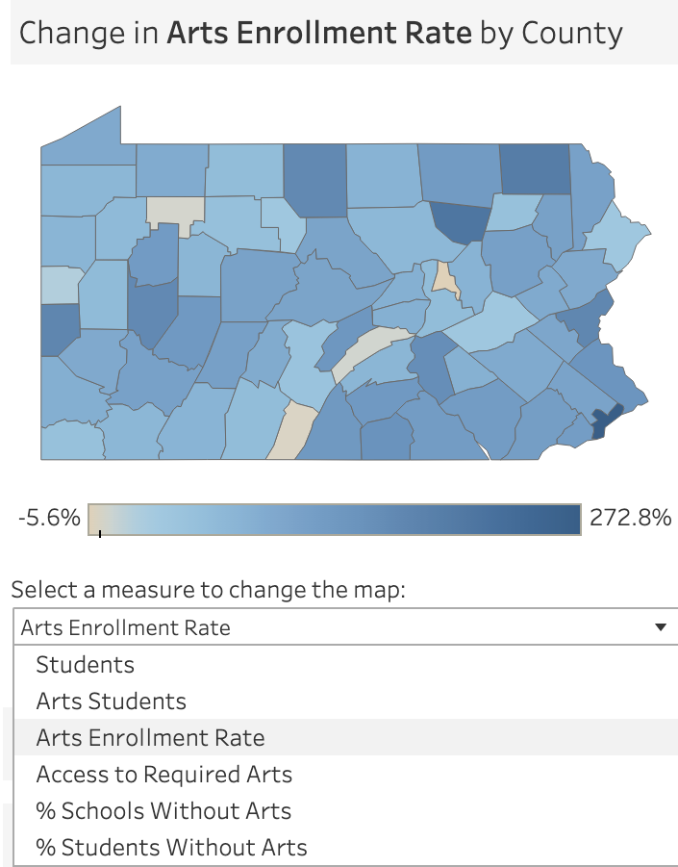
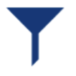
Trends Over Time: Change in Enrollment by County
Select the county to see the change in arts enrollment rate. Refine your search by using the filter icon.
Select this filter icon to sort Trends Over Time. The map will change as will the information that relates to the selected measure.

Slide 7
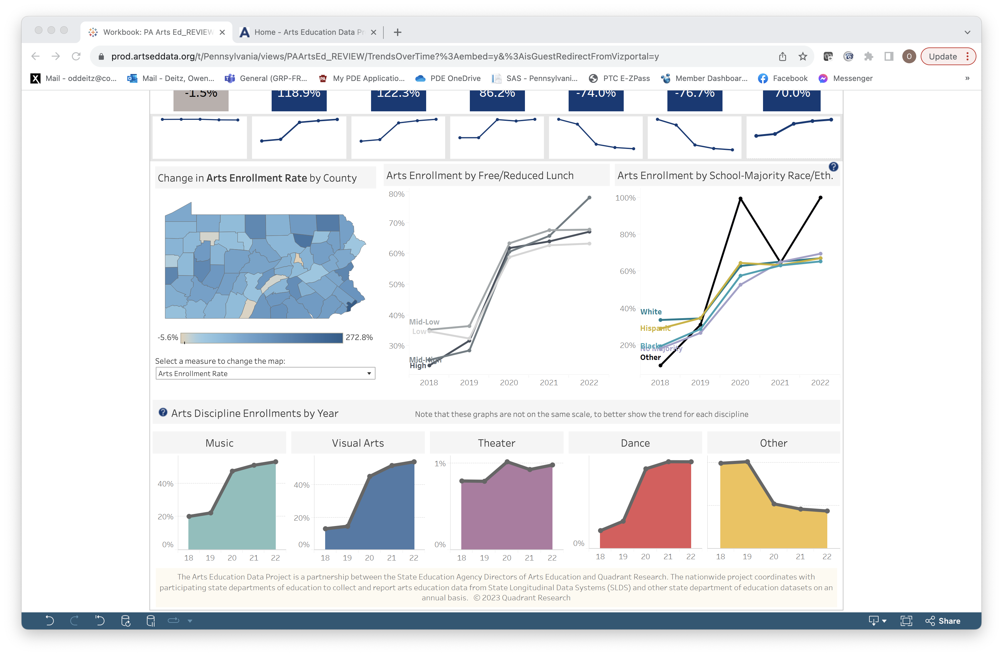
Trends Over Time: FRL & Race/Ethnicity
Select dots on the trendlines to see the % of students in the category and year who participated in arts courses.
Note that this graph is scaled 30% to 80%.
Note that this graph is scaled 20% to 100%.

Slide 8
Trends Over Time
Select any point along the line on the discipline area charts to see the top/bottom four courses with the greatest change in enrollment for that discipline over the selected time span.
Note that the graphs are not to the same scale, to better show the trend for each discipline.

Slide 9

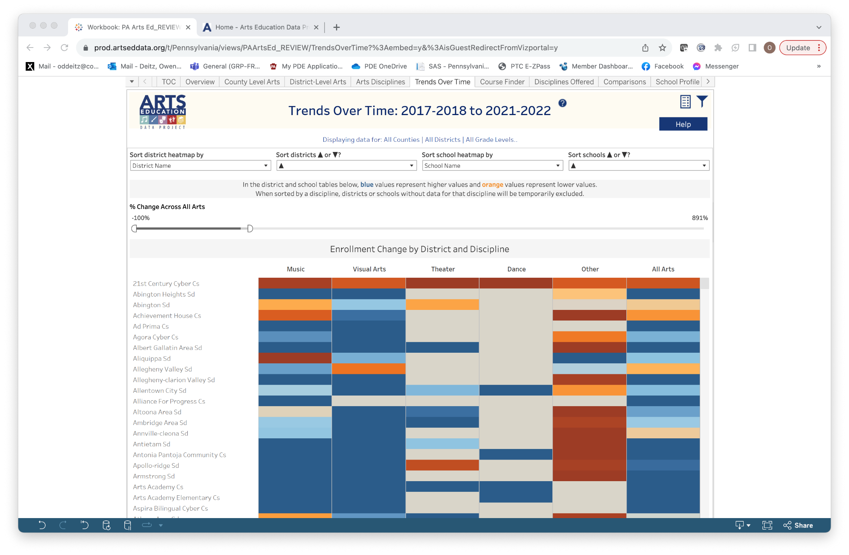
Trends Over Time: List View
Select the list view icon to sort Trends Over Time by District and School.

Slide 10
Trends Over Time: District & School Level Data
Use the slider to identify schools with similar % changes across all arts.
Select any district to expand that district’s information by individual school.

Slide 11
Trends Over Time: Filter Options
This tab has lots of filter options!

