Slide 1
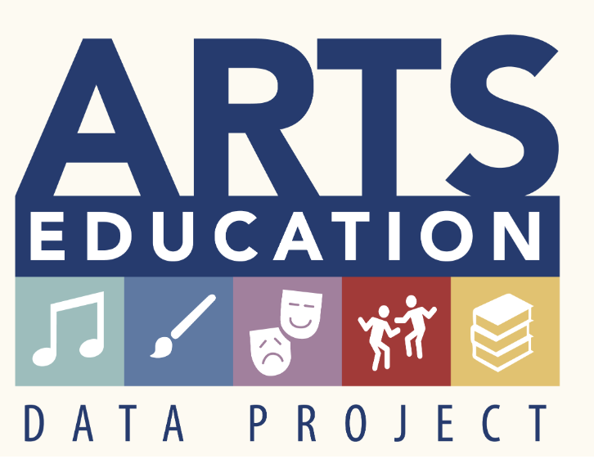
The Pennsylvania Dashboard for the…

Slide 2
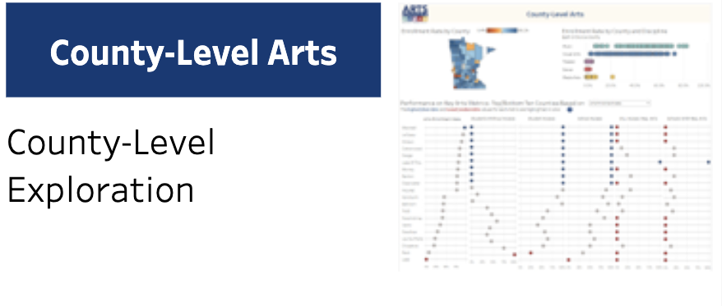
County-Level Arts

Slide 3
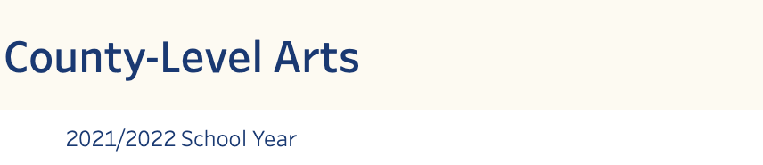
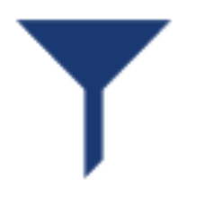
County-Level Arts: School Year/Help
The County-Level Arts page does not have a filter.
Information is for the current year only.

Slide 4
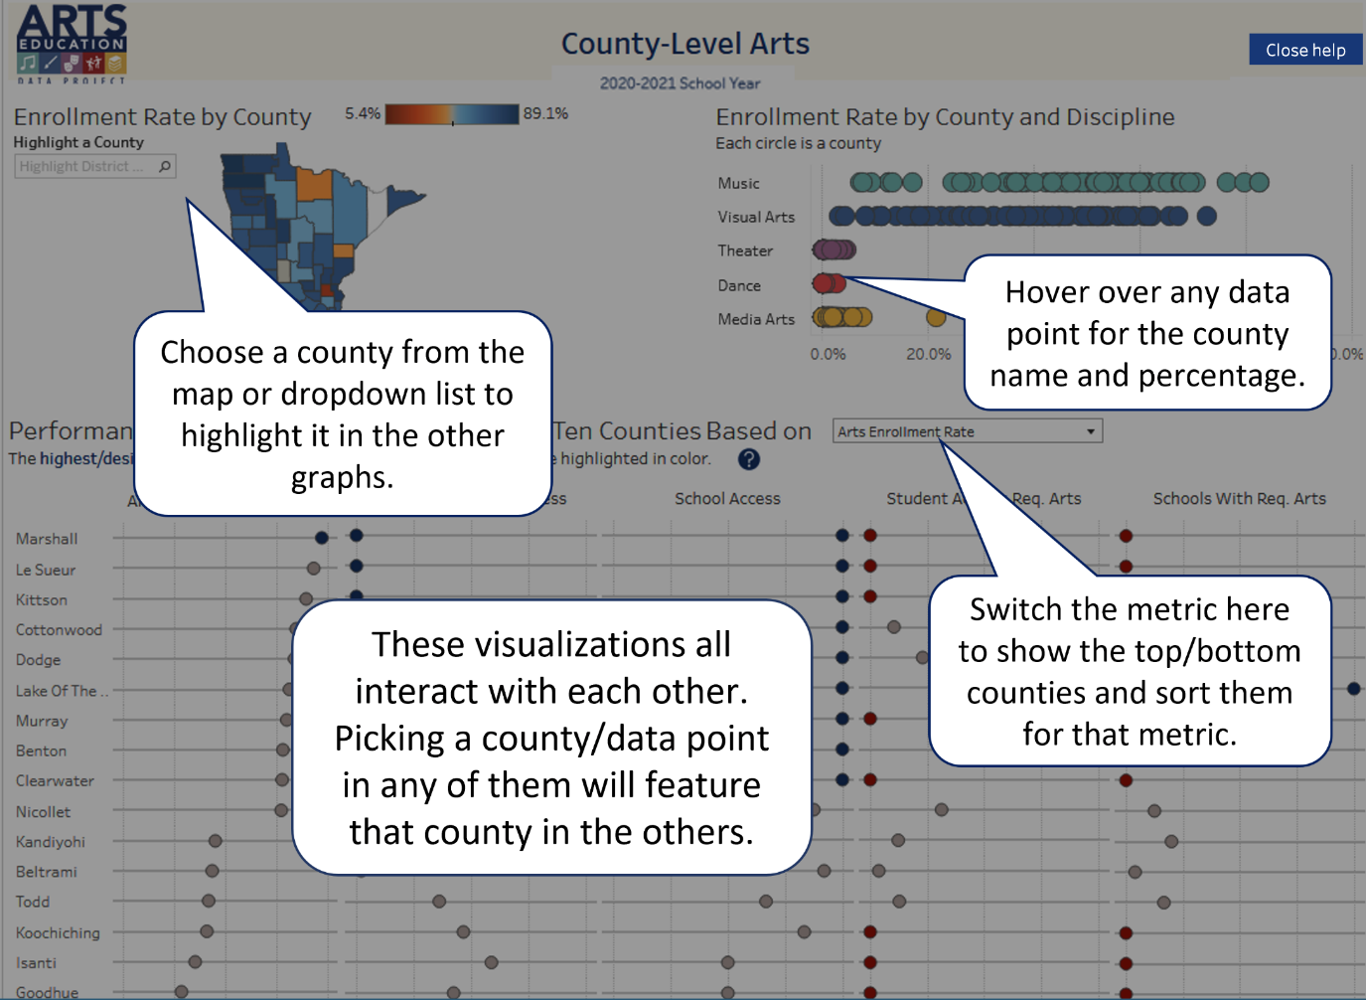
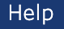
County-Level Arts: Help
Select the Help button in the upper right-hand corner to better understand how this page presents data.

Slide 5
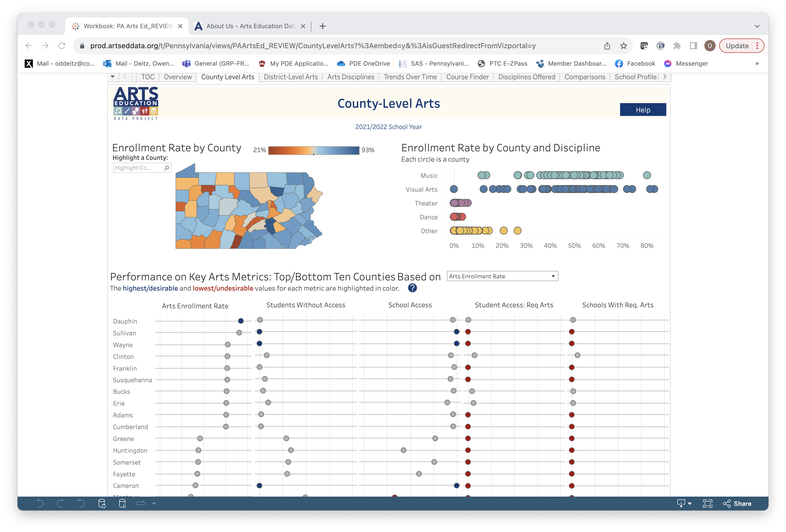
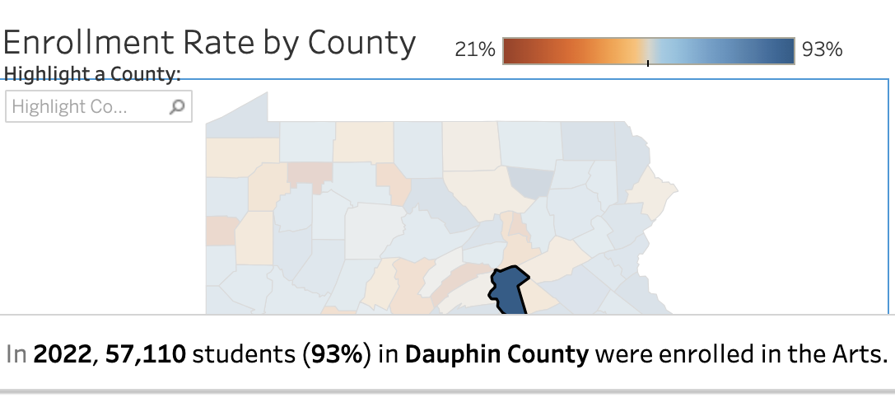
County-Level Arts: Enrollment Rate
Select any county to highlight that county’s data (see next slide).
Use the drop-down to select a county and highlight that county’s data (see next slide).
Hover over any county to find the number and % of students enrolled in arts courses in that county.

Slide 6
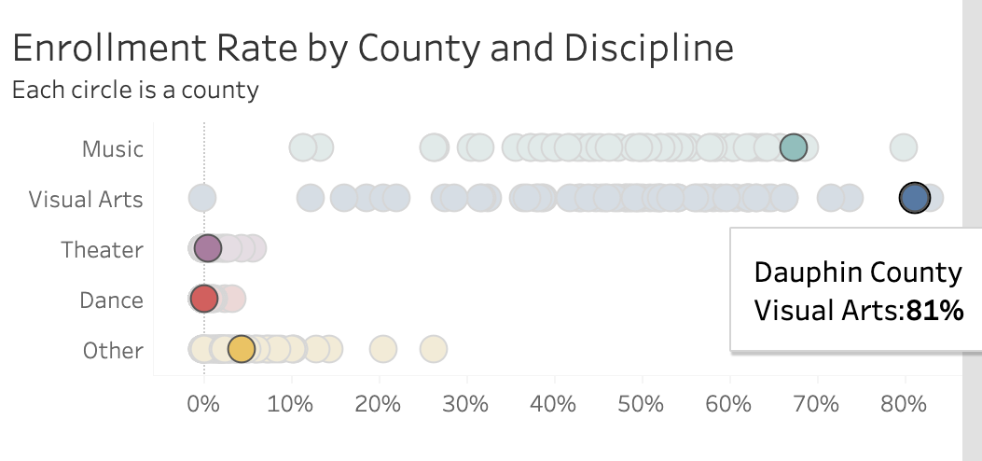
County-Level Data: Discipline Enrollment Rate
Select or hover over any data dot to find the county and % of students enrolled in that discipline in that county.
When you select a county data dot (see previous slide), that county’s data is highlighted.

Slide 7
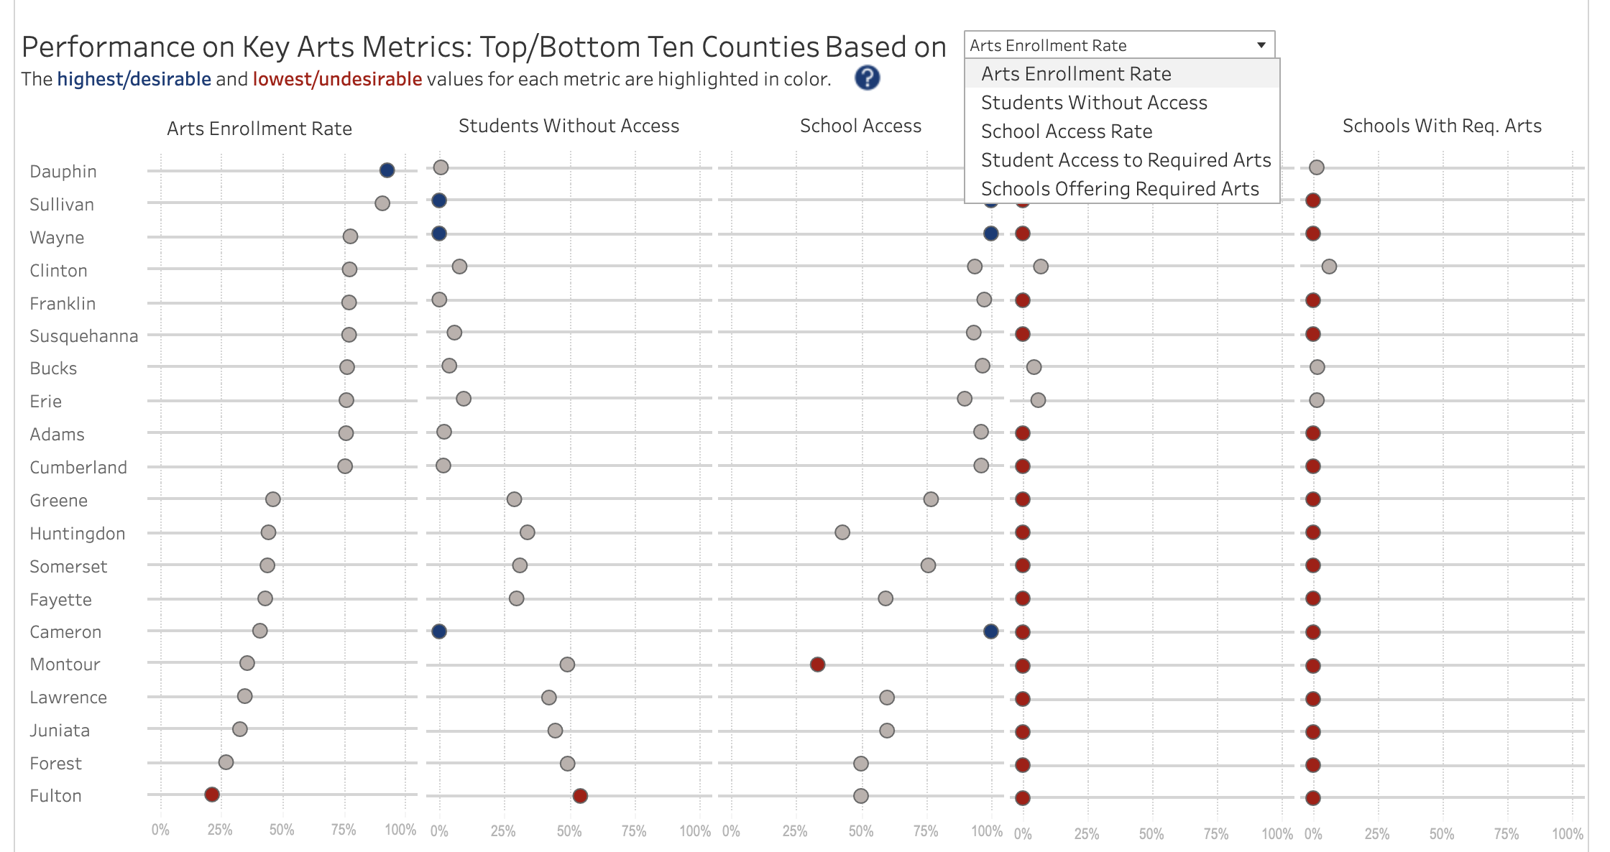
County-Level Data: Performance on Key Arts Metrics
This chart shows County information based on
Arts Enrollment
Students Without Access
School Access
Student Access to Required Arts
Schools Offering Required Arts
PA has academic standards in dance, music, theatre, and visual art.
Use the drop-down to reorganize each column based on the column’s metric title.
Select the data dot to learn more about the county information for the column’s metric.

