Slide 1
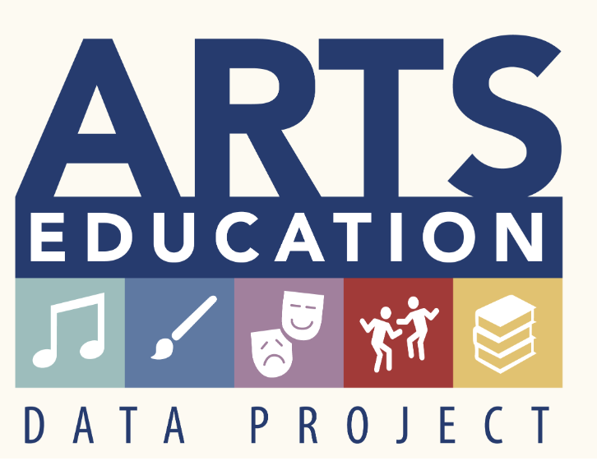
The Pennsylvania Dashboard for the…

Slide 2
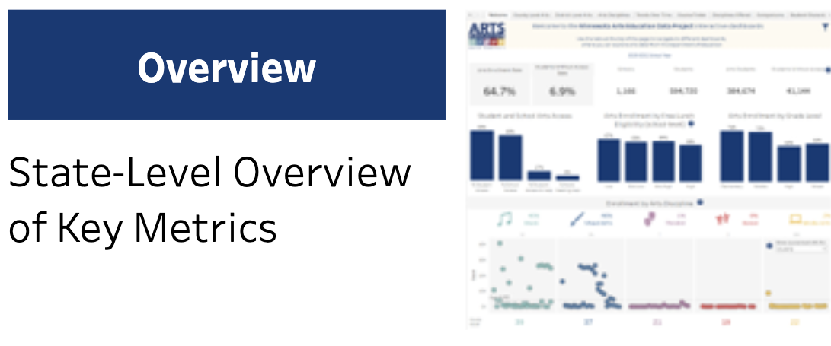
Overview

Slide 3
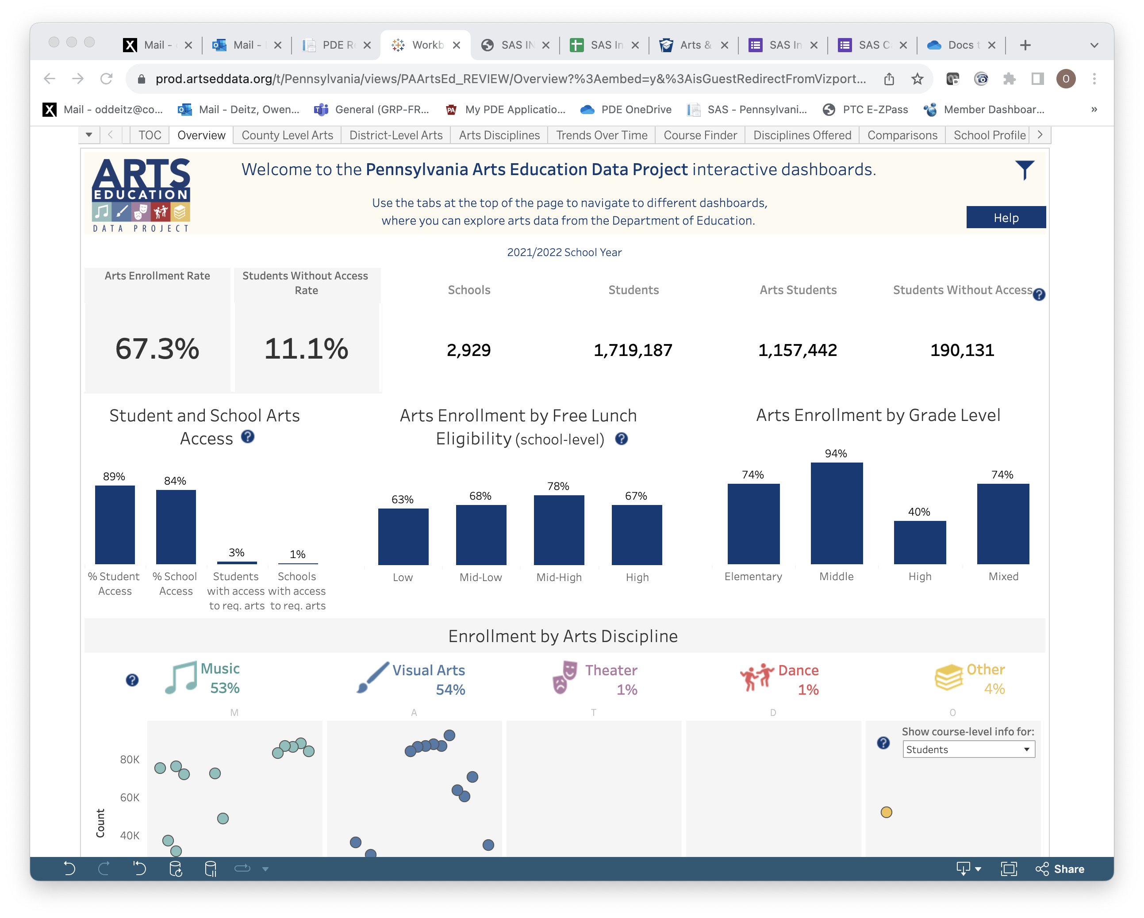
Overview: Heading
Check here on each tab to ensure that you are viewing the correct school year for your inquiry.

Slide 4
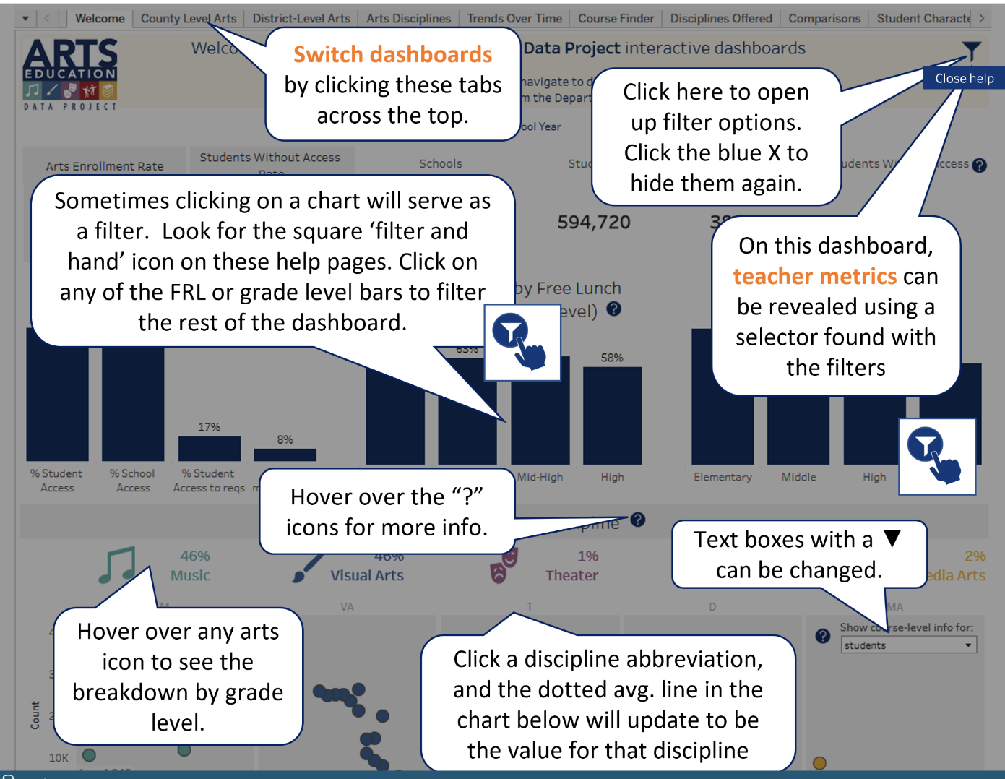
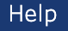
Overview: Help
Select the Help button in the upper right-hand corner to better understand how this page presents data.

Slide 5
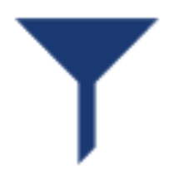
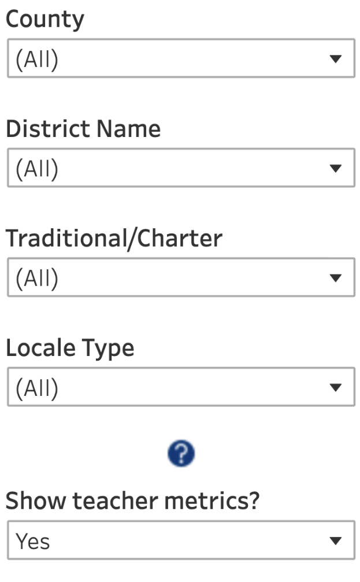
Overview: Filter Options
Remember to select the filter icon to sort Overview Data by County, District, Traditional/Charter, or Locale Type.
Unique to this filter is the ability to show teacher metrics on this tab. Be sure to select Yes if you want to see teacher data.

Slide 6
Overview: Enrollment & Access %
This block reports statewide data for 2022.
In 2022, 67.3% of students in PA public, charter, and CTC schools were enrolled in arts courses.
In 2022, 11.1% of students in PA public, charter, and CTC schools did not have access to an arts course.
In 2022, 3% of students in PA public, charter, and CTC schools had access to all required arts courses (dance, music, theatre, and visual art) through the 1% of schools that offered courses in all four disciplines.
In 2022, 89% of students in PA public, charter, and CTC schools had access to an arts course because 84% of those schools offered arts courses.

Slide 7
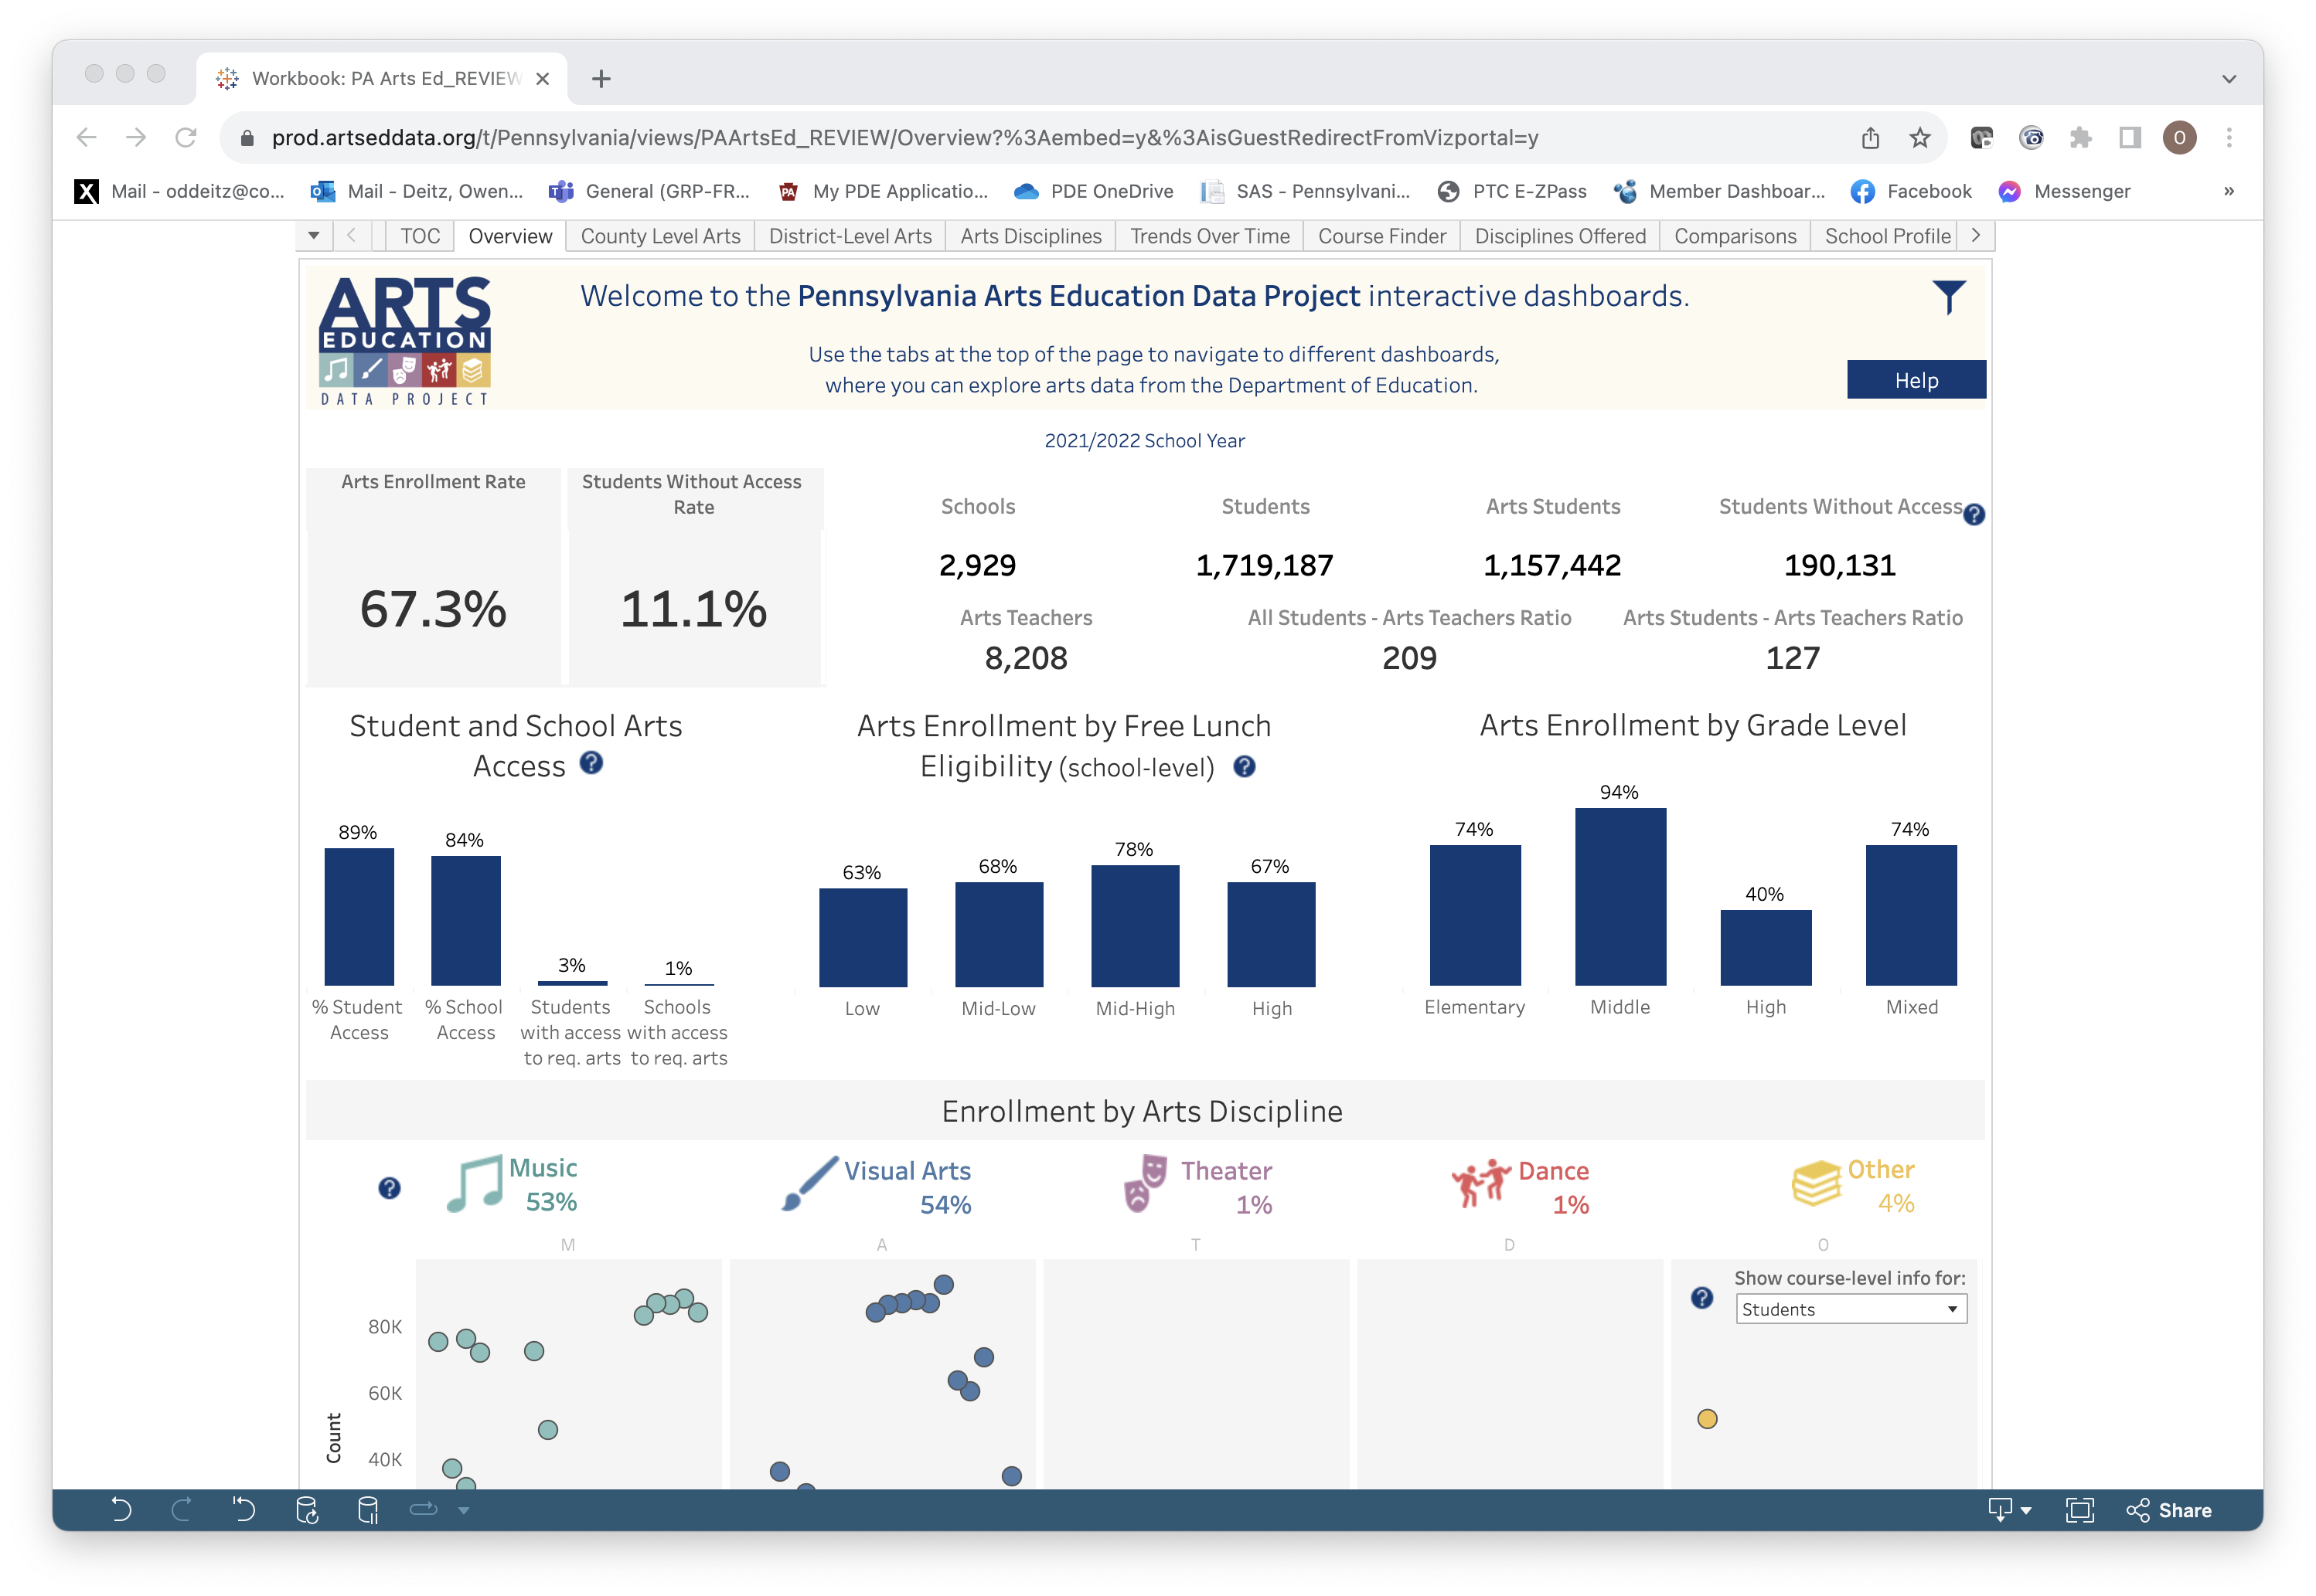
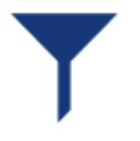
Overview: Enrollment & Access Numbers
Exact numbers are provided for enrollment and access in 2022.
Remember to select the filter icon to “show teacher metrics.”

Slide 8
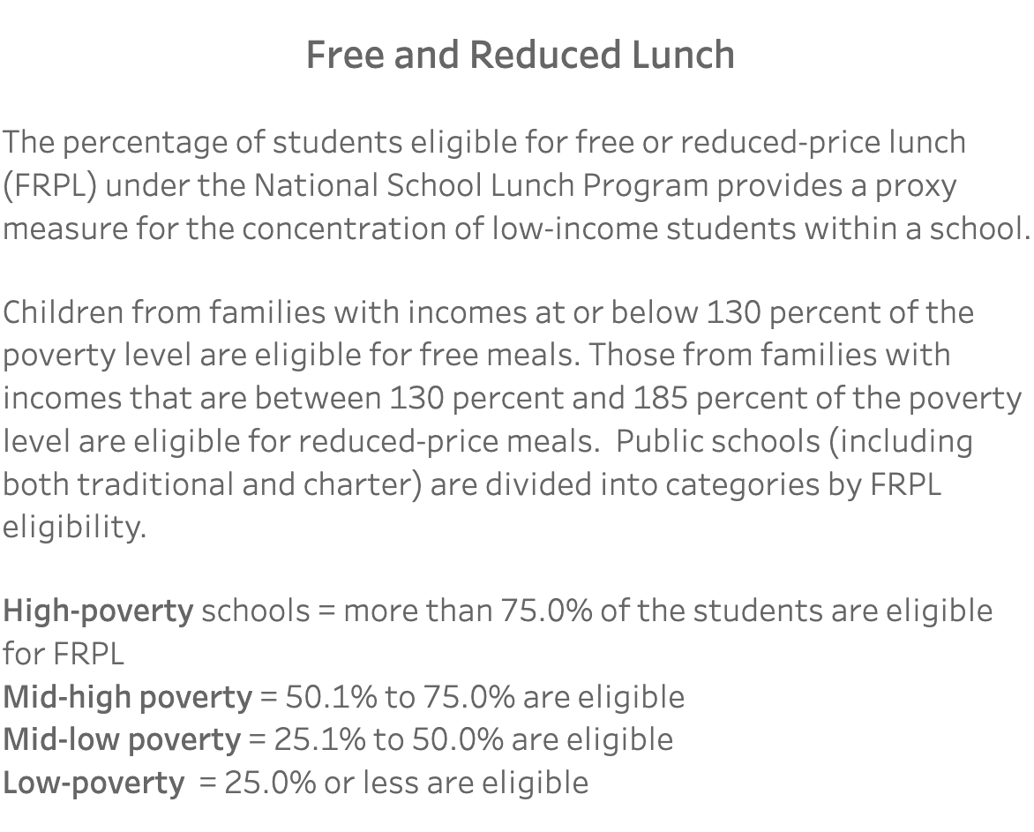
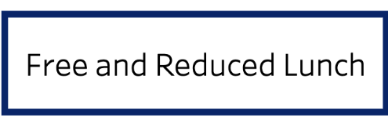
Overview: Arts Enrollment by Free Lunch Eligibility
The bar graphs show the percent of students in each category who are enrolled in arts courses.
Select or hover over each bar for detailed information.
The definition button for Free and Reduced Lunch can be found in the “Instructions & Info” tab.

Slide 9
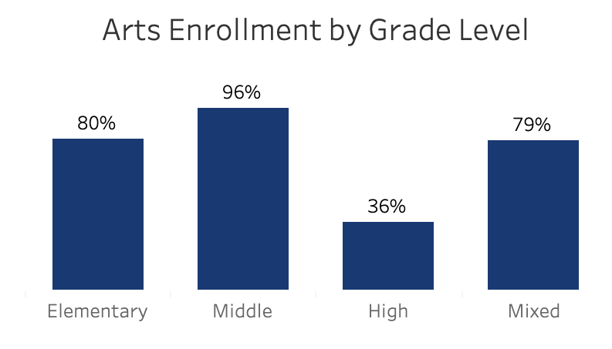
Overview: Arts Enrollment by Grade Level
The bar graphs show the percent of students in each category who are enrolled in arts courses.
Select or hover over each bar for detailed information.

Slide 10
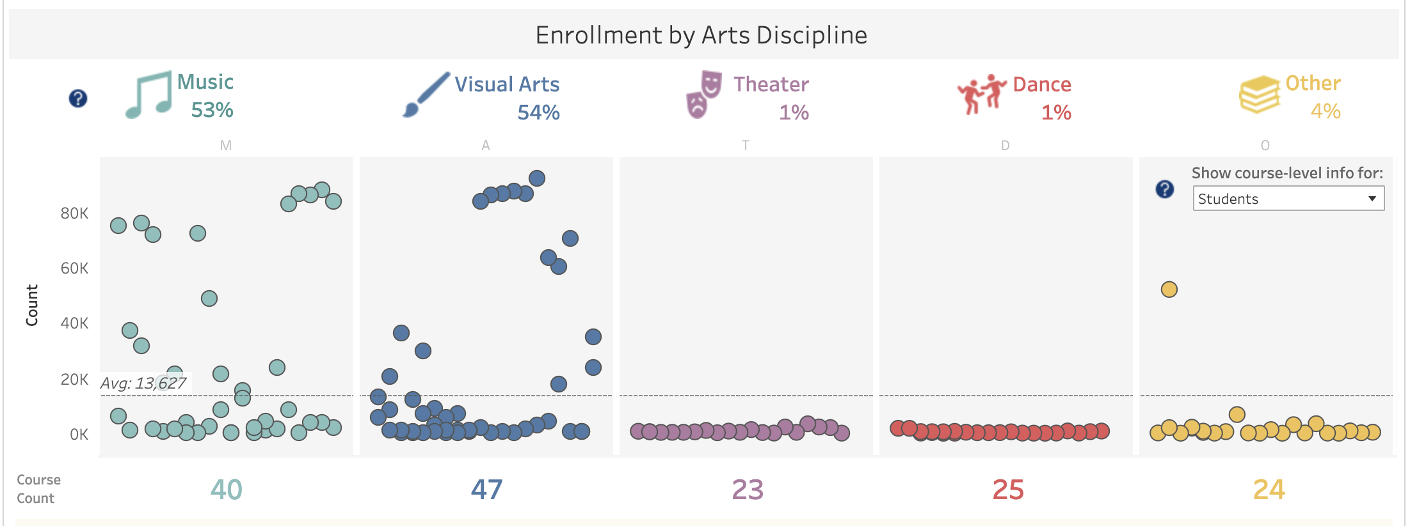
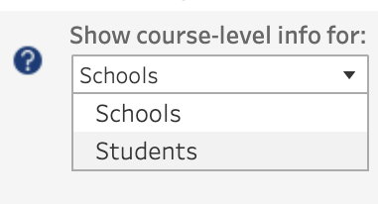
Overview: Enrollment by Arts Discipline
This graph displays the % of students enrolled in each discipline.
Use the drop-down to change the graph from school level to student level.
Hover or select the arts symbol to explore enrollment by grade level.
This is the number of identified courses within the discipline.
Hover over any dot to view the course name and number of students enrolled.

