Slide 1
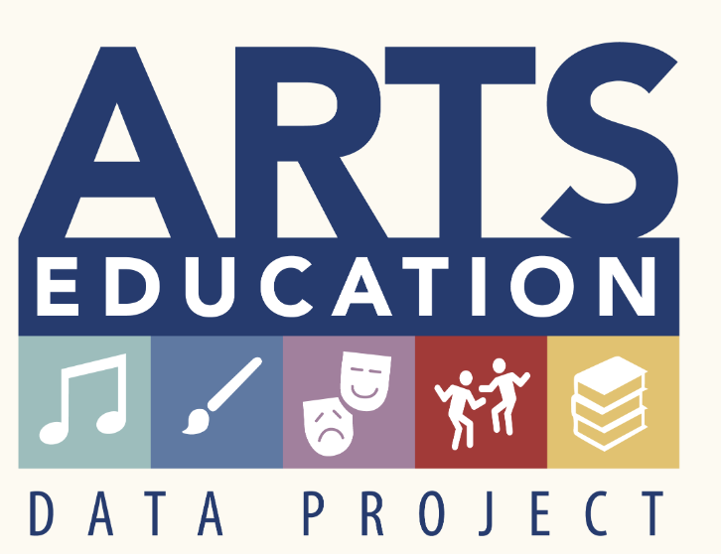
The Pennsylvania Dashboard for the…

Slide 2


Arts Education Data: Why?
The Pennsylvania Department of Education has partnered with Quadrant Research, a nationally recognized leader in arts and education research, and SEADAE, the State Education Agency Directors of Arts Education, as part of the National Arts Education Data Project. This project adopts a systemic, data-driven approach to understanding the current condition of arts education in the United States.
Answers to the following questions (and many more) can be found when working with the PA Dashboard:
Which schools provide access to arts education and in what
disciplines (Dance, Music, Theatre, Visual Arts, Media Arts)?
How many students are participating?
How many arts teachers are providing instruction?
Who has access to arts instruction?
Most importantly, who does not?
How have the answers to these questions changed over time?
The Arts Education Data Project has been designed to answer these questions and more for parents, teachers, policymakers and advocates. The goal of the project is for the data to be the catalyst to drive changes in arts education that will lead to increased
participation for students across the nation.

Slide 3
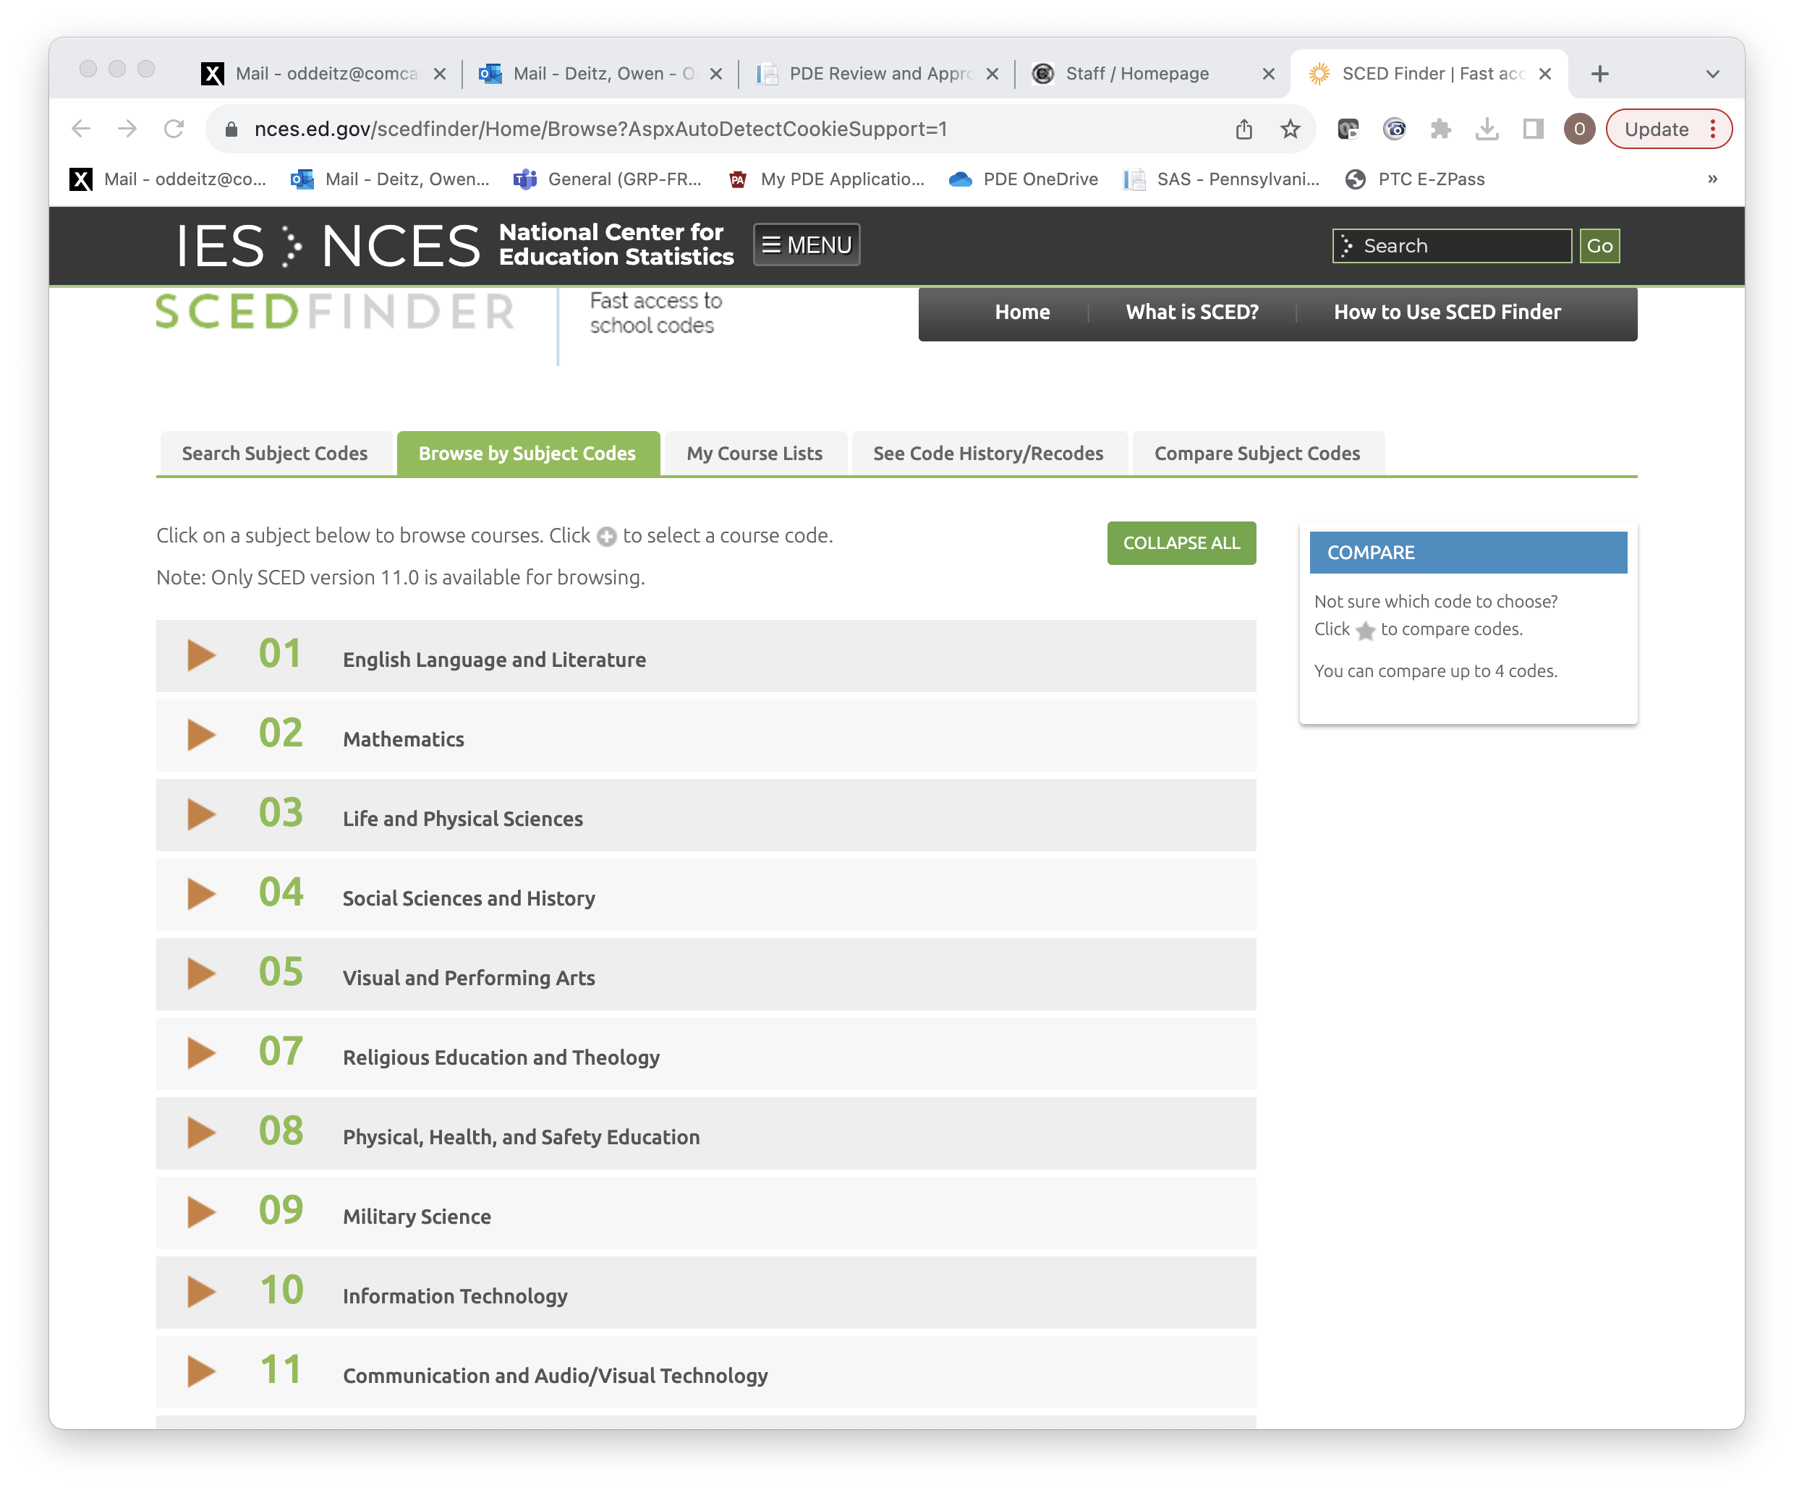
How is data collected?
Pennsylvania Public, Charter, and Career/Technical Education schools are required to report data about coursework offered in their schools. This is done by using definitions found in the School Courses for the Exchange of Data (SCED) codes.
Search SCEDFINDER
https://nces.ed.gov/scedfinder/Home/Search
Subject Code (05, Visual and Performing Arts)
https://nces.ed.gov/scedfinder/Home/Browse

Slide 4
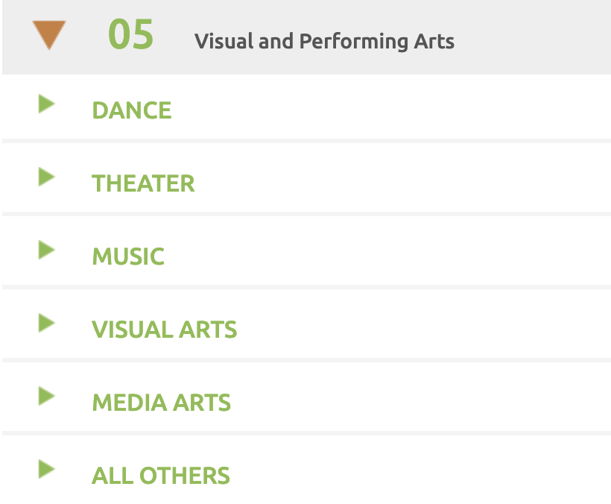
SCED Code Course Definitions
The drop-down for Section 5 provides definitions for five separate arts disciplines and “other.”

Slide 5
Sample SCED Code Definitions
MUSIC APPRECIATION (Code # 05-101)
Music Appreciation courses provide students with an understanding of music and its importance in their lives. Course content focuses on how various styles of music apply musical elements to create an expressive or aesthetic impact. Students also have the ability for informal music performance and creation within the classroom.
ART APPRECIATION (Code # 05-151)
Art Appreciation courses introduce students to the historical study of and foundation for many forms of art. These courses help students form an aesthetic framework to examine social, political, and historical events in the world and how visual images express the ideas of individuals and society. Students are involved in the creative process through research and lecture, responding and dialogue, observation and interpretation with art works and artifacts.

Slide 6
SCED Code Reporting “Decisions”
Some SCED Code definitions are similar, causing variation in reporting between school districts.
Example:
GENERAL BAND (CODE #05101)
General Band courses help students develop techniques for playing brass, woodwind, and percussion instruments and their ability to perform a variety of concert band literature styles. These courses may emphasize rehearsal and performance experiences in a range of styles (e.g., concert, marching, orchestral, and modern) and also include experiences in creating and responding to music.
CONCERT BAND (CODE #05102)
Courses in Concert Band are designed to promote students’ technique for playing brass, woodwind, and percussion instruments and cover a variety of band literature styles, primarily for concert performances and also include experiences in creating and responding to music.
Which code was used by schools who have Wind Ensemble, High School Band, Cadet Band, etc?

Slide 7
How recent is the data?
Data from 2018-2022 is included in the initial dashboard. Data from years 2023, 2024, 2025, and 2026 will be added as it becomes available.
Note: between years 2019 and 2020, a large increase in arts participation and numbers of teachers can be observed. Prior to 2020, school districts were not required to report arts data at the elementary level.

Slide 8
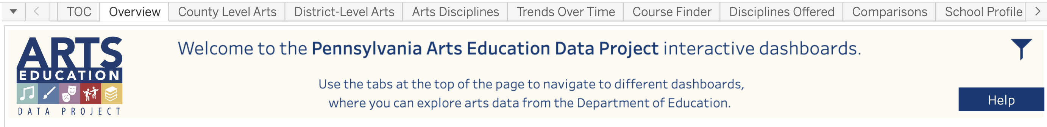
Viewing the Tabs
Use the tabs to view data in different ways.

Slide 9
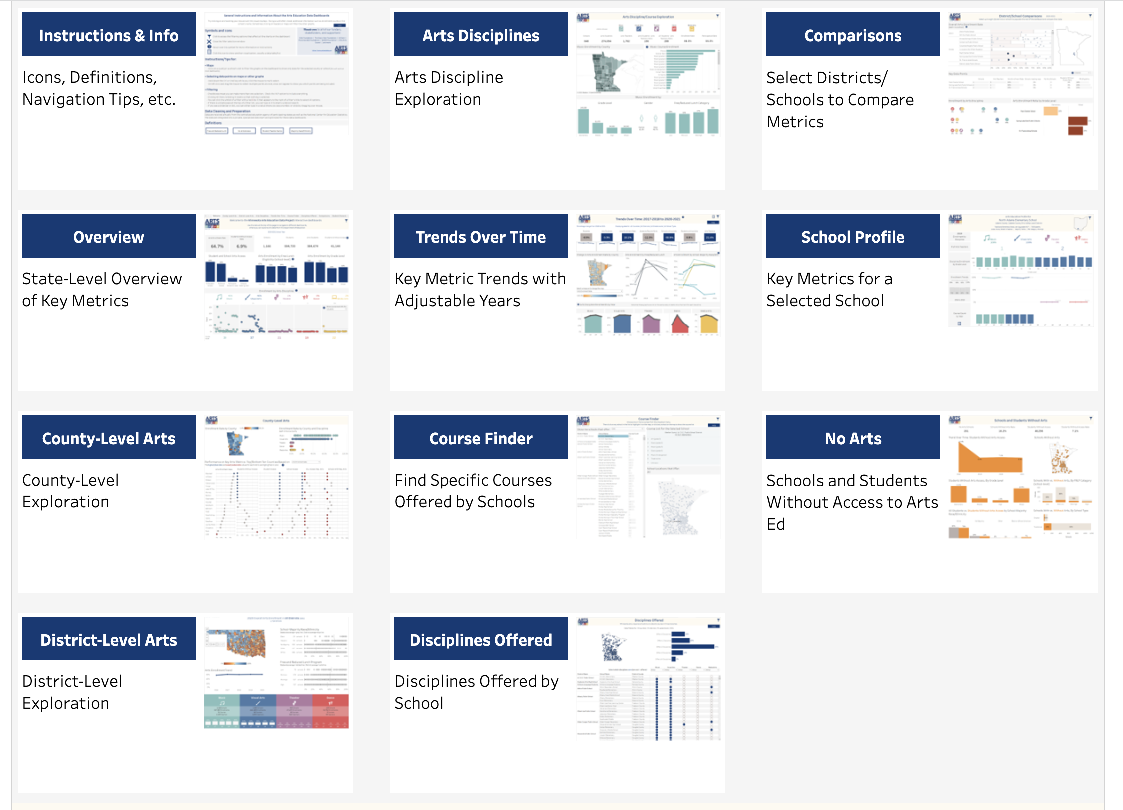
Table of Contents
The Table of Contents Tab displays 11 different ways in which the data can be explored.
Click on the BLUE buttons to choose a specific tab.

Slide 10
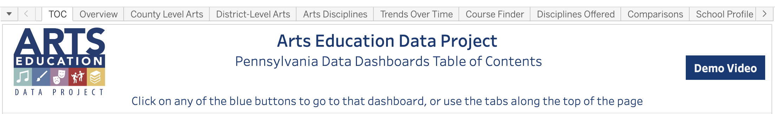
Table of Contents: Demo Video
Select the Demo Video button in the upper right-hand corner of the Table of Contents page for a 10-minute instructional video.

