Slide 1
PDE Update
July 2023

Slide 2
O David Deitz
Fine Arts Education Consultant
PA Dept of Education
c-odeitz@pa.gov

Slide 3
Update Topics from Past Years
Arts PLC
Arts Education Access Data
Arts Teacher Shortage
ESSA (Every Student Succeeds Act)
Title IV and ESSER (Elementary and Secondary School Emergency Relief) funding
Career Readiness
Teacher Evaluation in the Arts
State and National Standards
Modern Band

Slide 4
Khalid Mumin, Secretary of Education
Secondary English Teacher, Scotland PA
Superintendent, Reading and Lower Merion SDs
Author: Problem Child: Leading Students Living in Poverty Towards Infinite Possibilities of Success.
Biography

Slide 5
Joining the Arts and Humanities PLC
Go to pdesas.org.
In the upper right-hand corner, click "register" (if you are already a SAS user, click "login") Complete your registration (a PPID number is only necessary if you ever want Act 48 professional development credit.)
The upper right-hand corner will now say "SAS Tools," click on that icon.
On the left-hand side, look for "communities." Click.
In the stripe "Find a community," type "arts." Click on the “search” icon.
Select the icon called "Arts and Humanities Professional Learning Community." You are in! Click “Join.”
Look around the Moderator’s Message and Shared Content. Enjoy!

Slide 7
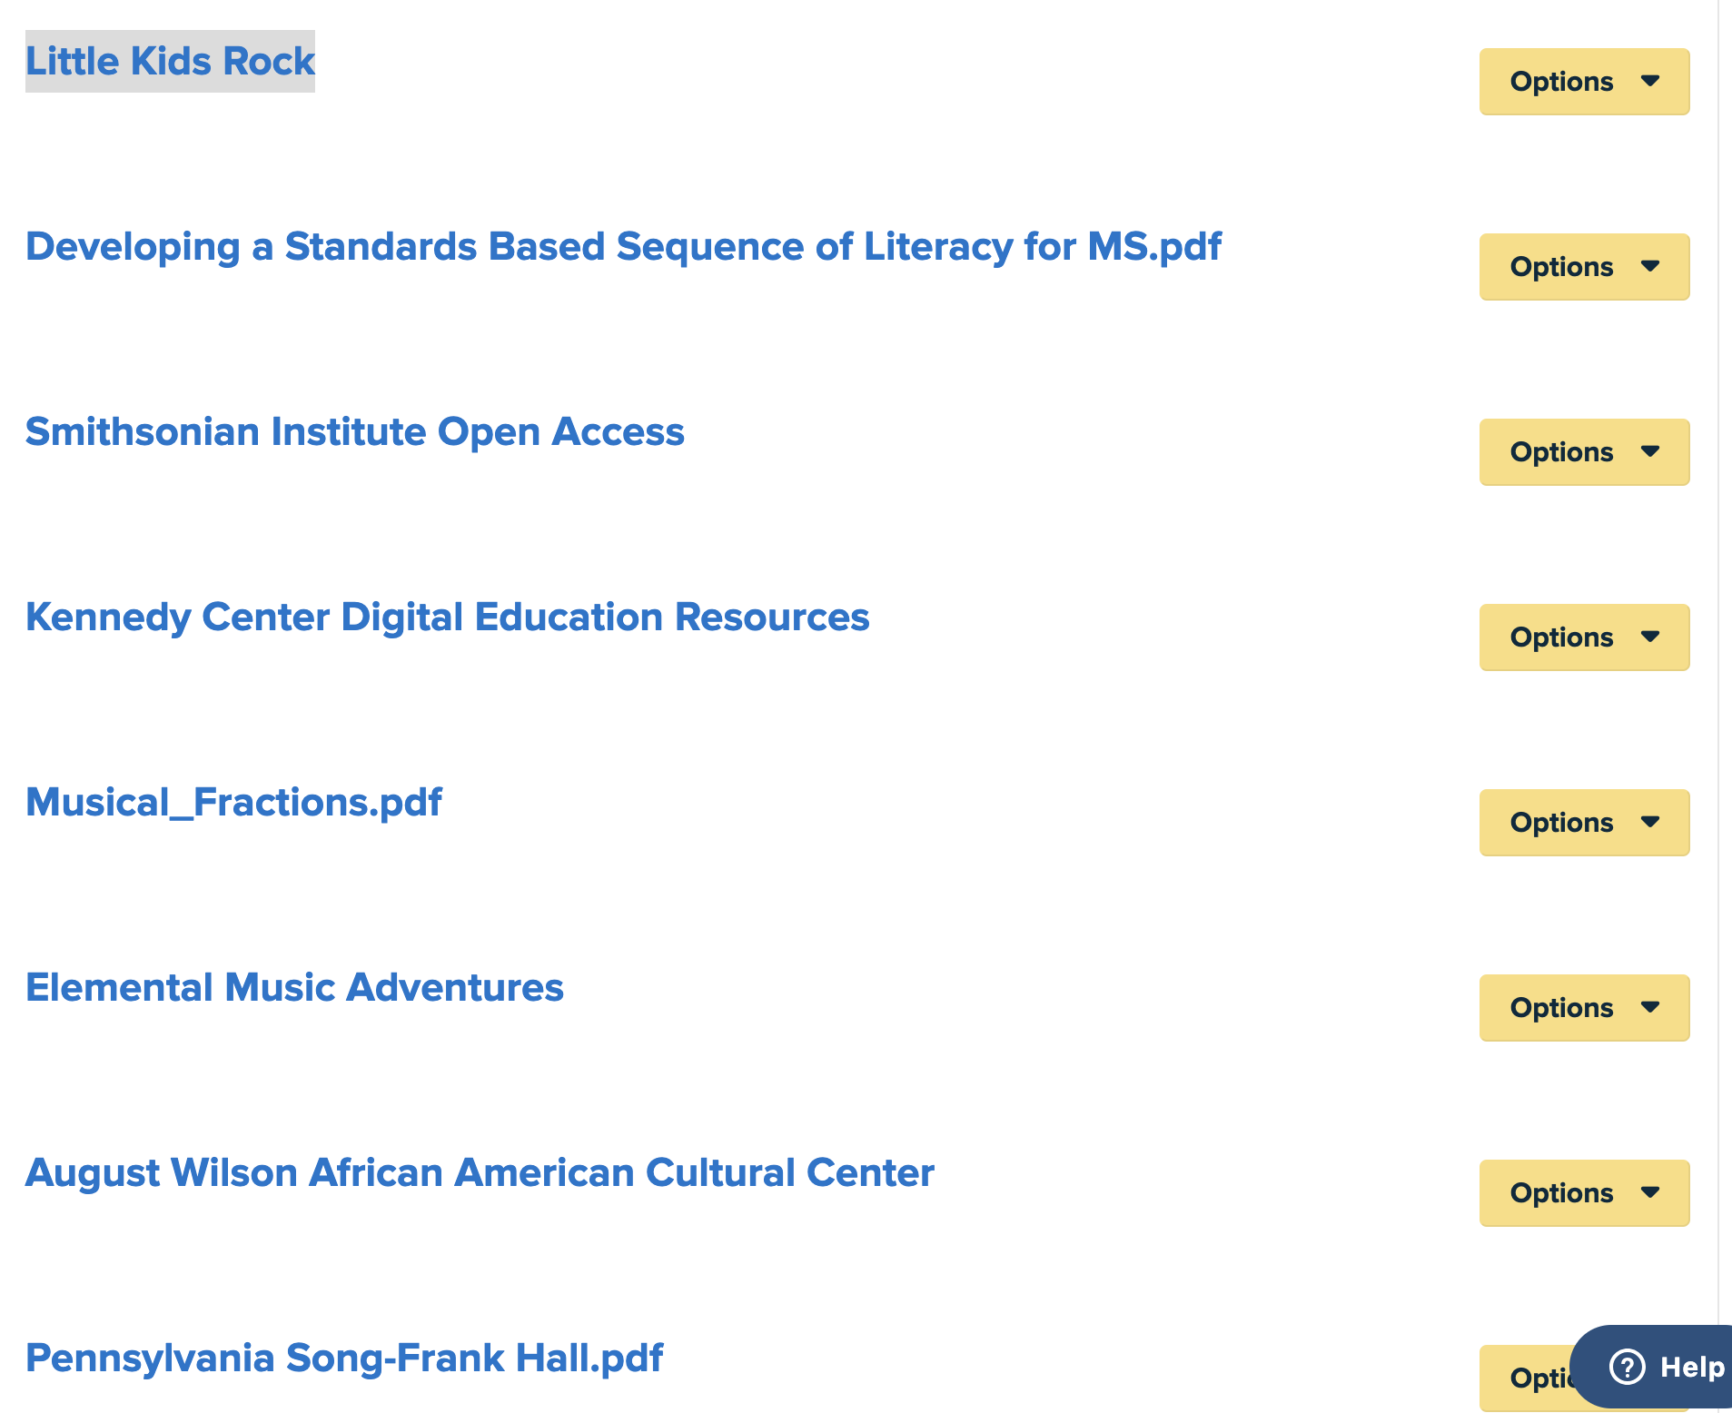

Slide 8
Arts and Humanities PLC
eBlast

Slide 9
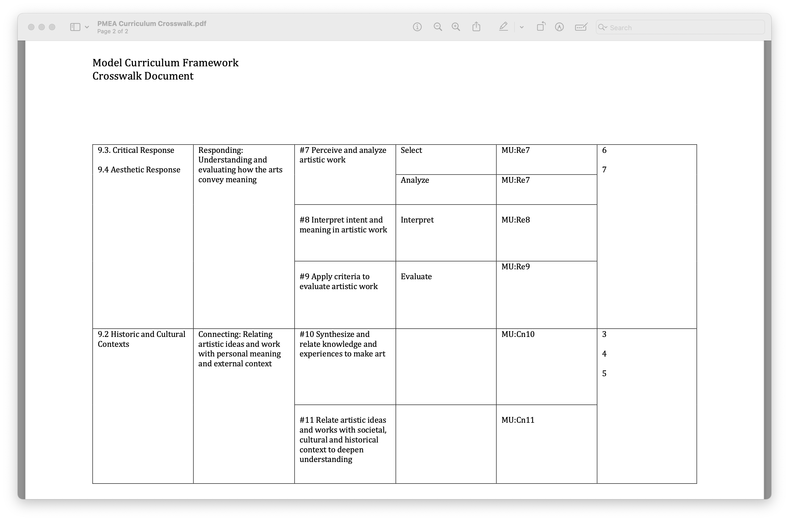
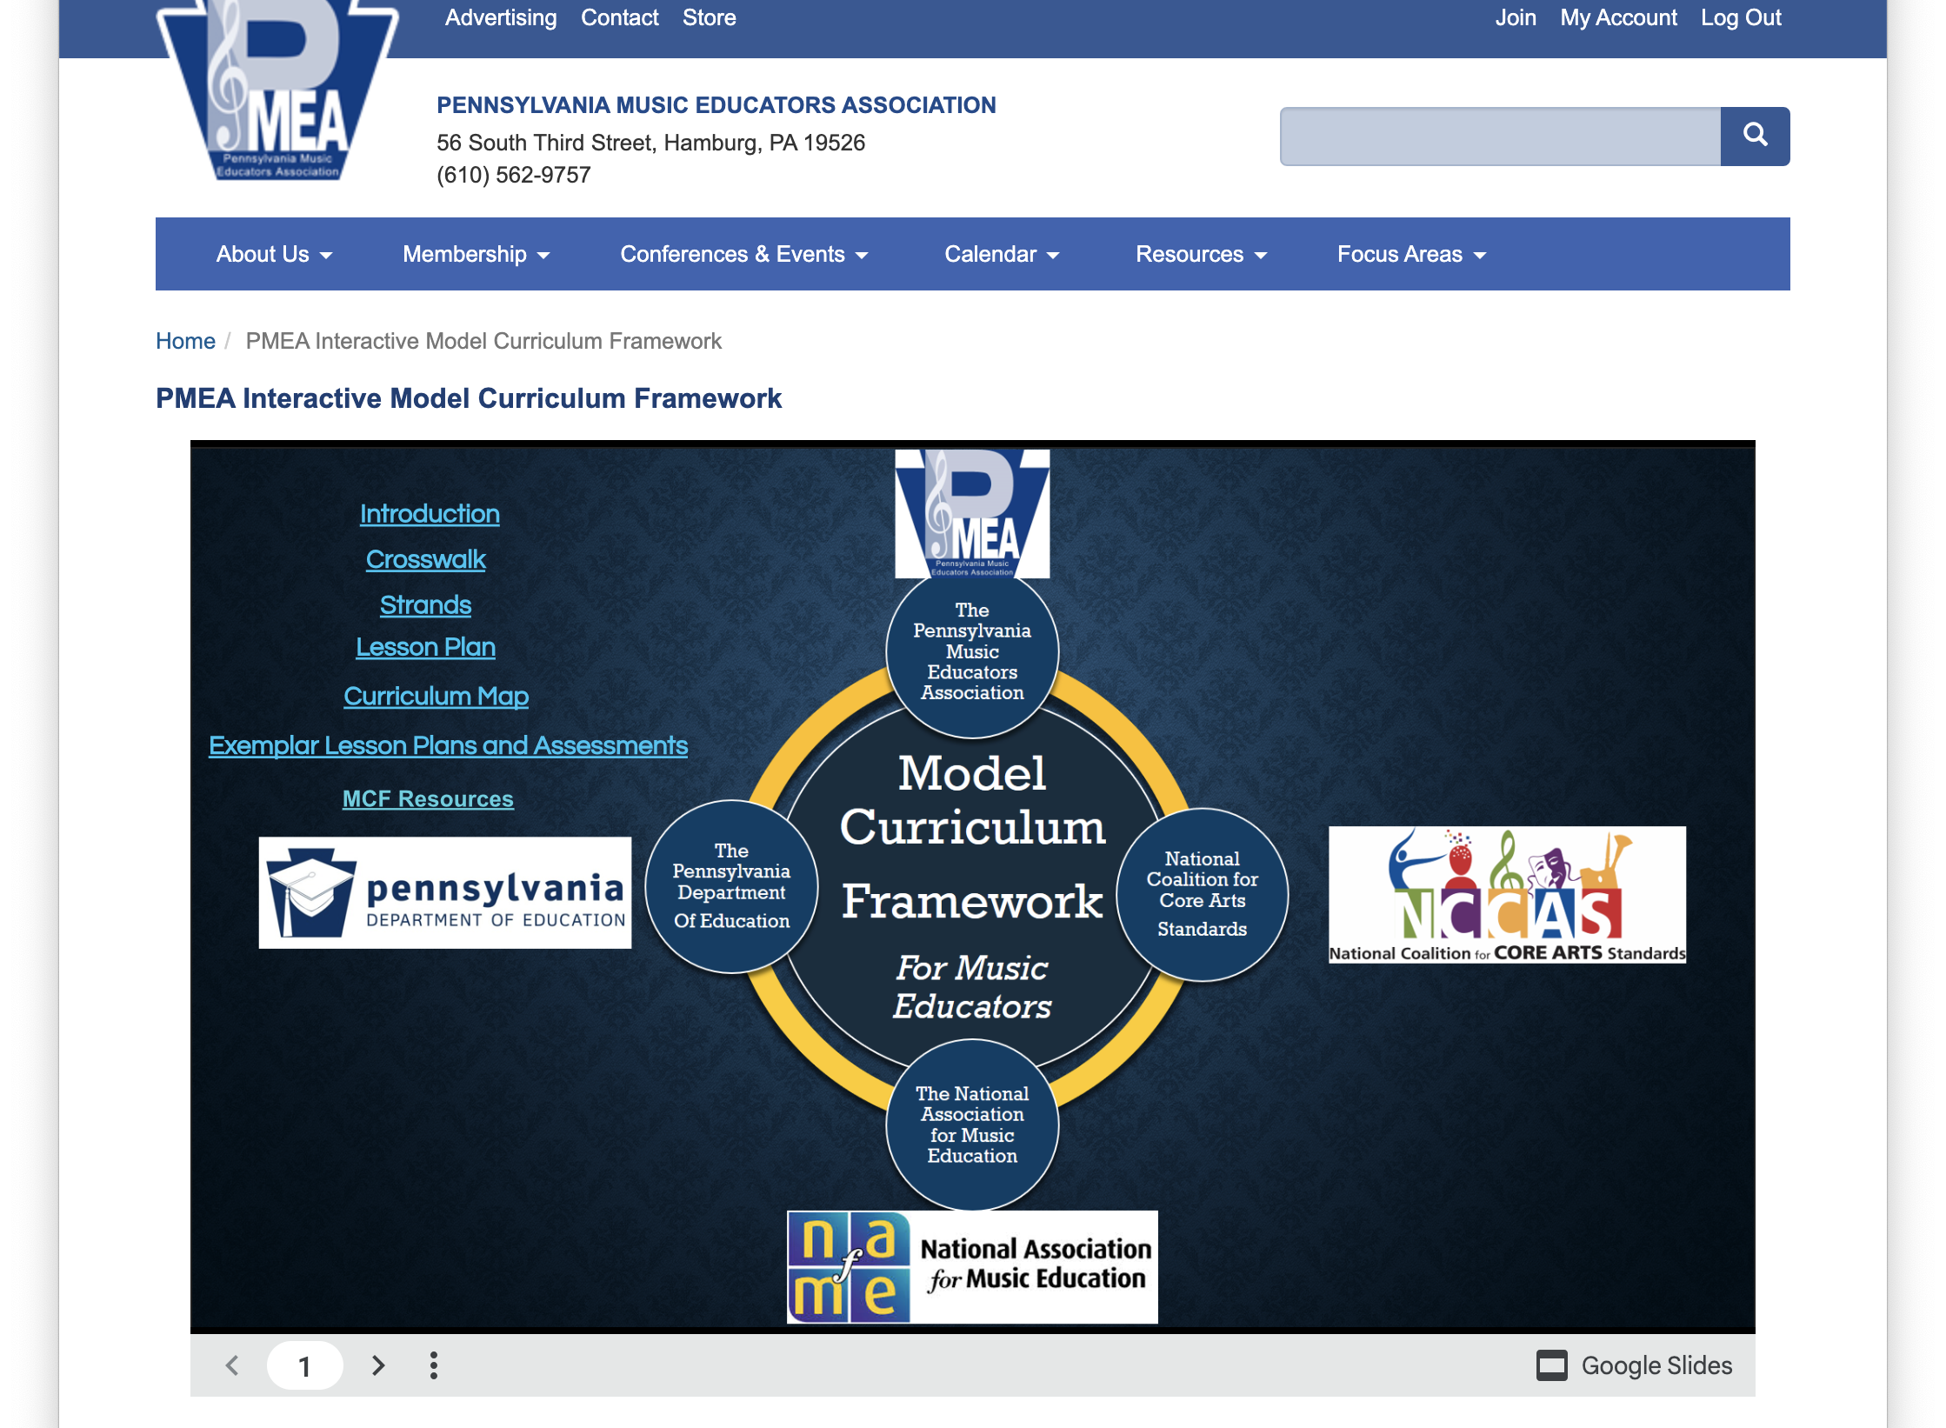
PMEA Standards Crosswalk

Slide 10
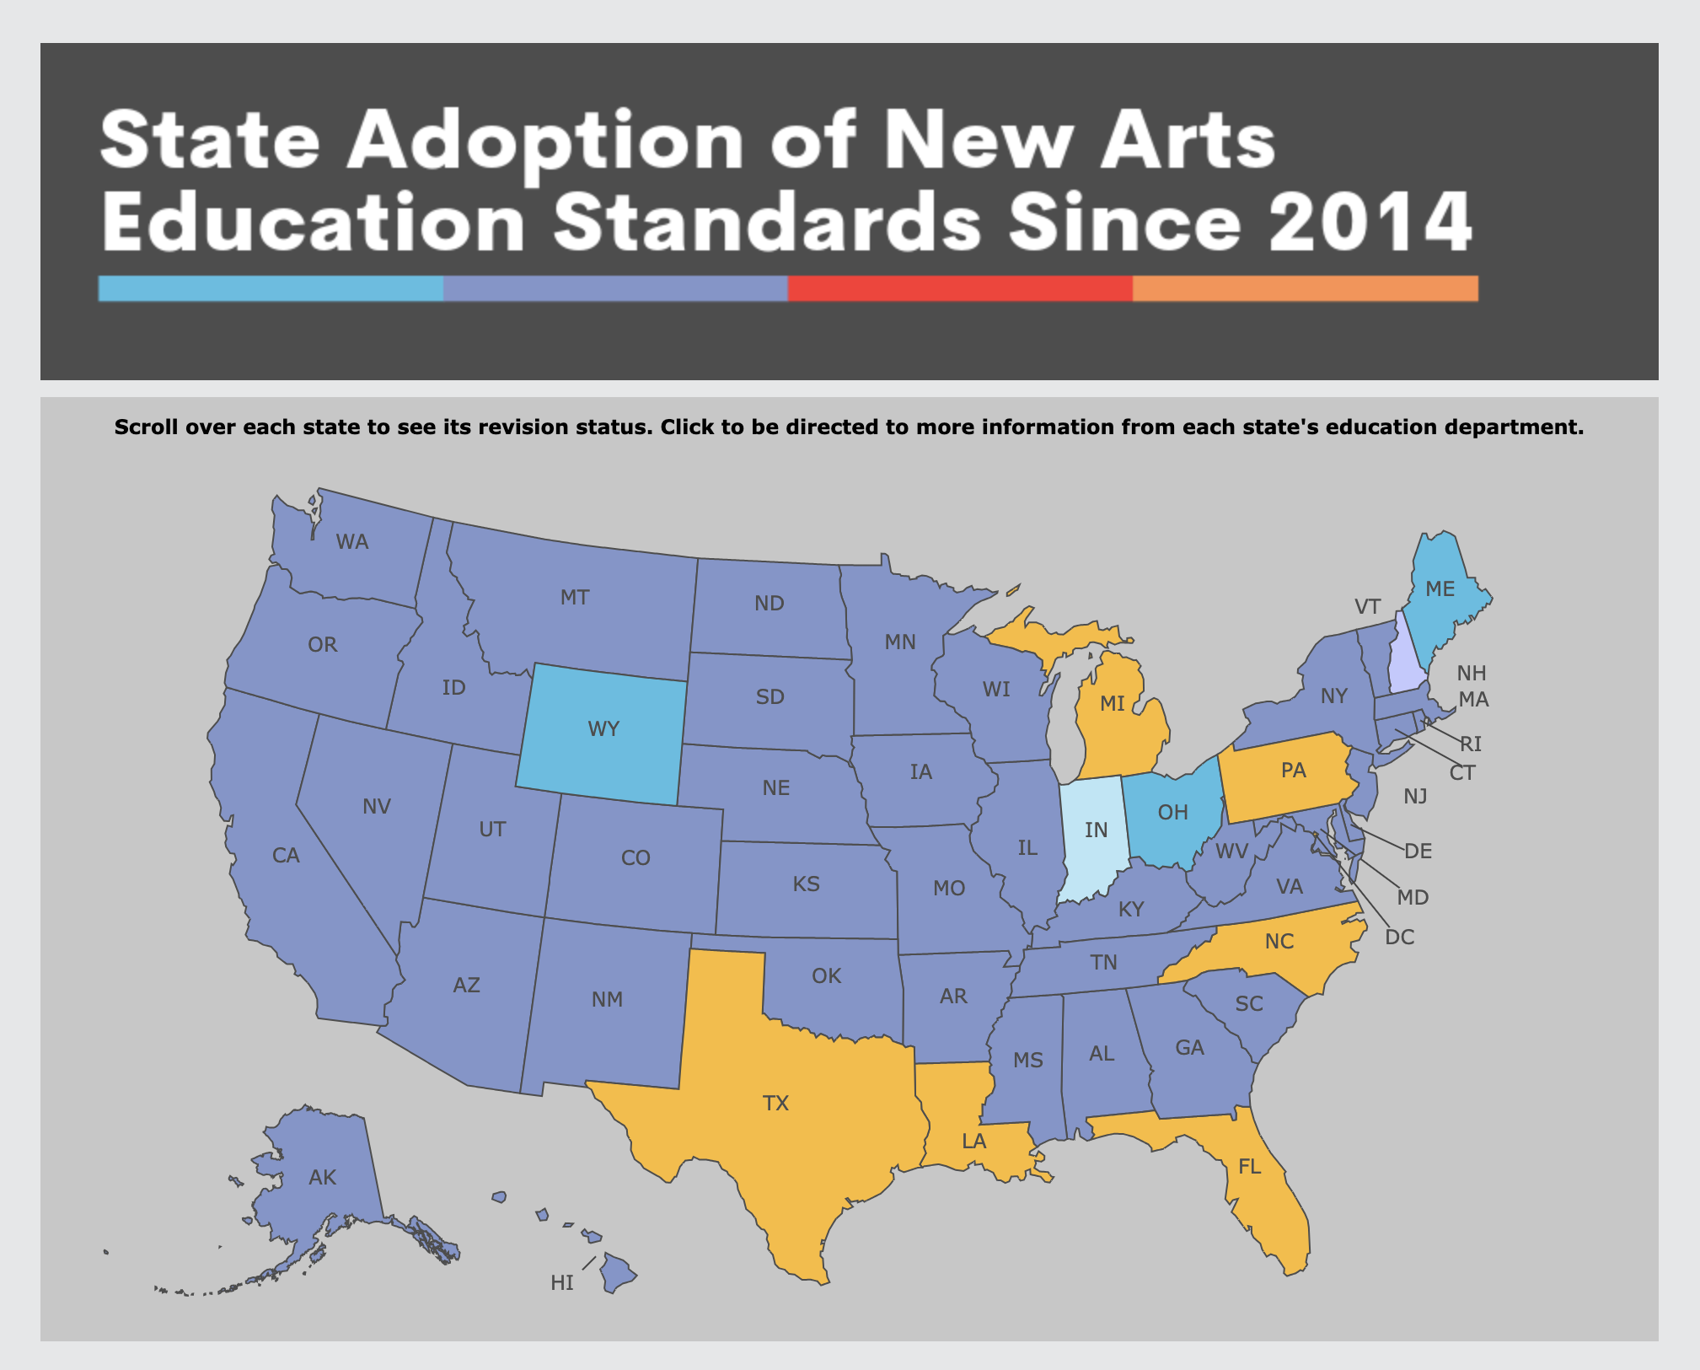
There is currently no public plan for the Pennsylvania Department of Education to adopt new arts education standards.

Slide 11
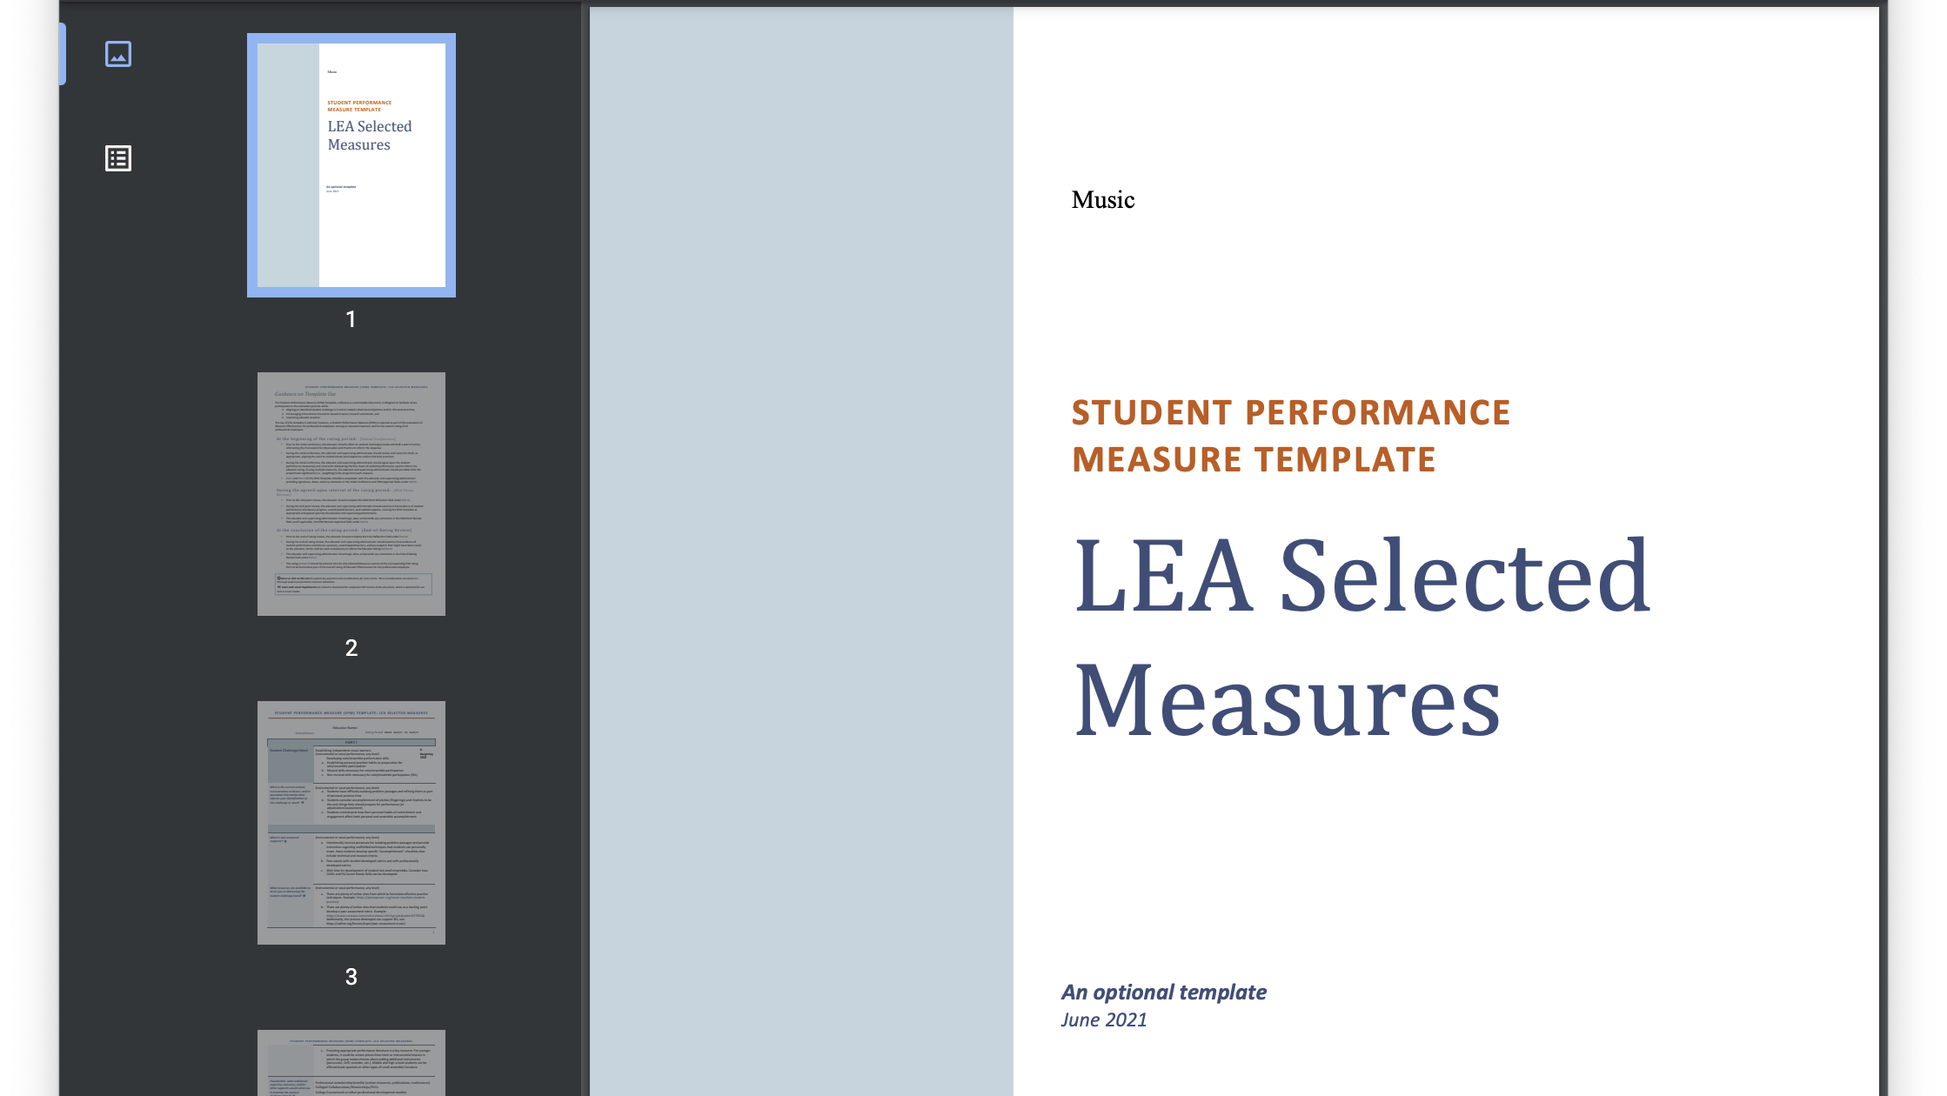

Slide 12
Dance Certification January 2023

Slide 14
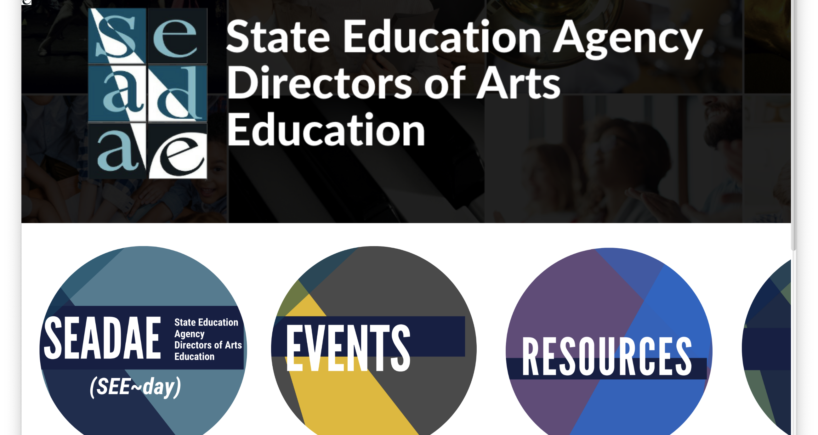
Notes:
Folk and Traditional Arts
Folk and Traditional Arts are defined as those artistic traditions characteristic of specific ethnic, religious, linguistic, occupational, or regional groups. These arts are shaped and shared within families, neighborhoods, and communities. They are passed down from one generation to another and learned through ongoing participation in community-based activities, and through observation, practice or apprenticeships with elders and masters rather than through classes, books or other means of institutional instruction.
DEFINITION
Customized arts learning is a process for developing authentic arts instructional approaches intended to address the diverse traditions and experiences of individual students.
To support learning in arts education, Customized Arts Learning - A Toolkit (CALAT) is a professional learning project intended to provide SEADAE members with resources to support their individual state constituents with the capacity to meet the needs of diverse populations, thus addressing gaps that hinder learning. Expanding upon previous project outcomes addressing SEL and DEIA, CALAT will focus on inclusivity through arts learning within its given context, functioning as a bridge to equitable and inclusive academic learning. The intent of the project is to 1) evaluate current art education practices for equity and inclusivity and 2) provide appropriate resources and strategies to support arts learning - about all, and for all.

Slide 15
CALAT
Customized Arts Learning: A Toolkit

Slide 16
Folk and Traditional Arts Arts in Education Residencies

Slide 18
PA Arts Teacher Access Data

Slide 19
Why Arts Teacher Access Data?
To look at relationships that change over time
School enrollment changes
Arts teacher employment changes
To find gaps in access to arts educators
To tell a story; frame a narrative that:
Predicts future need or surplus
Supports advocacy efforts
Informs ways in which the field of arts education is changing

Slide 20
How good is data?
Data is only as good as what is reported.
Data reported as “change over time” is affected by the time span.
Data can mislead and be
mis-interpreted:
Small n counts vs. large n counts
numbers vs. percent
Notes:
Schools report arts teachers in several ways, some of which includes teachers with temporary certificates, dual certificates and K-4 or 4-8 teachers who teach arts as part of an enclosed elementary classroom setting.
A larger number of data points provides a more realistic picture of what is reported. (% reporting is better with a larger number of data points)
Point in time factors that affect teacher data can include Covid, politics (no child left behind), in and out availability (retirement/college graduates), certification (no dance or theatre cert makes those areas tough to report, even though we have standards; and technology in arts (STEAM) teachers may be reported in other content areas, even thought the teacher certification is in the arts.)
Increases and decreases cited must consider defined points in time and what happened within those points in time.

Slide 21
Public School Enrollment Data
General decline in public school enrollment across the country
Axios 1.8.23, Politics and Policy
Notes:
Public school enrollment fell by 3% during the first year of the pandemic, according to federal data. The largest decline since 1943, it wiped out a decade of enrollment growth.
The decrease left public schools with 49.4 million students in fall 2020 — about 1.4 million fewer than the previous fall.
Up until 2020, there had been a slight increase in public school enrollment
National Center for Education Statistics (NCES) 2019-2020
National 3% (back to 2009 levels)
State 5%

Slide 22
PA Schools Required to Report Data
 | 2022 | 2017 | 2012
Public | 500
Charter | 185 | 183 | 158
Intermediate Units | 29
Career & Technical Centers | 69 | 60 | 59
Notes:
This data shows an increase n Charter Schools and Career/Technical Centers. Some are new, some went out of business, some combined their reporting (combining elementary and secondary campuses that previously reported separately)

Slide 23
PA Public School Enrollment Data
Enrollment 2022 | Enrollment 2017 | Enrollment 2012 | Change 12-17 | Change 17-22 | Change 12-22
1,516,002 | 1,578,459 | 1,644,704 | -66,245 | -62,531 | -128,776
 |  | % change | -4% | -4% | -8%
Notes:
PA Public School Enrollment did not follow the national statistic. We have seen a decrease in public school enrollment statewide of 128,766 students, which can be reported as an 8% decrease in the last decade.

Slide 24
PA Charter School Enrollment Data
Enrollment 2022 | Enrollment 2017 | Enrollment 2012 | Change 12-17 | Change 17-22 | Change 12-22
170,941 | 133,497 | 104,706 | 28,840 | 37,444 | 66,235
 |  | % change | 28% | 28% | 63%

Slide 25
Download the Report
PA Release Date
August 2023

Slide 26
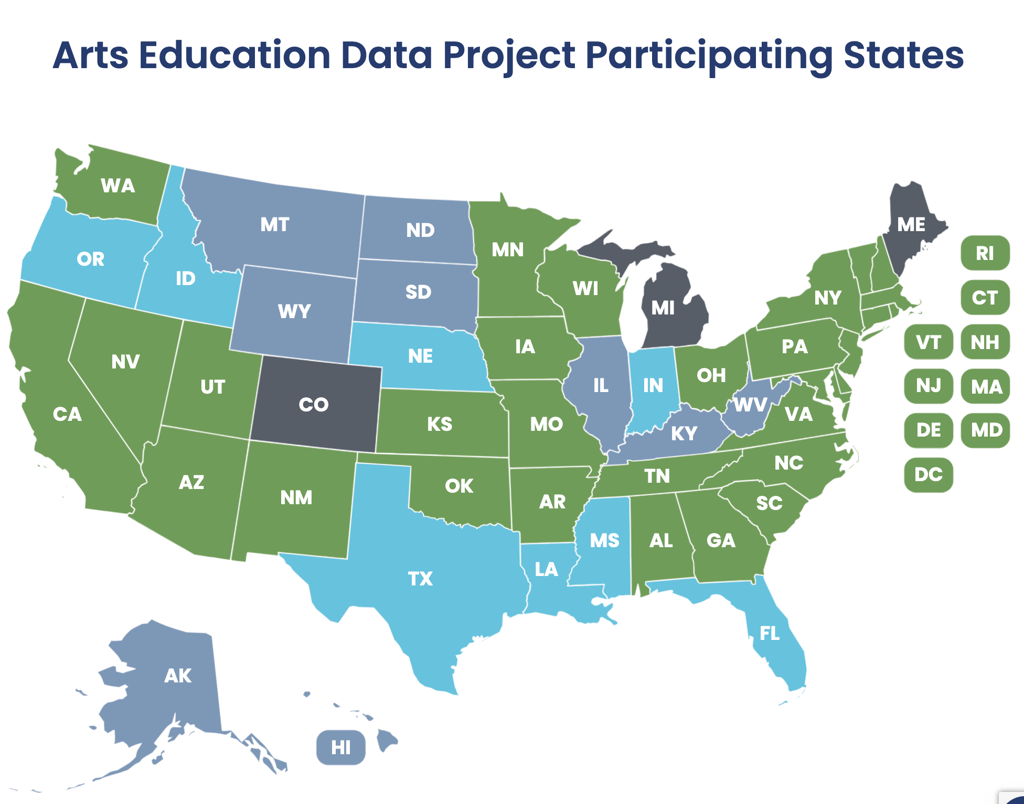

Slide 27
School Courses for the Exchange of Data (SCED) Codes
Search
https://nces.ed.gov/scedfinder/Home/Search
Subject Code (05, Visual and Performing Arts
https://nces.ed.gov/scedfinder/Home/Browse

Slide 28
SCED Code Descriptions

Slide 30
https://teach.com/careers/become-a-teacher/teaching-credential/state-requirements/pennsylvania/#shortage

Slide 32
To submit a proposal, go to https://forms.gle/WQ93Rif7vCCdLgkc8 for a list of suggested topics and other relevant details.
Request for Proposals

Slide 33
Arts PLC
Arts Education Access Data
Arts Teacher Shortage
ESSA (Every Student Succeeds Act)
Title IV and ESSER (Elementary and Secondary School Emergency Relief) funding
Career Readiness
Teacher Evaluation in the Arts
State and National Standards
Modern Band

