Slide 1
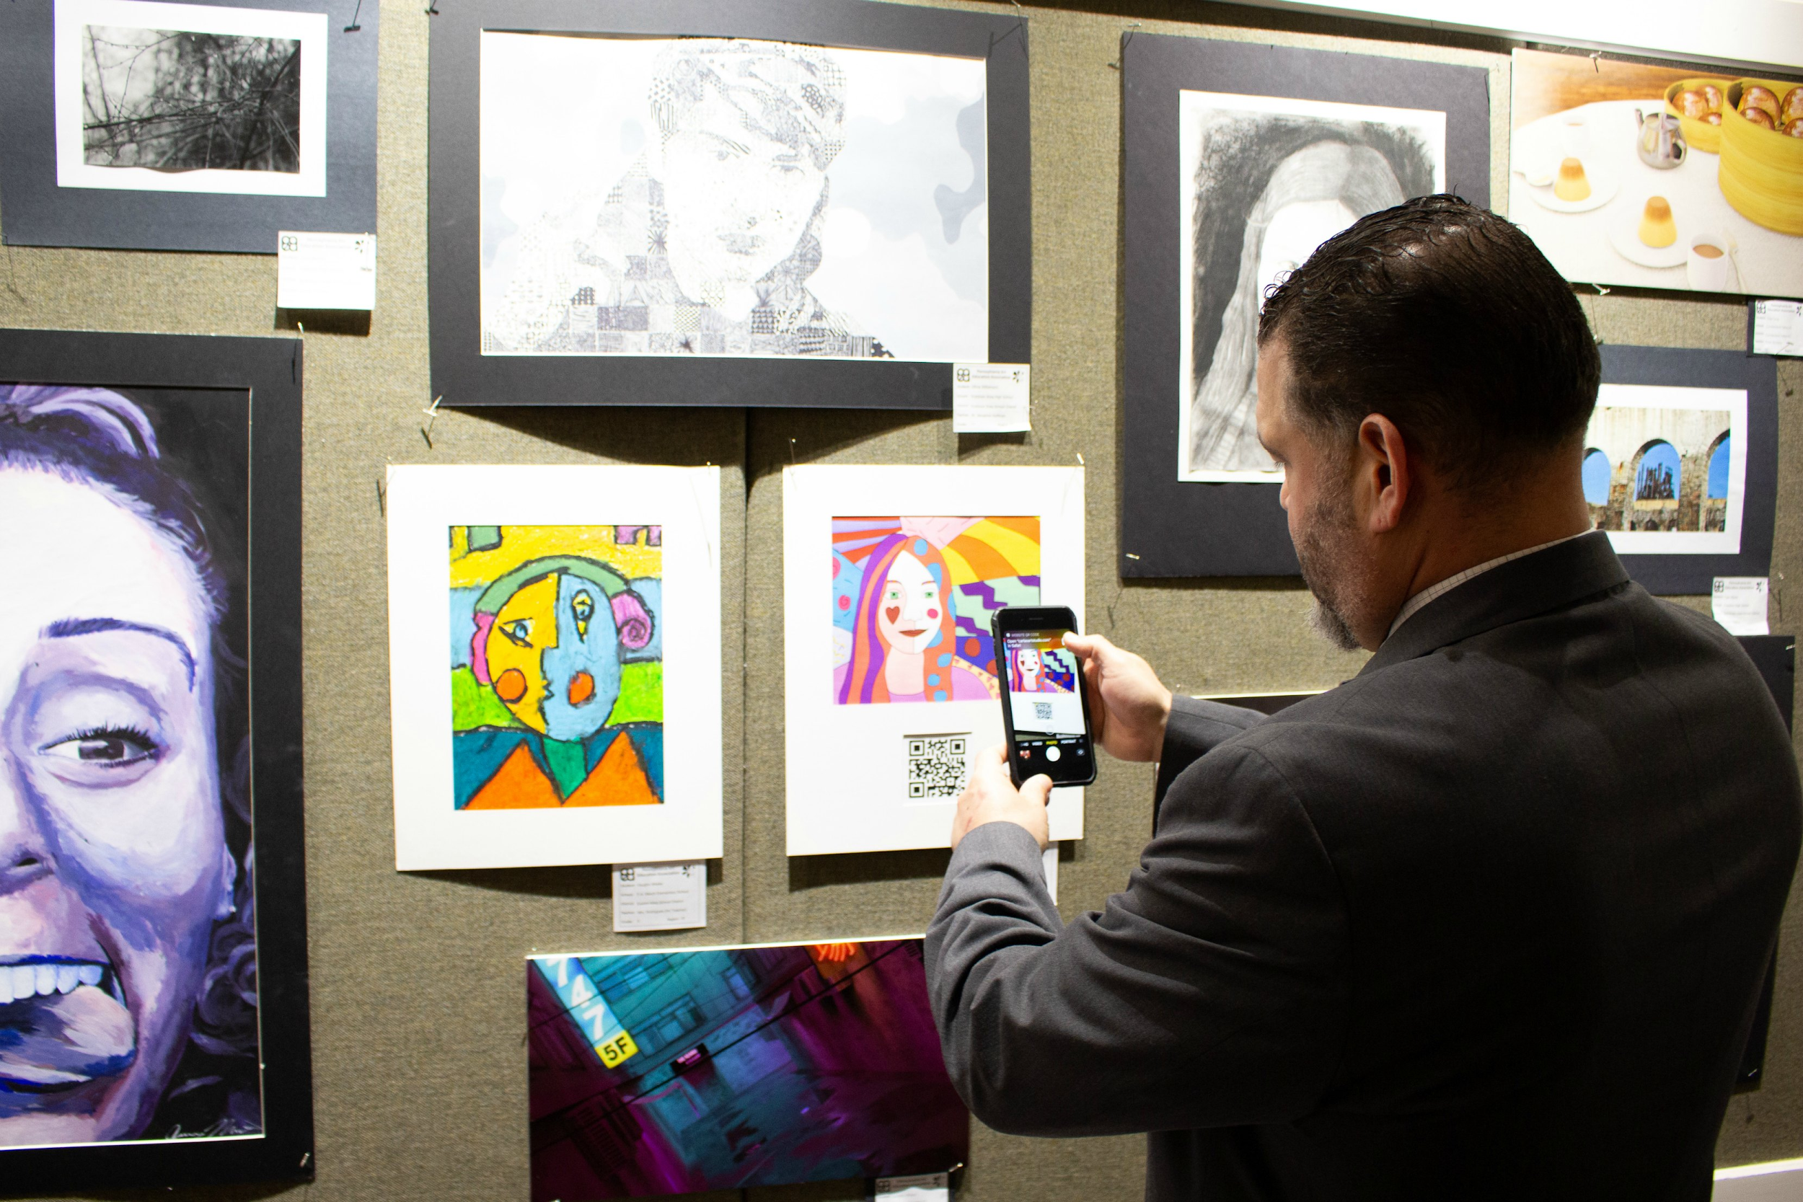
Toolkit: Standards, Social Emotional Learning and Career Ready Skills in the Visual Art Classroom
August 2020

Slide 2
Developed through resources from the
PA Department of Education
and the

Slide 3
How do I use this toolkit?
As a resource bank:
Select appropriate resources to supplement SEL programs currently being implemented in your school or district.
As a framework for professional development:
Create professional development for visual art teachers that informs SEL learning through art-specific, standards-based instruction.
As a self-paced training:
Learn the language of SEL through the lens of art education.

Slide 4
When you see this icon, look for an embedded link or video button on the slide.

Slide 5
Topics
Definition and historical perspectives
SEL as defined by CASEL
Self-Assessing Social & Emotional Instruction and Competencies
SEL Relationship to:
PA Career Skills Continuum
State Standards
National Standards
Designing Intentional SEL/Visual Art Instruction
Habits of Mind
Resources
PA Department of Education
Toolkit Links

Slide 6
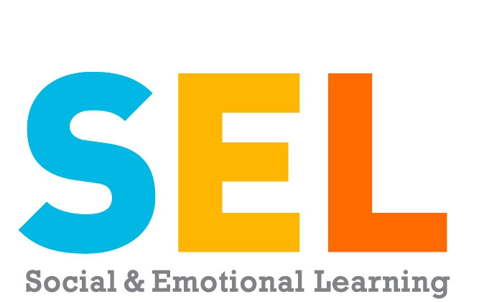
Topic 1 Definition and historical perspectives

Slide 7
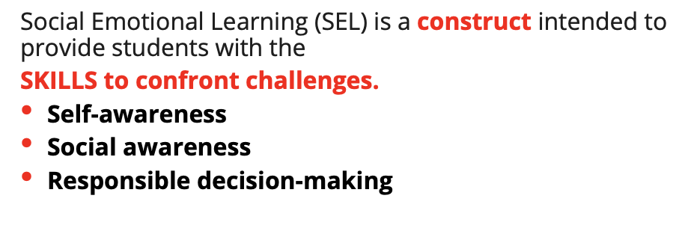

Slide 8
Broad SEL instruction often takes the form of
reflection, discussion, and lecture.
How many “minutes a day” should I spend on SEL is the
WRONG QUESTION!
Students can view
this as forced,
formulaic, and
scripted.

Slide 9
For SEL to be most effective, it needs to be embedded in the curriculum.
Art teachers can do this in a much more authentic way—through Art!

Slide 10
Purposeful integration of SEL into visual art education will enrich the students’ personal connection to art.
The following is a public service announcement!
For any artistic endeavor to impact the social and emotional learning (SEL) of our students it must be intentional and embedded into the curriculum. If you are not doing it with intention... you are not doing it.
Yes... SEL is inherent in the arts... but it must be activated in order to have impact. As SEL comes into focus we must be authentic in our approach. If you want to impact the social and emotional wellbeing of your students, then get to work embedding it into what your instructional approach will be. There are no shortcuts.
Effort and Intention are required.

Slide 11
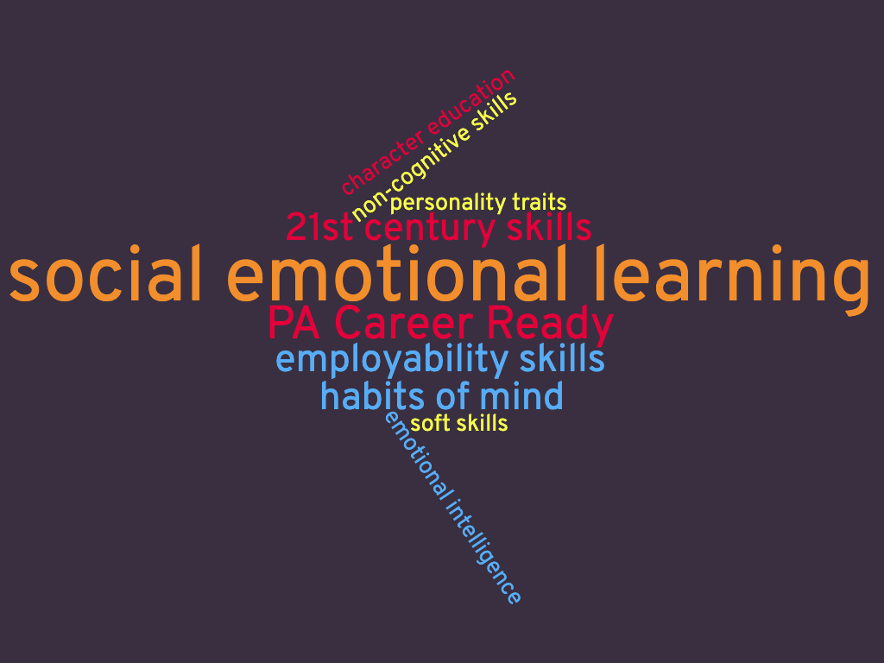
SEL has evolved from a variety of definitions and frameworks.
Historical Perspectives
Compare the Frameworks

Slide 12
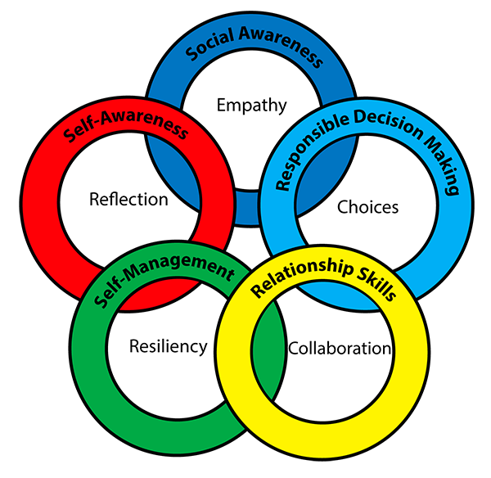
2. SEL as defined by CASEL
Topic 2 SEL as defined by CASEL

Slide 13
CASEL’s SEL Definition from the Collaborative for Academic, Social, and Emotional Learning
Social and emotional learning (SEL) is the process through which children and adults
(1) understand and manage emotions,
(2) set and achieve positive goals,
(3) feel and show empathy for others,
(4) establish and maintain positive relationships,
(5) and make responsible decisions.
What is SEL?

Slide 14
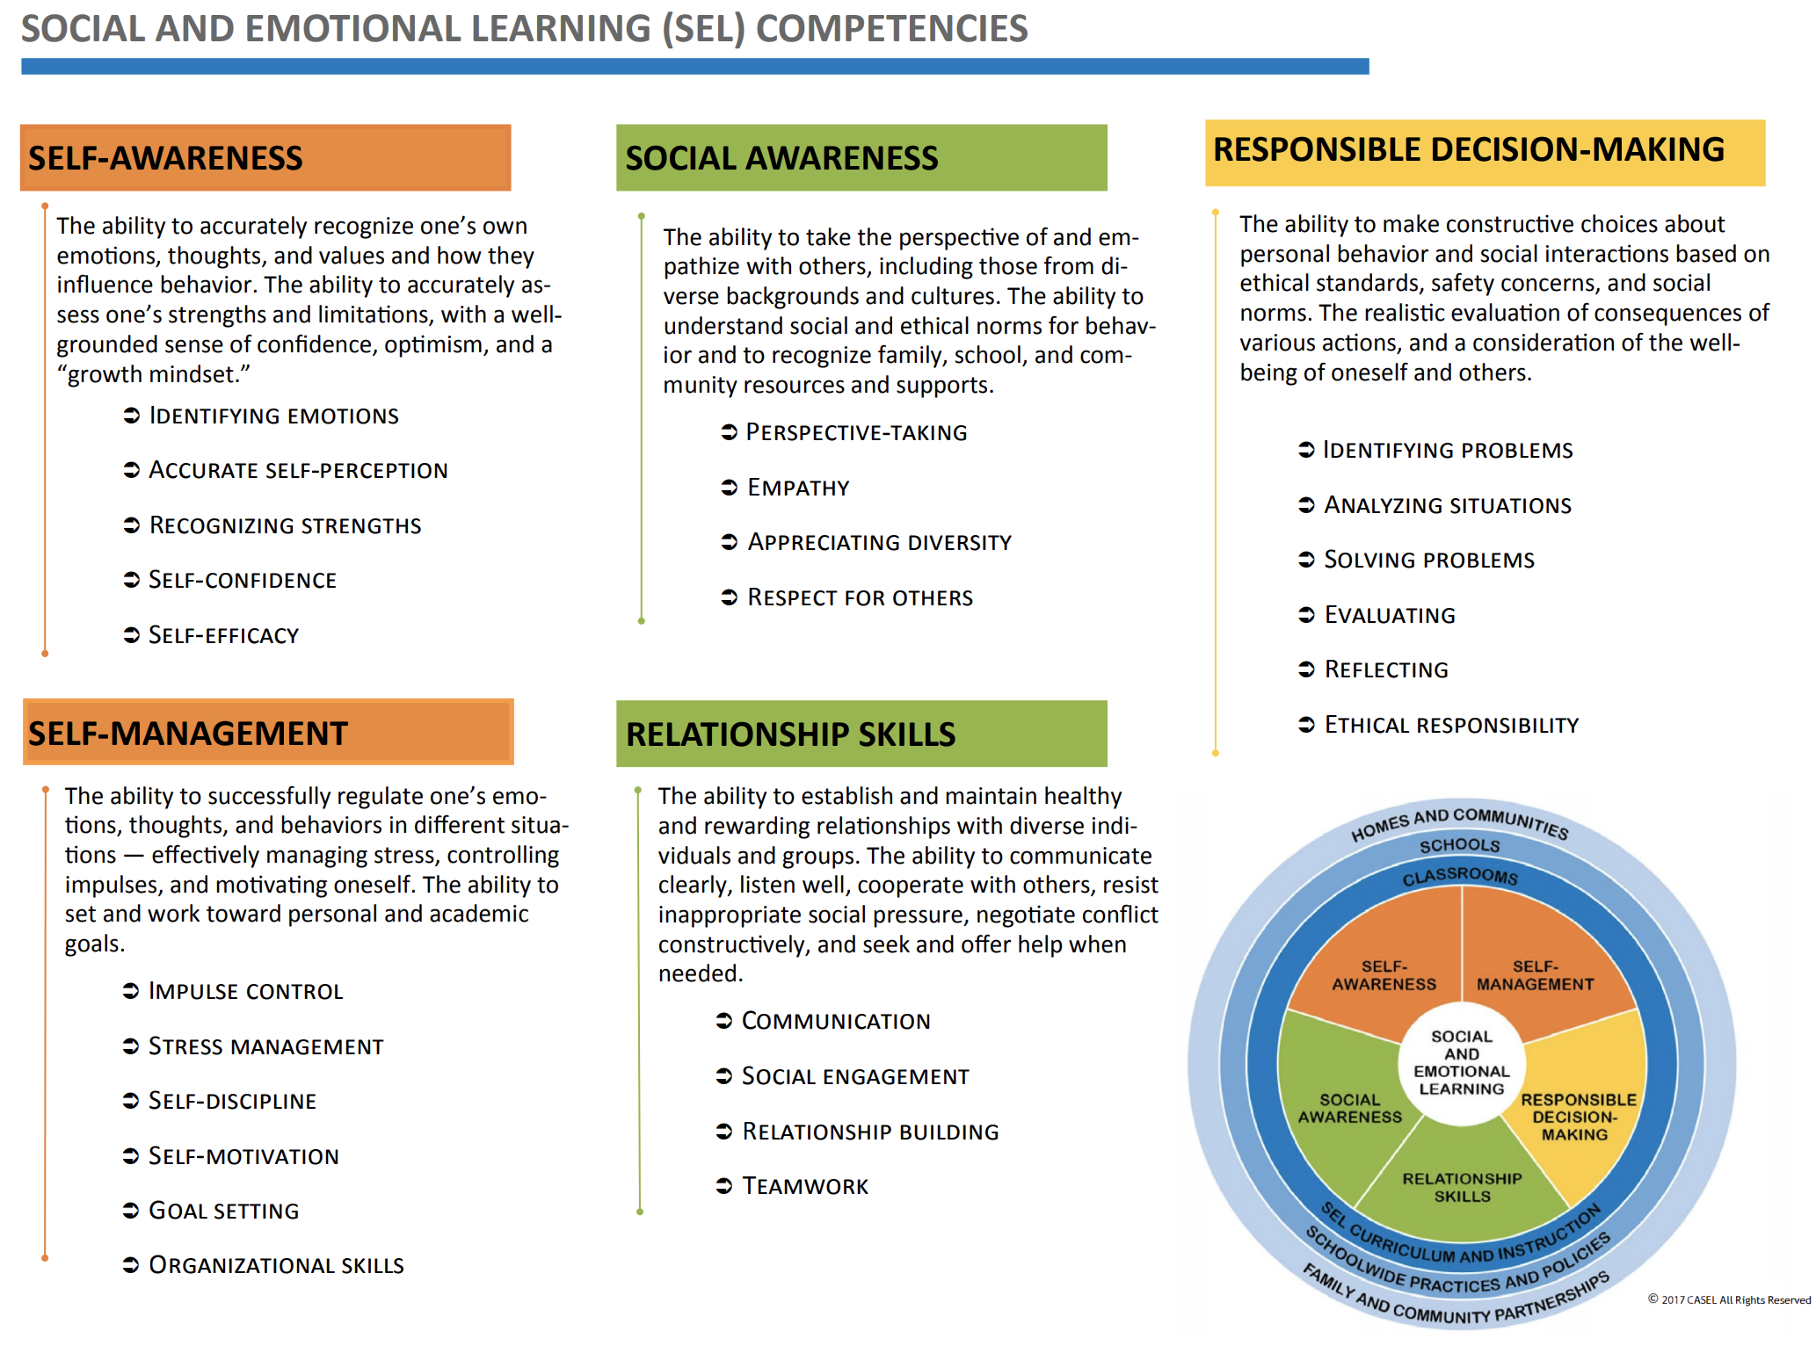

Slide 15
Play from 15:29-25:05 (Presented by a music educator but applicable to all content areas.)

Slide 16
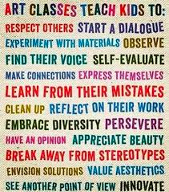
Some visual art teaching practices provide a natural foundation for SEL learning.

Slide 17
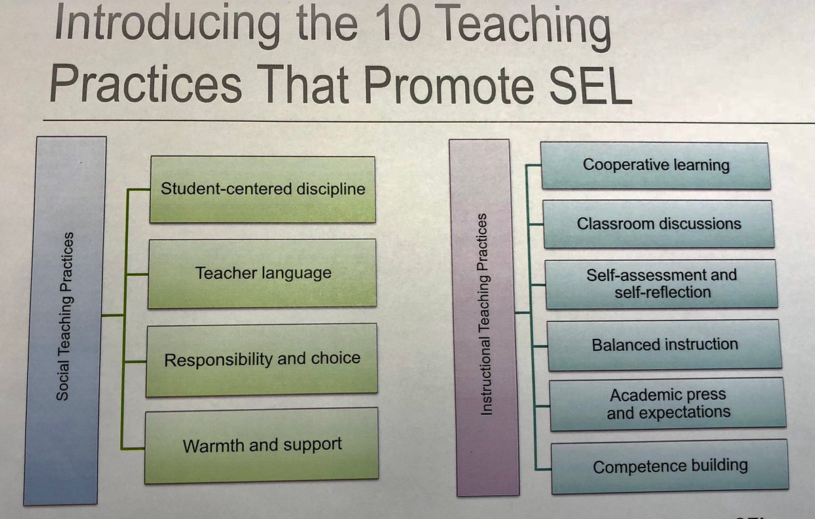
Topic 3 Self-Assessing
TEACHER
Social & Emotional Instruction and Competencies

Slide 18
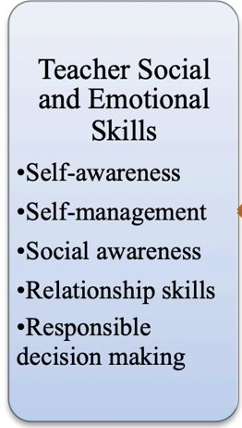
…are important for student…

Slide 20
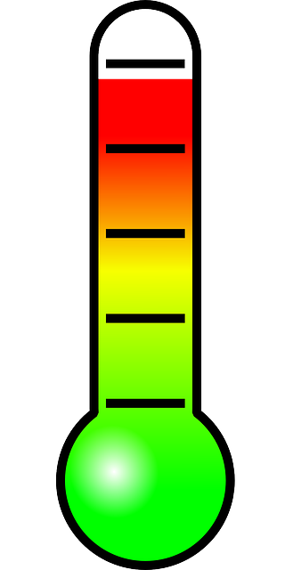
Taking Your “Teacher” SEL Temperature
Instructional Practices/Competencies/Strategies | Self Rating
I teach students strategies to handle the emotions that affect their learning (e.g., stress, frustration)
I arrange experiences that allow my students to become responsible (e.g., classroom aides or jobs, peer tutoring, specific roles in group work) in developmentally appropriate ways.
I am aware of how my cultural beliefs and background affect my social teaching practices with my students.
I model behaviors (e.g., form guidelines, set boundaries) to help students learn to regulate emotions during social teaching practices.
I usually understand the perspectives of my students and can pay attention to their emotional cues during classroom interactions.
I create learning experiences in which my students must apply positive social skills to be successful.
I ensure that my students feel responsible for accomplishing or failing to accomplish their academic work.

Slide 21
Do any of those statements inform your thinking about designing instruction?
Create learning experiences in which my students must apply positive social skills.
Arrange experiences that allow my students to become responsible.
Be aware of how my cultural beliefs and background affect my social teaching practices with my students.

Slide 22
Self-Assessing Social and Emotional Instruction and Competencies: A Tool for Teachers

Slide 23
Topic 4 SEL Relationship to: PA Career Skills Continuum State Standards National Standards

Slide 24
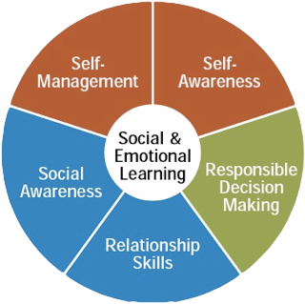
There’s a strong relationship between the
SOCIAL EMOTIONAL LEARNING (SEL) COMPETENCIES
and the
Pennsylvania Career Ready Skills Continuum
=

Slide 25
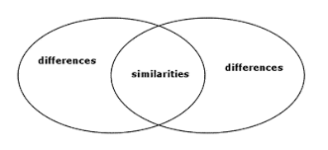
Here’s a fun task!
Align the language of the
SEL COMPETENCIES
with the language of the
Pennsylvania Career Ready Skills Continuum

Slide 26
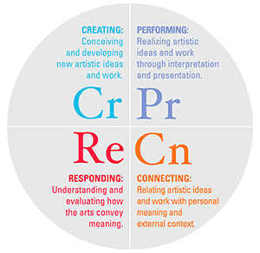
To purposefully integrate SEL into visual art instruction, you’ll need to know the language of visual art education standards.

Slide 27
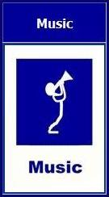
PA Arts & Humanities Standards
PA Arts Curriculum Framework
Pennsylvania Arts and Humanities Standards have 4 components:
9.1 Performance (creating or recreating works in the arts)
9.2 Historical and Cultural (understanding the context of a work in the arts)
9.3 Criticism (evaluating works in the arts)
9.4 Aesthetics (responding to works in the arts and analyzing your own responses)

Slide 28
National Core Arts Standards Processes—Anchor Standards—Grade Level Standards

Slide 29
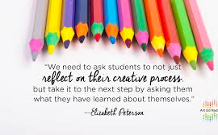
Topic 5
Designing Intentional SEL/Visual Art Instruction

Slide 30
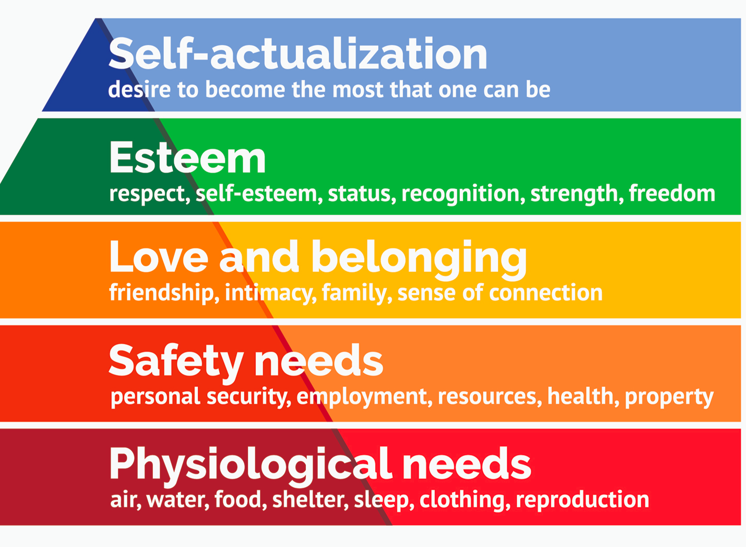
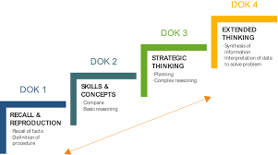
Intentional SEL/Music Instruction requires Maslow and Webb Meeting Human Needs in tandem with Academic Needs
Abraham Maslow’s Hierarchy of Needs
Norman Webb’s DOK for the Arts

Slide 31
Designing Instruction to Support SEL Competencies
Sample Teaching Activities to Support Core SEL Competencies

Slide 32
Intersections: What would appropriate grade-level instruction look like at each intersection?
SEL Competencies | Creating | Presenting | Responding | Connecting
Self-Awareness | ? | ? | ?
Self-Management | ? | ? | ?
Social Awareness | ? | ? | ?
Relationship Skills |  |  |  | ?
Responsible Decision Making | ? | ? | ? | ?
PA Career Ready Skills Continuum | Creating |  |  | Connecting
Self-Awareness & Self Management | ? | ? | ?
Establishing & Maintaining Relationships |  |  |  | ?
Social Problem-Solving Skills | ? | ? | ? | ?

Slide 33
Instruction at the Intersection of Competencies, Skills, & Standards
SEL Competencies | Creating | Presenting | Responding | Connecting
Self-Awareness The ability to accurately identify one’s own emotions. | Crayola Creativity Hour (13:50-16:05)
Self-Management
Social Awareness
Relationship Skills
Responsible Decision Making
PA Career Ready Skills Continuum | Creating | Presenting | Responding | Connecting
Self-Awareness & Self Management Grades PK-2: Recognize and label basic feelings. Grades PK-2: Distinguish between situations that elicit positive or negative feelings. Grades 1-5: Identify one’s own strengths, needs, and preferences. | Crayola Creativity Hour (13:50-16:05)
Establishing & Maintaining Relationships
Social Problem-Solving Skills

Slide 34
Grades PK-5 (Crayola)
SEL Competencies | Creating |  | Presenting | Responding |  | Connecting
Self-Awareness The ability to accurately recognize one’s own emotions, thoughts, and values and how they influence behavior. | The Best of Me
Self-Management
Social Awareness
Relationship Skills The ability to establish and maintain healthy relationships | Gifts of Kindness
Responsible Decision Making
PA Career Ready Skills Continuum
Self-Awareness & Self Management | The Best of Me
Establishing & Maintaining Relationships Explain ways to establish relationships that are positive and supportive of others. Select and utilize expressive communication strategies (e.g., tone, body language, facial expressions) with an understanding of its effect on others. | Gifts of Kindness
Social Problem-Solving Skills

Slide 35
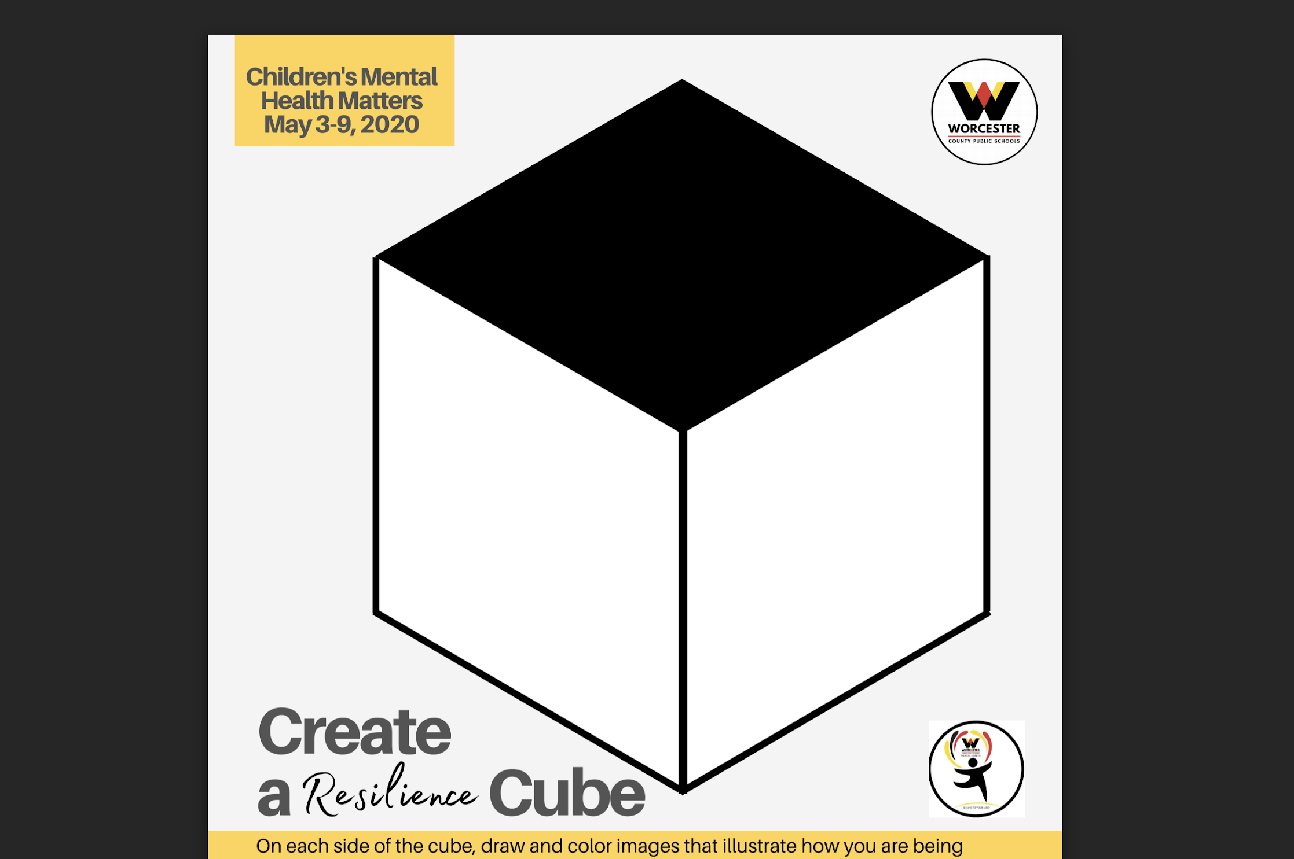
Resilience Cube/ Mural of Resiliency
Social Emotional Learning Through the Arts

Slide 36
Resilience Cube (Creating, Connecting)

Slide 37
Resilience Cube (PA CRS Grade Band 6-8)
SEL Competencies | Creating | Presenting | Responding | Connecting
Self-Awareness | Resilience Cube |  |  | Resilience Cube
Self-Management
Social Awareness
Relationship Skills
Responsible Decision Making
PA Career Ready Skills Continuum | Creating | Presenting | Responding | Connecting
Self-Awareness & Self Management Identify and select coping skills relevant to adverse situations. | Resilience Cube |  |  | Resilience Cube
Establishing & Maintaining Relationships
Social Problem-Solving Skills Distinguish among various social contexts and how they impact personal feelings. Analyze various perspectives on a situation.

Slide 38
Putting Instructional Content at the Intersection
Standard:
PA or National; Process, Enduring Understanding, Essential Question, Grade Level Statements
SEL Competency/PA Career Ready Skills:
Competency/Skill Category,
Grade Band Statement
Instructional Resource: Lesson Plan, Technique, Tool, Assessment, etc.

Slide 39
The Arts Education and Social and Emotional Learning (SEL) Framework… …is designed to illuminate the intersection between arts education and social-emotional learning to allow for the intentional application of appropriate teaching and learning strategies, with the overarching goal of enhancing Arts Education.

Slide 40
EXAMPLE: Resilience Cube as Instructional Content at the Intersection
Standard: National VA:Cr2.3.7a Creating EU: People create and interact with objects, places, and design that define, shape, enhance, and empower their lives. Gr. 7: Apply visual organizational strategies to design and produce a work of art, design, or media that clearly communicates information or ideas.
PA Career Ready Skills Continuum:
B. Establishing and Maintaining Relationships; CRS Grade Band 6-8: Explain how expressive communication strategies can affect others.
Instructional Resource: Resilience Cube

Slide 41
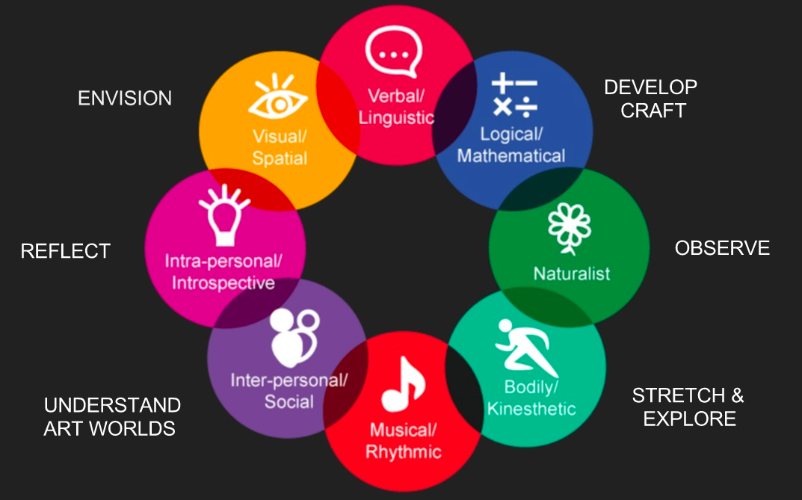
Topic 6 Habits of Mind

Slide 42
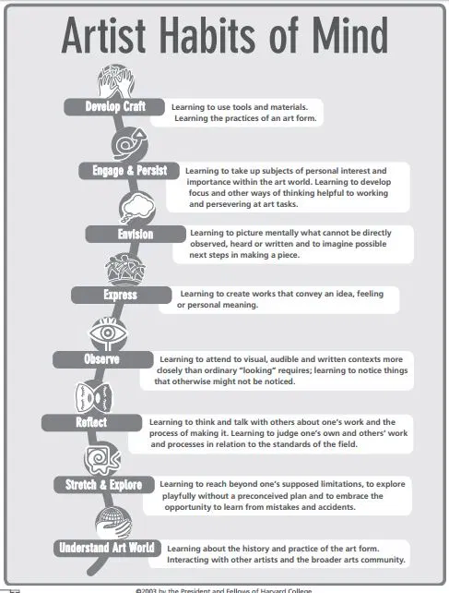
How Do (Dance, Media, Music, Theatre, Visual) Artist Habits of Mind Support SEL and PA Career Ready Skills Learning?
Artist Habits of Mind

Slide 43
Topic 7 Resources PA Department of Education Toolkit Links

Slide 44
Practices in the Arts Classroom
pdesas.org
PA Career Ready Toolkit

Slide 45
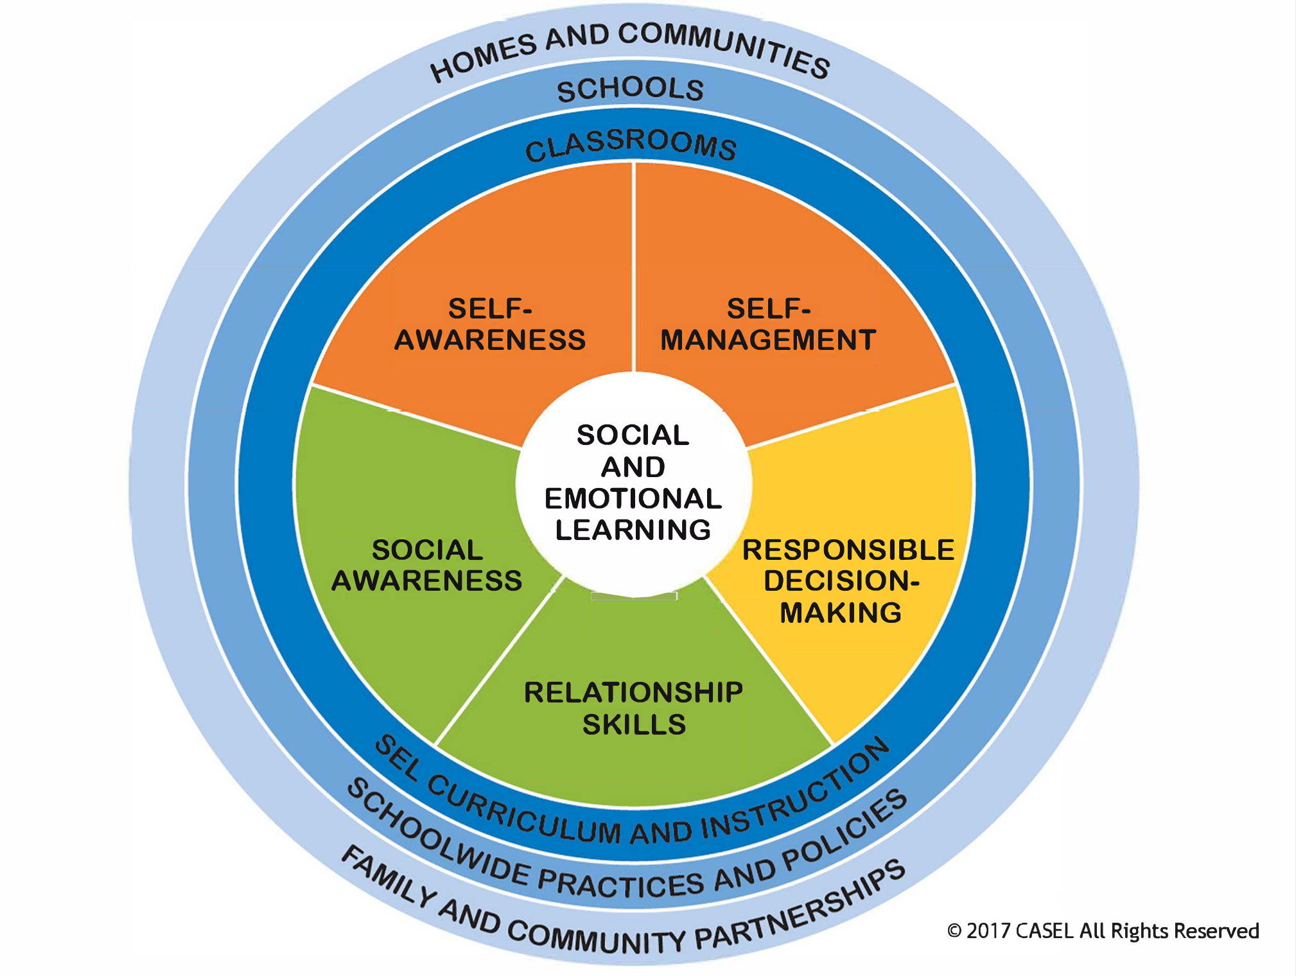
Social Emotional Learning is the responsibility of the teacher, school, family and community.

Slide 46
Use the systems and language that best support your school and community initiatives.
PA Arts and Humanities Standards
(and/or)
National Core Arts Standards
SEL Competencies
(and/or)
PA Career Ready Skills
Instructional Resource: Lesson Plan, Technique, Tool, Assessment, etc.

Slide 47
Learning about Social Emotional Learning
What has challenged you in this toolkit/training?
What has been reaffirmed?
What might you do differently?

Slide 48
Well, almost...
Next slide please!

Slide 49
Toolkit Links
1 | Video Slide 6 | https://www.youtube.com/watch?time_continue=9&v=4YxyAcV9QXc&feature=emb_logo
 | Compare the Frameworks | http://exploresel.gse.harvard.edu/frameworks/
2 | What is SEL? | https://casel.org/what-is-sel/
 | What is SEL Video | https://www.youtube.com/watch?v=4YxyAcV9QXc&feature=emb_title
 | Music & SEL Vimeo | https://vimeo.com/393005958
3 | AIR Teacher Social and Emotional Competencies | https://gtlcenter.org/sites/default/files/SelfAssessmentSEL.pdf
4 | SEL Competencies | https://casel.org/core-competencies/
 | Pennsylvania Career Ready Skills Continuum | https://www.education.pa.gov/Documents/K-12/Safe%20Schools/PA%20Career%20Ready%20Skills/The%20Pennsylvania%20Career%20Ready%20Skills%20Continuum.pdf
 | PA Arts Standards | http://pdesas.org/Standard/Search
 | PA Arts Curriculum Framework | http://pdesas.org/CMap/CFramework
 | National Core Arts Standards | https://www.nationalartsstandards.org/
Next slide please!

Slide 50
5 | Abraham Maslow’s Hierarchy of Needs | https://www.verywellmind.com/what-is-maslows-hierarchy-of-needs-4136760
 | Norman Webb’s DOK for the Arts | https://www.coloradoplc.org/files/archives/dok-arts.pdf
 | Sample Teaching Activities to Support Core SEL Competencies | https://www.casel.org/wp-content/uploads/2017/08/Sample-Teaching-Activities-to-Support-Core-Competencies-8-20-17.pdf
 | Crayola Creativity Hour | https://us02web.zoom.us/rec/play/6J0qJLupqjI3HtLGtwSDUfIqW43vKv6s03JP-6cIyRvnUyIENwbzZbpBa7YHD-Aa7llqtuDeGunjPnyF?startTime=1590073240000&utm_source=EDU_Leads_&utm_medium=email&utm_campaign=06092020_middleschoolwritingkits&utm_content=https%3a%2f%2fus02web.zoom.us%2frec%2fplay%2f6J0qJLupqjI3HtLGtwSDUfIqW43vKv6s03JP-6cIyRvnUyIENwbzZbpBa7YHD-Aa7llqtuDeGunjPnyF%3fstartTime%3d1590073240000&EncodedEmail=b2RkZWl0ekBjb21jYXN0Lm5ldA==
 | The Best of Me | https://created.crayola.com/viewdocument/everyone-has-feelings-video-crayol
 | Gifts of Kindness | https://created.crayola.com/viewdocument/gifts-of-kindness-video-crayola-cr
 | Social Emotional Learning Through the Arts | https://static1.squarespace.com/static/5b62f7232487fd03344fb77d/t/5ee6f77cc7d20c58c2b24901/1592194950685/SEL+Through+the+Arts+FINAL+COPY.pdf
 | Resilience Cube | https://drive.google.com/file/d/1F9gw8DVji0Rkg_0XBUF9c3C_ZSRgTSsj/view
 | Arts Education and Social and Emotional Learning (SEL) Framework | https://selarts.org/
Next slide please!

Slide 51
6 | Artist Habits of Mind | https://www.learningtogive.org/system/tdf/Artist%27s%20Habits.jpg?file=1&type=node&id=13002&force=
7 | PDE Standards Aligned System (SAS) | http://pdesas.org/
 | PDE Career Ready Skills Toolkit | https://www.education.pa.gov/K-12/CareerReadyPA/CareerReadySkills/Toolkit/Pages/default.aspx
Now you have reached...

