Slide 1
PMEA Fest/Festival Host Training
An introduction to hosting a PMEA event!
Use this as a companion to the Host Manual.

Slide 2
What Kind of Event am I Hosting?
If the event serves students in grades:
K-9
Fest (1 day)
OR Festival (2+days)
$3 per student State Fee
$25 Insurance Fee
10-12
FESTIVAL
1+ Days
$7 per student State Fee
NO Insurance Fee

Slide 3
First Thing’s First!
Obtain approval from your school district and send it to your PMEA District President.
Set a date for your event (consult the PMEA Long Range Calendar)
Print the Host Manual from the PMEA website
Meet with your Fest or Festival Coordinator
Obtain your District’s Host Manual (if one exists)

Slide 4
Online Forms – Due ASAP (but no later than October 1st - also available at www.pmea.net)
FESTIVALS
FESTS
Host Financial Responsibility Form
Festival Concert Information Form
The phone number you provide for ticket information will be posted with the event on the PMEA website.
Festival Insurance Form
*If you submit these online forms, you do NOT need to send a paper copy.
Host Financial Responsibility Form
Fest Concert Information Form
The phone number you provide for ticket information will be posted with the event on the PMEA website.
Fest Insurance Form
There is a $25 insurance fee PER DAY due to the state office NO LATER THAN 30 days prior to the event.

Slide 5
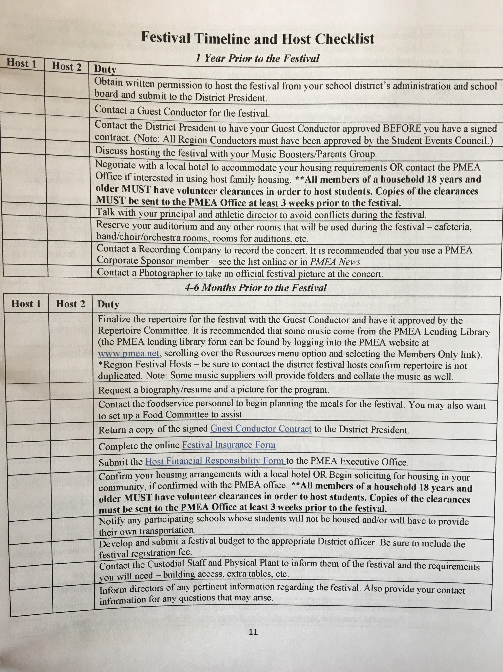
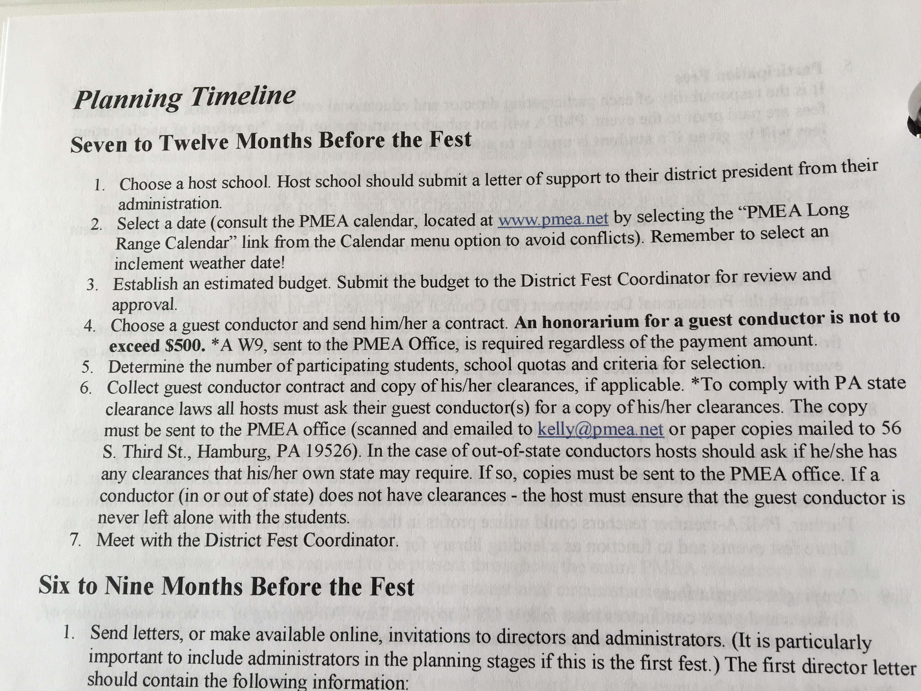
Utilize the Planning Timeline in your Host Manual.

Slide 6
Guest Conductor Information
Guest Conductor contracts DO NOT need to come to the state office. The District President, Host, and Guest Conductor should have copies.
DO send a W-9 to the state office.
DO send guest conductor CLEARANCES to the state office (if it is a PA conductor).
If they are from out of state, make sure they are current with their state’s requirements)
Secure a guest conductor as soon as you know you are hosting
Check with your district to see if you have specific conductor honorarium guidelines (the state recommendations are in the host manual)
Send your guest conductor the repertoire from the last 3 years
Contact Shanna Danielson if you need this information
Utilize music libraries (state or district) to keep costs down!

Slide 7
Useful Information
If using a past program as a template, remember to UPDATE the District and State Officers!
Make sure to include the copyright statement in your program.
Send things to the State Office electronically to save postage!
Programs, forms, etc.
sdanielson@pmea.net
When titling your event on paperwork and programs:
Districts use Arabic Numerals (1-12)
Region events use Roman Numerals (I-VI)
Consider Co-Hosting or forming a “Host Committee”- this is a lot to take on by yourself.
This could include other music teachers in your district, booster parents, or other eager volunteers.

Slide 8
NURSE GUIDELINES
Secure a nurse 3-6 months prior to the event
It is the host’s responsibility to ensure that students’ medical needs are met- arrange to have a nurse (at least on call) for the duration of the event.
Medical Administration Forms should be forwarded to the Host at least ONE MONTH in advance, so that the event host and nurse will be prepared.
On that note, consider setting a general form deadline 2-4 weeks prior to the event.

Slide 9
Your Coordinator Is Your Friend.
It is recommended that you communicate with your Fest/Festival Coordinator at least once a month while planning your event!

Slide 10
Keep Key Parties Involved in Scheduling AND Budgeting!
Send your tentative schedule (at least 3 months prior) and budget (at least 6 months prior) to your Coordinator as soon as you have a draft.
If hosting a District or Region event, you or your coordinator should send a copy of your schedule to the State Office (festivals@pmea.net) AT LEAST 4 weeks prior to your event.

Slide 11
Stay in contact with participating directors.
Utilize the online forms for Instrument Responsibility Form and Dietary Needs Form.
Have students fill these out AFTER they have been selected/confirmed as participants!
*Dietary Needs form is only required if a student, in fact, has special dietary needs. This includes, but is not limited to:
-Vegetarian
-Vegan
-Lactose Intolerant
-Gluten-Free
Food Allergies
Gather contact information at the event the year prior, or ask last year’s host for a contact list.

Slide 12
ACT 48 INFORMATION
https://www.pmea.net/act-48-information/
Please follow the deadlines to ensure credit for your attendees. Your clinician needs to submit a form at least 45 days before the event!
Make sure attendees sign in on the Act 48 Roster
Attendees must also complete 2 surveys!

Slide 13
AFTER THE EVENT…
Finalize paperwork!
BE HELPFUL FOR THE NEXT HOST!
Submit fees, final report, and program to state office. Check with your coordinator to see what should be sent to the District Secretary/Treasurer.
ALL PAPERWORK MUST BE RECEIVED no later than 30 days after your event. Hosting in May? Papers must be received BY JUNE 1st.
Consider completing the HOST SURVEY that will be sent out in May.
Send copies of the following to assist in the planning of next year’s event (especially if it is a first-time host)
Proposed budget
Program
Press releases
Sample schedules
Director contact information
Vendor Reviews (if next year’s host might utilize the same vendors)

Slide 14
PROFITS
Every effort should be made to avoid making a profit from student registrations.
Hosts must submit their Final Financial Reports to the state office.
Establish a preliminary budget at least 6 months prior to the event, and submit it to your coordinator and district president for review.
Check with your district to see what their policy is on profit.

Slide 15
Speaking of that Final Report…
It is an editable Excel file- change the categories to fit your event.
Please send THIS FORM to the State Office, even if your district uses something different.
Double check your amounts with your Coordinator or Treasurer to avoid confusion and assure accuracy
CHECK WITH YOUR DISTRICT to see if they charge a student fee IN ADDITION to the fee due to the state office.

