Slide 1
Teacher Effectiveness
and the
Student Learning Objectives Process
An update from O David Deitz
Consultant, Educator Effectiveness, PDE
for the
PMEA Annual Conference, Hershey
3.26.14

Slide 2
This Presentation:
Brief background on teacher evaluation
Look at the SLO Process Template
Critique Goal Statements and aligned Performance Measures
Experience online materials and resources to support SLO implementation

Slide 3
(B) FOR PROFESSIONAL EMPLOYES AND TEMPORARY PROFESSIONAL
EMPLOYES WHO SERVE AS CLASSROOM TEACHERS, THE FOLLOWING SHALL APPLY:
(1) BEGINNING IN THE 2013-201 4 SCHOOL YEAR, THE EVALUATIO N
OF THE EFFECTIVENESS OF PROFESSIONAL EMPLOYES AND TEMPORARY
PROFESSIONAL EMPLOYES SERVING AS CLASSROOM TEACHERS SHALL GIVE
DUE CONSIDERATION TO THE FOLLOWING:
(I) CLASSROOM OBSERVATION AND PRACTICE MODELS THAT ARE
RELATED TO STUDENT ACHIEVEMENT IN EACH OF THE FOLLOWING AREAS:
(A) PLANNING AND PREPARATION.
(B) CLASSROOM ENVIRONMENT.
(C) INSTRUCTION.
(D) PROFESSIONAL RESPONSIBILITIES.
(II) STUDENT PERFORMANCE, WHICH SHALL COMPRISE FIFTY PER
CENTUM (50%) OF THE OVERALL RATING OF THE PROFESSIONAL EMPLOYE
OR TEMPORARY PROFESSIONAL EMPLOYE SERVING AS A CLASSROOM TEACHER
AND SHALL BE BASED UPON MULTIPLE MEASURES OF
Race to the Top
House Bill 1901
Teacher Effectiveness

Slide 6
What is a SLO?
(Student Learning Objective)
  A (5)process to
  (4) document a
  (3) measure of educator effectiveness
  based on (2)student achievement of (1)content standards.
6

Slide 7


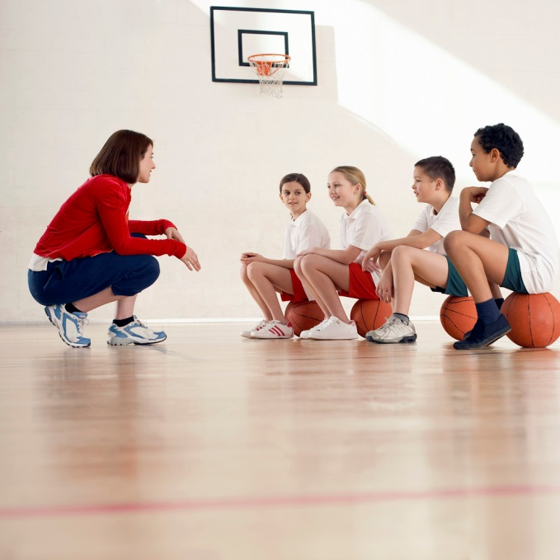





Every teacher designs an SLO
Math
Physics
Physical Education
History
Chemistry
Kindergarten
Special
Ed
Journalism
Notes:
Every teacher is expected to create an SLO

Slide 8
What does the SLO
(Student Learning Objective)
process look like?
STUDENT LEARNING OBJECTIVE (SLO) PROCESS TEMPLATE SLO is a process to document a measure of educator effectiveness based on student achievement of content standards. SLOs are a part of Pennsylvania’s multiple-measure, comprehensive system of Educator Effectiveness authorized by Act 82 (HB 1901).
Context
Goal
Measures
Indicators
Elective Rating

Slide 9
Classroom Context
1a. Name |  | 1b. School |  | 1c. District
1d. Class/ Course Title |  | 1e. Grade Level |  | 1f. Total # of Students
1g. Typical Class Size |  | 1h. Class Frequency |  | 1i. Typical Class Duration
2. SLO Goal
2a. Goal Statement
2b. PA Standards
2c. Rationale

Slide 10
3. Performance Measures (PM)
3a. Name | PM #1: PM #2: PM #3: PM #4: PM #5: |  | 3b. Type | District-designed Measures and Examinations Nationally Recognized Standardized Tests Industry Certification Examinations Student Projects Student Portfolios Other:_________________________
3c. Purpose | PM #1: PM #2: PM #3: PM #4: PM #5: |  | 3d. Metric | Growth (change in student performance across two or more points in time) Mastery (attainment of a defined level of achievement) Growth and Mastery
3e. Administration Frequency |  | PM #1: PM #2: PM #3: PM #4: PM #5: | 3f. Adaptations/ Accommodations |  | IEP ELL | Gifted IEP Other
3g. Resources/ Equipment |  | PM #1: PM #2: PM #3: PM #4: PM #5: | 3h. Scoring Tools |  | PM #1: PM #2: PM #3: PM #4: PM #5:
3i. Administration & Scoring Personnel |  | PM #1: PM #2: PM #3: PM #4: PM #5: | 3j. Performance Reporting |  | PM #1: PM #2: PM #3: PM #4: PM #5:

Slide 11
Key SLO Process Component:
Performance Indicator
Based on the performance measure, what are
the expectations for individual student achievement?

Slide 12
4. Performance Indicators (PI)
4a. PI Targets: All Student Group | PI Target #1: PI Target #2: PI Target #3: PI Target #4: PI Target #5:
4b. PI Targets: Focused Student Group (optional) | PI Target #1: PI Target #2: PI Target #3: PI Target #4: PI Target #5:
4c. PI Linked (optional) |  | 4d. PI Weighting (optional)

Slide 13
Key SLO Process Component:
Teacher Elective Rating
Describes the number of students expected to meet the performance indicator criteria.
5. Elective Rating
5a. Level | Failing 0% to ___ % of students will meet the PI targets. | Needs Improvement ___% to ___% of students will meet the PI targets. | Proficient ___% to ___% of students will meet the PI targets. | Distinguished ___% to 100% of students will meet the PI targets.

Slide 14
6th Grade Band
Goal Statement
Students will demonstrate progress and improvement toward developing essential independent instrumental performance skills, with the goal of performing alone and with others in a variety of musical settings.
Performance Measure
6th Grade Instrumental Music IPA: Individual assessments inform each student of his/her progress as an independent musician. The purpose of this assessment is to provide data regarding student progress in the development of essential instrumental skills.

Slide 15
HS Concert Band
Goal Statement
Demonstrate comprehensive musicianship through performing the skills, techniques, elements, and concepts appropriate for an instrumental performing ensemble.
Performance Measure
Individual Performance Assessment

Slide 16
8th Grade Choral
Goal Statement
Demonstrate the independent performance skills, techniques, elements, and principles appropriate for a choral performing ensemble.
Performance Measure
Individual Vocal Assessment

Slide 17
HS Choir
Goal Statement
Demonstrate how music provides a medium to understand and exchange ideas.
Performance Measure
Listening Analysis: Measure student ability to correctly analyze a recording of choral music
Blogging Analysis: Measure student ability to write their analysis through blogging
Oral Presentation: Measure student ability to give an oral presentation on their analysis of the choral work

Slide 18
3rd Grade General
Goal Statement
Practice the skills, techniques, elements and principles of music to perform an understanding of musical concepts.
Goal Statement
Visual Awareness: Representations must include a minimum of three valid examples of the target rhythm in forms such as, but not limited to, 3 sounds on one beat, the words short-short-long, iconic representations
Performance of Song with rhythm syllables , 7 out of 8 beats correct is considered mastered
Growth sing target song with rhythm names pretest/posttest Student Growth percentile (75% or higher)

Slide 19
7th Grade General
Goal Statement
The skills, techniques, elements, and principles of the arts can be learned, refined, studied, and practiced.
Performance Measure
Melody Assessment: To measure student proficiency on steady beat and ability to read standard notation in treble clef via guitar.
Song Performance Assessment: To measure student ability to interpret an exemplar work of music and perform with appropriate and aesthetic style via guitar

Slide 20
7th Grade General
Goal Statement
Create and perform music that incorporates innovative techniques using both traditional methods and contemporary technologies.
Performance Measure
Guitar Melody Composition: are appropriate for measuring a student’s mastery or development of independent composition skills that prepare students to create and perform music outside the music classroom.
Keyboard Melody Composition: are appropriate for measuring a student’s mastery or development of independent composition skills that prepare students to create and perform music outside the music classroom.

Slide 21
8th Grade General
Goal Statement
Students will develop an understanding of the importance of music in today's society by studying composers, performers, and major works of cultural impact from the Renaissance through modern times.
Performance Measure
Written Exams: To discover extent of student's retention of facts
Classroom Discussion: To discover extent of student's grasp of concepts presented in the class
Group Presentation: To foster independent learning and research skills

Slide 22
Kindergarten General
Goal Statement
Students will create, recreate and express music through the use of their voice, instruments and movement.
Performance Measure
Express Vocally Rubric: Measure students ability to duplicate a response to a musical call
Express and Create movement Rubric:
Express with Instruments Rubric:

Slide 23
Jazz Band
Goal Statement
Students will demonstrate the ability to independently create, recreate, rehearse and perform improvisation in a variety of jazz styles and explain why this is important.
Performance Measure
12 Bar Blues Improvisation: To measure a student’s ability to perform an improvisation while applying the concepts of melodic phrasing, balance, tempo, stylistic elements, and the given harmonic progression of a 12-Bar Blues progression (only 3 chord changes to interpret)
Standard Jazz Solo Improvisation: To measure a student’s ability to perform an improvisation while applying the concepts of melodic phrasing, balance, tempo, stylistic elements, and the given harmonic progression of a standard jazz solo (minimum of 5 chord changes to interpret)

Slide 24
7th Grade Band
Goal Statement
As an ensemble how do we produce a characteristic tone, achieve ensemble intonation, and properly warm up during the instrumental rehearsal
Performance Measure
Scale and long tone performance: to understand the fundamentals of tone production and the relationship of various key signatures on the student’s chosen instrument

Slide 25
9th Grade General
Goal Statement
Students will develop an understanding of the importance of music in today's society by studying composers, performers, and major works of cultural impact from the Renaissance through modern times.
Performance Measures
Written exams: To discover extent of student's retention of facts
Classroom discussion: To discover extent of student's grasp of concepts presented in class
Group presentation: To foster independent learning and research skills

Slide 26




Help!
is available, in the form of…
Let’s learn more about these materials.

Slide 27
Music-specific Webinar
PDE Music Curriculum Framework
All SLO PowerPoint designed for PMEA
pmea.net
/resources/pennsylvania-dept-of-education-information/

Slide 28

pdesas.org

Slide 29




Training SLO and Assessment Literacy in PA
pdesas.org

Slide 30
Student Learning Objectives
PowerPoints/Videos
Sample Templates
Blank Templates
Additional Materials
PowerPoints/Videos
Sample Templates
Blank Templates
Additional Materials
PowerPoints/Videos
Sample Templates
Blank Templates
Additional Materials

Slide 31
Assessment Literacy Series
PowerPoint/Videos
Sample Templates
Blank Templates
Additional Materials
PowerPoint/Videos
Sample Templates
Blank Templates
Additional Materials
PowerPoint/Videos
Sample Templates
Blank Templates
Additional Materials

Slide 32
O David Deitz
Consultant, PDE Educator Effectiveness Team
Lead for the SLO Project
oddeitz@comcast.net

